Slide 1
75.0 N

Slide 2
1.15 x 10³ N

Slide 3
7.4 x 10² N; 1.3 x 10² N; 2.8 x 10³ N ; 0 N

Slide 4
98.0 N; 294 N

Slide 5
68.4 N

Slide 6
-7.80 x 10² N

Slide 7
-2.45 m/s/s (down)

Slide 8
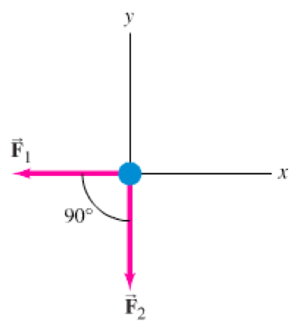
a
19.0 N, 0.703 m/s/s @ 237º

Slide 9
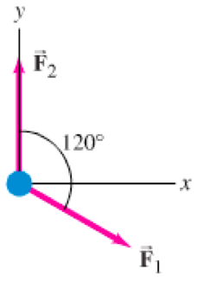
b
14 N, 0.520 m/s/s @ 51º

Slide 10
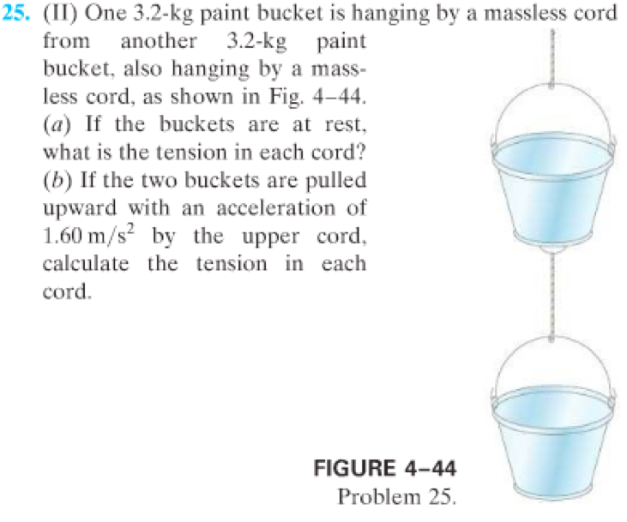
31 N, 63 N, 36 N, 73 N

Slide 11
39.6 N

Slide 12
1.9 m/s/s, 370 N

Slide 13
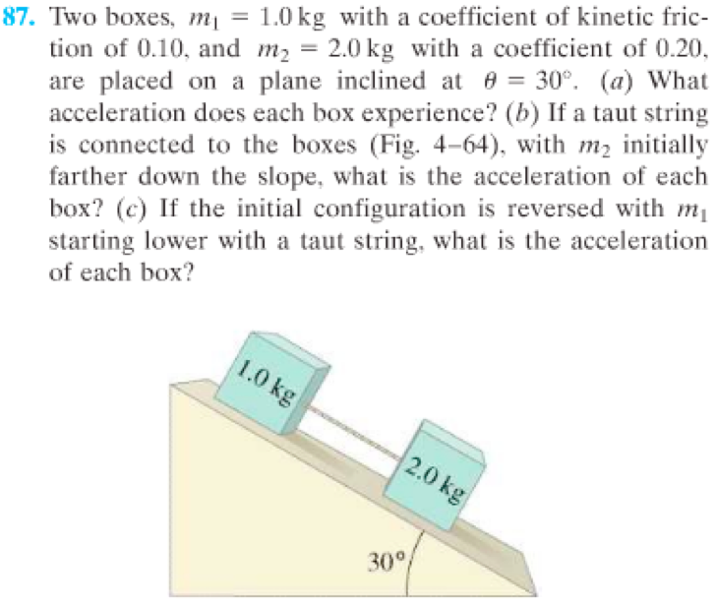
4.1 m/s/s, 3.2 m/s/s; The Same as a; 3.5 m/s/s

Slide 14
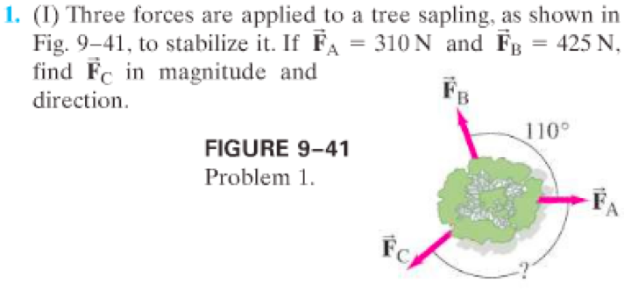
430 N @ 112º

Slide 15
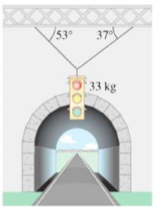
Left = 258 N, Right = 195 N

Slide 16
answer

