Slide 1
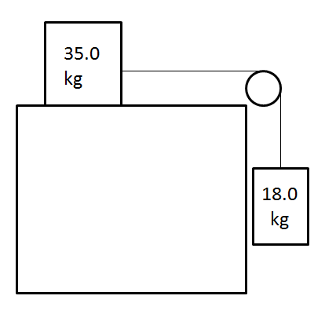
µ_{d} = 0.112
Find the tension in the string and the acceleration of the system.
(2.61 m/s/s right/down, 130. N)

Slide 2
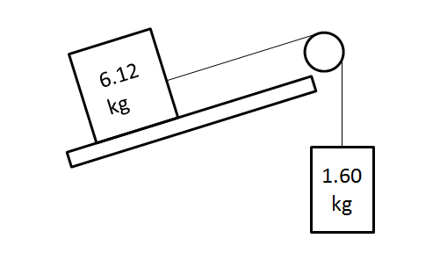
The 28.0 degree inclined plane is frictionless, neglect the mass of the pulley and the string:
Find the tension in the string and the acceleration of the system. (1.62 m/s/s down the plane/up, 18.3 N)

