Slide 1
Concept 0 - Types
Consider: 10 ± 2 m
The (absolute) uncertainty is 2
The fractional uncertainty is 2/10 (or 20%)

Slide 2
Concept 1 – Estimating Uncertainty of Measurements
Reading an analog scale (ruler, balance, meter)
Uncertainty is half the smallest division:

Slide 3
Concept 1 – Estimating Uncertainty of Measurements
Reading an analog scale (ruler, balance, meter)
Uncertainty is half the smallest division:

Slide 4
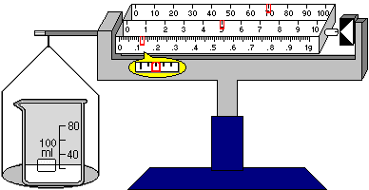
Concept 1 – Estimating Uncertainty of Measurements
Reading an analog scale (ruler, balance, meter)
Uncertainty is half the smallest division:

Slide 5
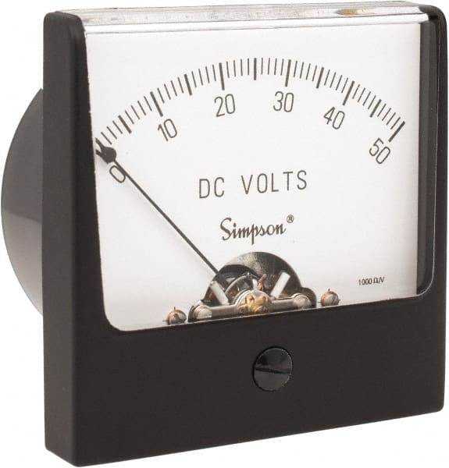
Concept 1 – Estimating Uncertainty of Measurements
Reading an analog scale (ruler, balance, meter)
Uncertainty is half the smallest division:

Slide 6
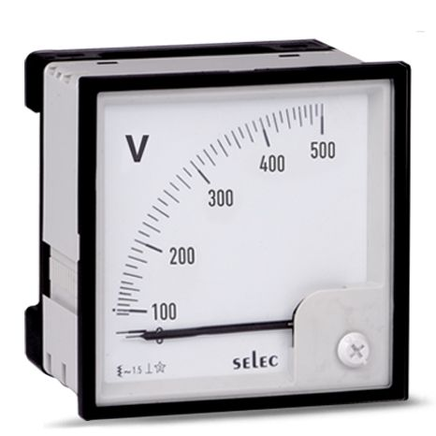
Concept 1 – Estimating Uncertainty of Measurements
Reading an analog scale (ruler, balance, meter)
Uncertainty is half the smallest division:

Slide 7
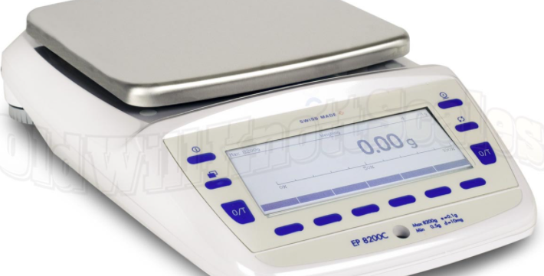
Concept 1 – Estimating Uncertainty of Measurements
Reading a digital scale
Uncertainty is the last digit:

Slide 8
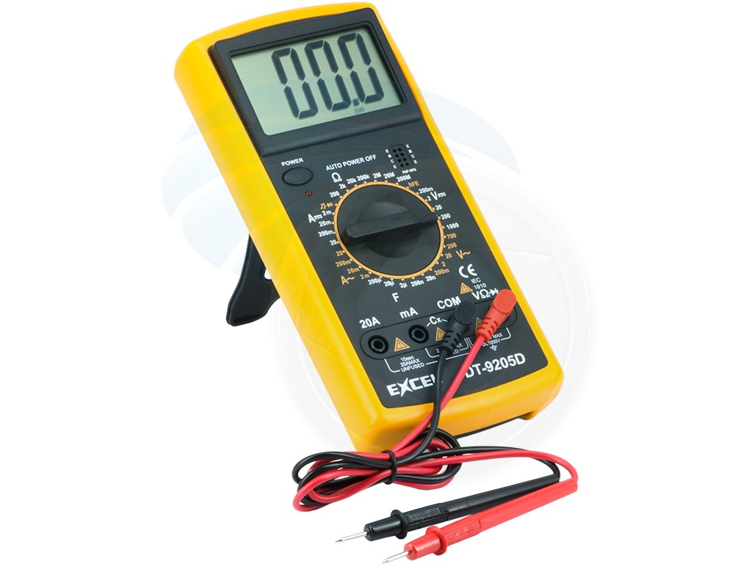
Concept 1 – Estimating Uncertainty of Measurements
Reading a digital scale
Uncertainty is the last digit:

Slide 9
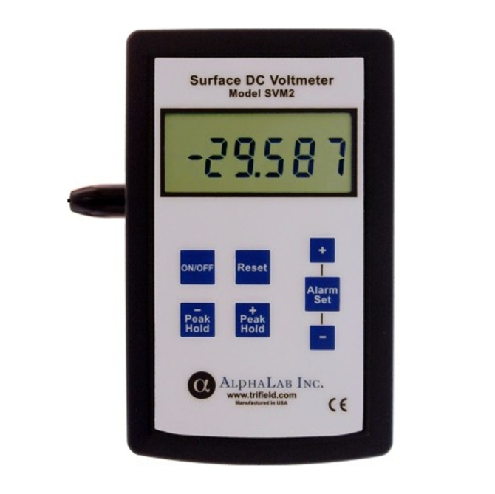
Concept 1 – Estimating Uncertainty of Measurements
Reading a digital scale
Uncertainty is the last digit:

Slide 10
Concept 1 – Estimating Uncertainty of Measurements
Uncertainty from repeated trials:
Uncertainty is half the range: (max – min)/2
Timing a pendulum:
Length (cm) | Trial 1 (s) | Trial 2 (s) | Trial 3 (s) | Trial 4 (s) | Average (s) | Uncertainty (s)
55.0 | 1.42 | 1.48 | 1.56 | 1.50 | 1.49

