Slide 1
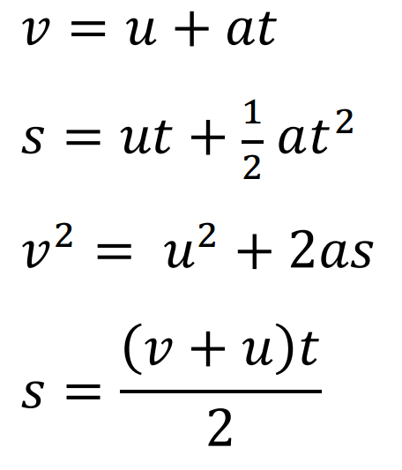
While you wait:
An air rocket is launched straight up at 28.0 m/s.
What time does it reach the top? (2.85 s)
What is its total time in the air? (5.71 s)
How high does it go? (40.0 m)
What is its final velocity when it is at an elevation of 24.0 m on the way down? (-17.7 m/s)
What time does it take to reach an elevation of 24.0 m on the way down? (4.66 s)
s – (m) displacement
u – (m/s) initial velocity
v – (m/s) final velocity
a – (m/s/s) acceleration
t – (s) time

