Slide 1
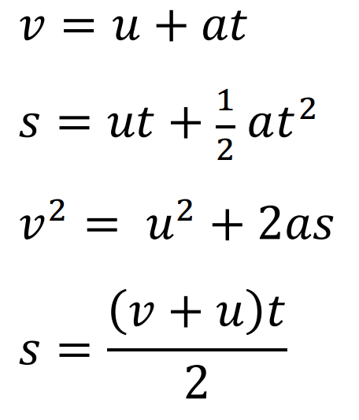
While you wait:
These are two part problems. (The parts share the same acceleration – assume a constant acceleration)
1. An airplane reaches 68.0 m/s from rest using 982 m of runway.
What was its velocity halfway down the runway? (48.1 m/s)
What was its velocity at 20.0 seconds from the start? (47.1m/s)
2. A car slows from 34.0 m/s to 12.0 m/s in 5.40 seconds.
At what elapsed time did it reach 21.0 m/s? (3.19 s)
In what distance would it go from 28.0 m/s to rest if it had the same acceleration? (deceleration?) (96.2 m)
s – (m) displacement
u – (m/s) initial velocity
v – (m/s) final velocity
a – (m/s/s) acceleration
t – (s) time

