Slide 1
Linear Kinematics – Vector Velocity
Contents:
Quantities and +/-
Examples of + and - velocity
Whiteboard

Slide 2
Kinematic Quantities:
s - Displacement (m) - Distance and direction
v - Velocity (m/s) - rate change of displacement
a - Acceleration (m/s/s) - rate change in velocity
-
-4 m
0 m
+4 m
+
s = +5 m
s = -6 m
Show velocity + and -
Meter sticks/car/volvo at intersection
Show acceleration + and –
C. P. and the Suburban
In our world, there are two directions - and +

Slide 3
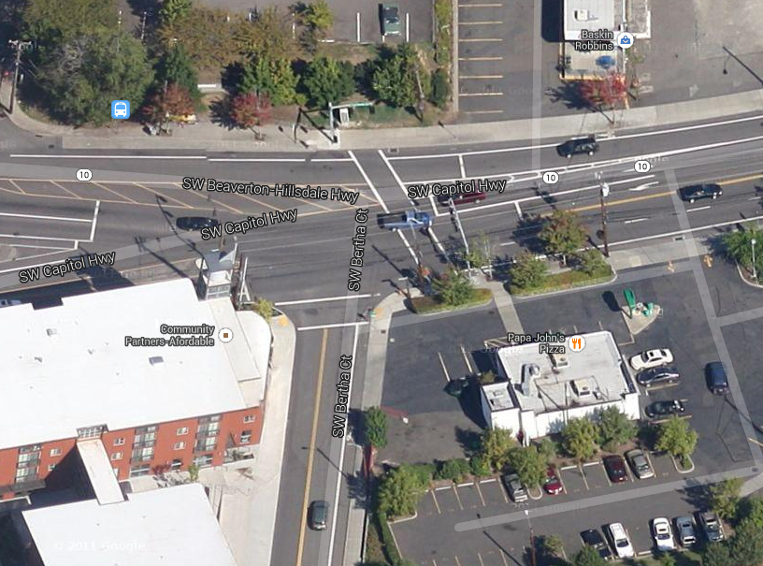

Slide 4
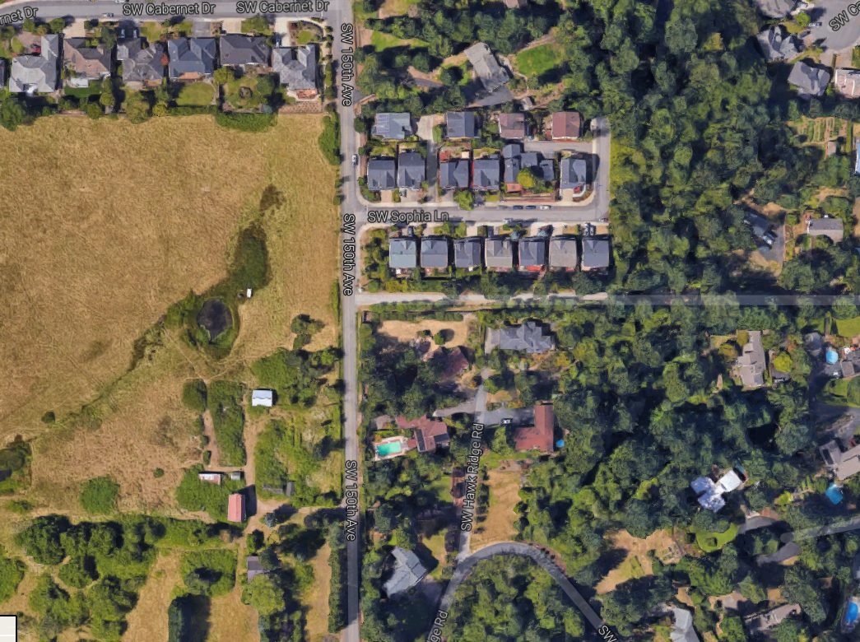

Slide 8
Whiteboards:
+ or - Velocity
1 | 2 | 3

Slide 9
A car has a velocity of -2.4 m/s for 36 seconds. What is its displacement in this time, and if it started at a position of +127.0 m, where will it end up?
v = Δs/Δt
Δs = (-2.4 m/s)(36 s) = -86.4 m (-86 m)
So we are at 127.0 + -86.4 = 40.6 m (41 m)
displacement -86 m, end up at 41 m

Slide 10
A train starts at a position of -35.1 m and ends at a position of 12.5 m in a time of 13.8 seconds. What was its velocity during this time?
v = Δs/Δt
Δs = 12.5 - -35.1 = +47.6 m
v = (47.6 m)/(13.8 s) = 3.449275362 m/s 3.45 m/s
+3.45 m/s

Slide 11
A train has a velocity of -25.2 m/s and ends up at a position of -57 m after a time interval of 15 seconds. What was its displacement during this time, and where did it start?
v = Δs/Δt
Δs = Δs = (-25.2 m/s)(15 s) = -378 m (-380 m)
Since it moved -378 m, it must have started + 378 m from -57 m, so it started at 321 m. (+320 m)
-380 m, +320 m

