Slide 1
Your presentation (9 -10 min)
3-5 slides per ride? (3 min per ride!)
General information
1-3 slides of calculations and data
Final summary that compares (3?) results

Slide 2
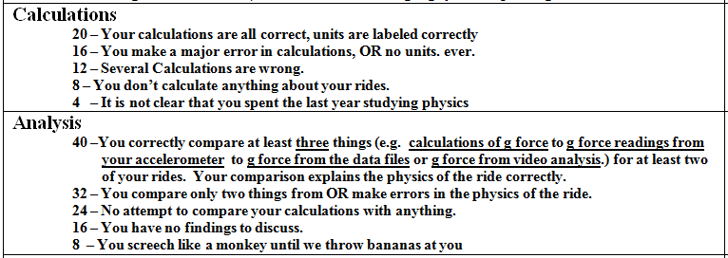
Slides 2-4 – Calculations and measurements

Slide 3
Slides 2-4 – Calculations and measurements
Examples for 3 comparisons:

Slide 4
Slide 5?– Summary comparison

