Slide 1
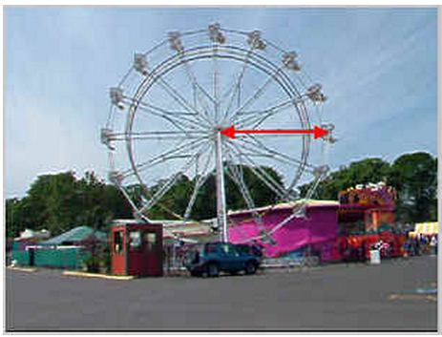
Ferris Wheel

Slide 2
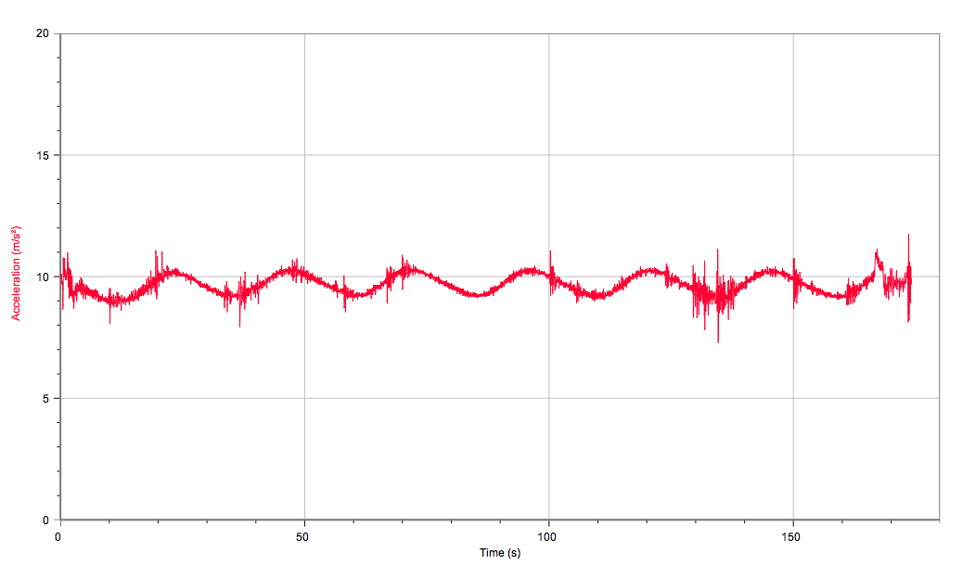

Slide 3
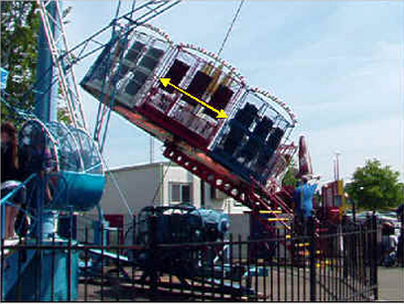
Eruption

Slide 4
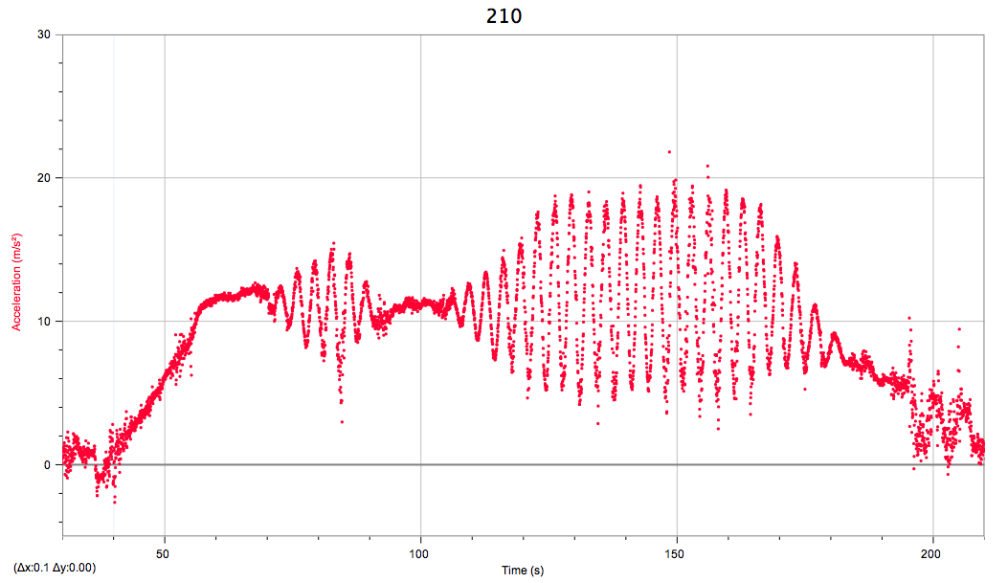

Slide 5
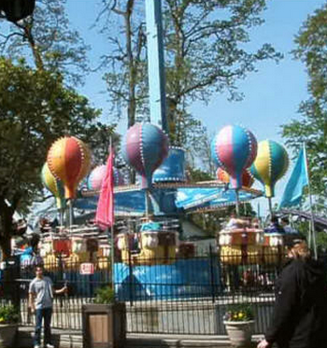
Balloons

Slide 6
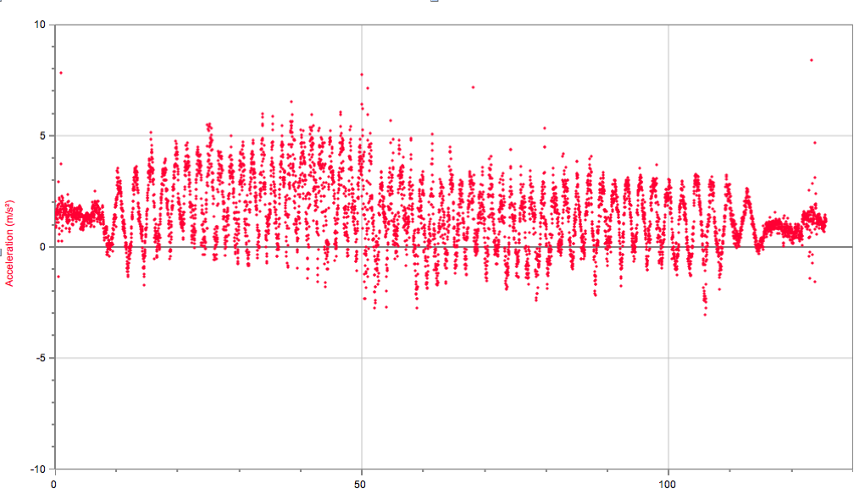

Slide 7
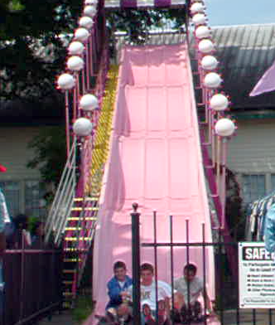
Big Pink Slide

Slide 8
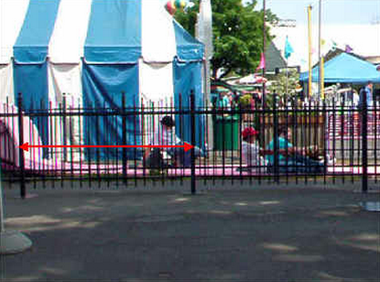
Big Pink Slide

Slide 10
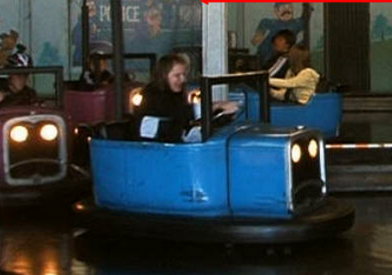
Bumper Cars

Slide 12
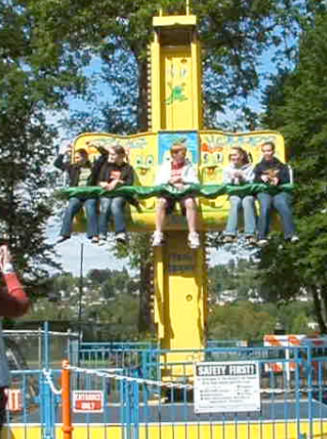
Frog Hopper

Slide 14
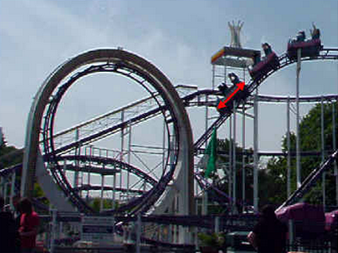
Looping Thunder

Slide 16
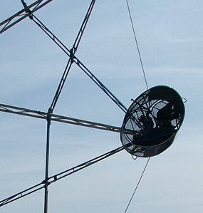
Rock O Plane

Slide 18
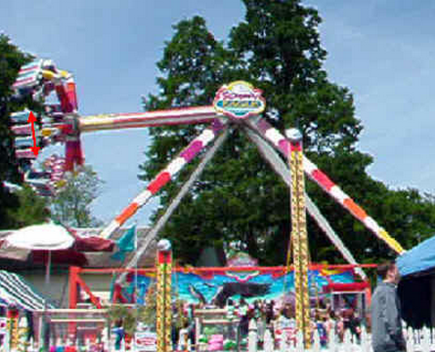
Screaming Eagle

Slide 20
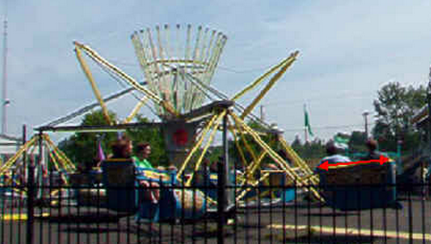
Scrambler

Slide 21
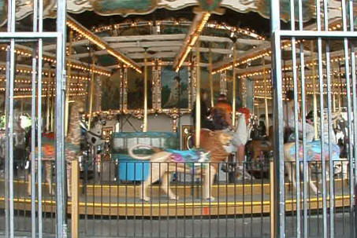
Carrousel

Slide 22
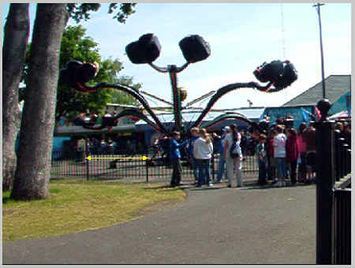
Spider

Slide 23
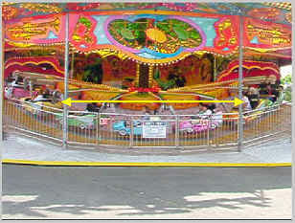
Rock and Roll

Slide 24
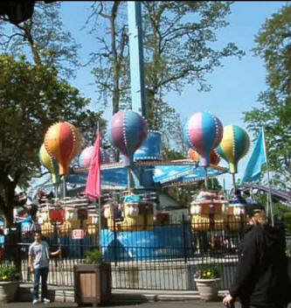
Balloons

Slide 25
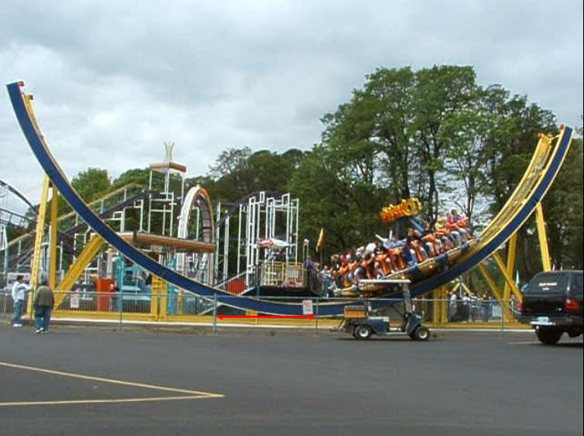
Disk O

Slide 26
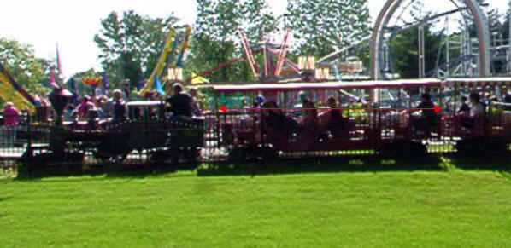
Train

Slide 27
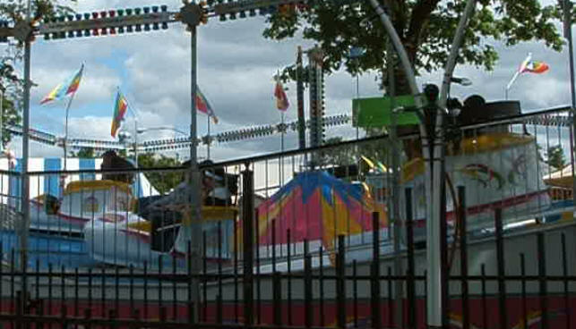
Tilt A Whirl

Slide 28
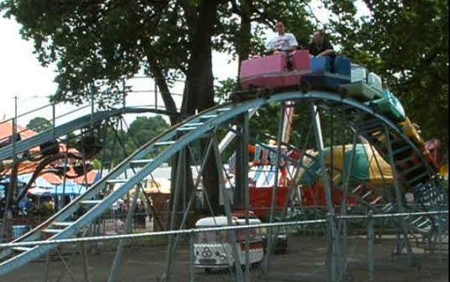
Zoom

Slide 29
Your presentation

Slide 30
Slide 1 – General information

Slide 31
Slide 2 – Calculations and measurements

Slide 32
Video analysis

Slide 33
Slide 4 – labquest data

