Slide 1
Oaks Park

Slide 2
Sensor Kinetics Pro – costs $0.99 for iOS, $2.99 for Android

Slide 3
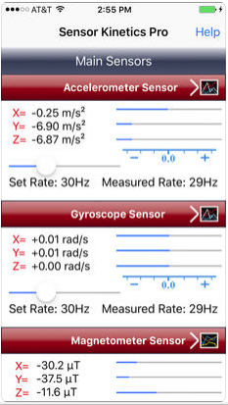
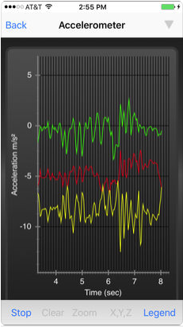
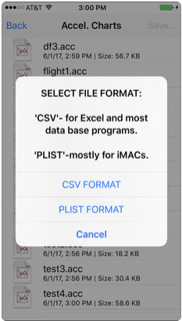

Slide 4
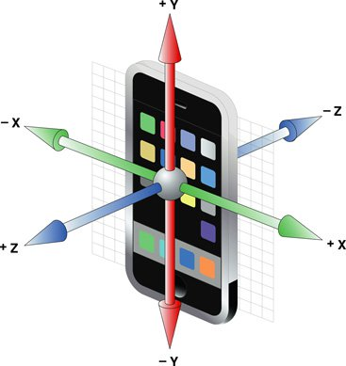
The Axes:
(Vertical)
-y
+z
(Axial)
+x
-z
-x
(Lateral)
+y

Slide 5
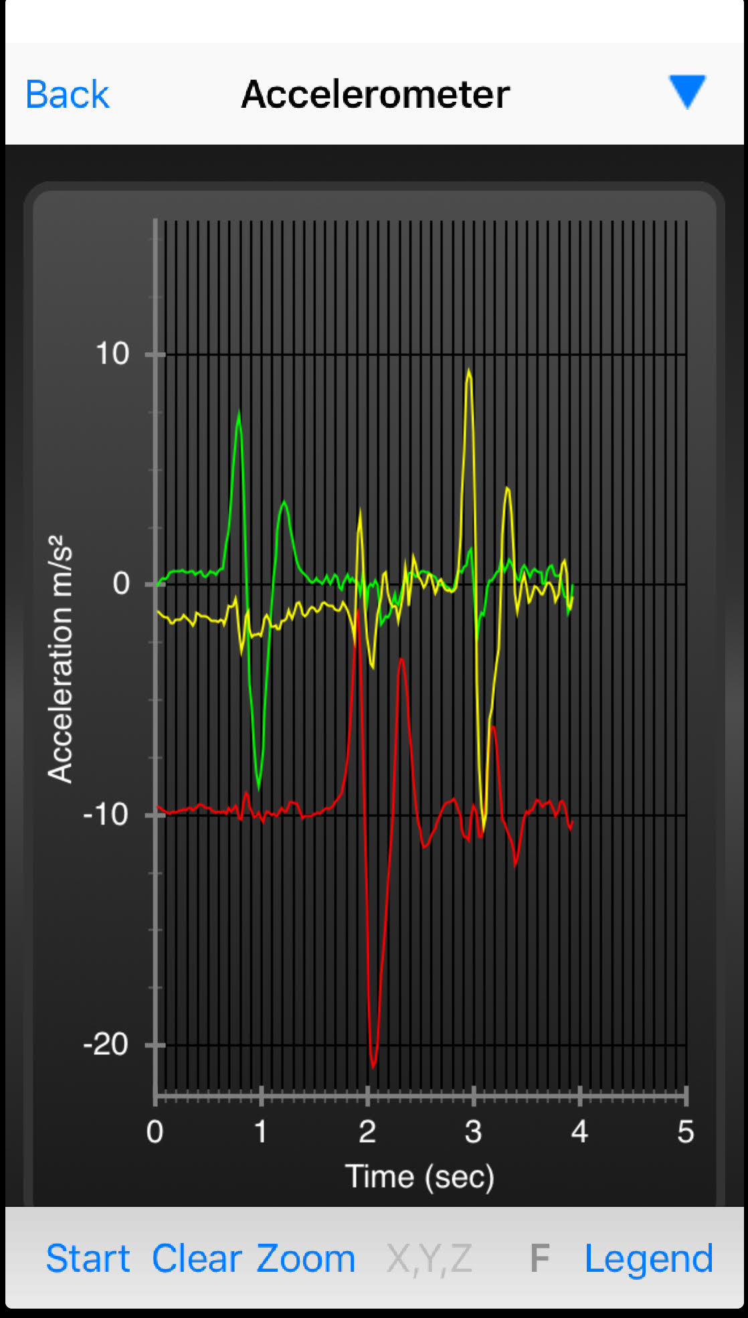
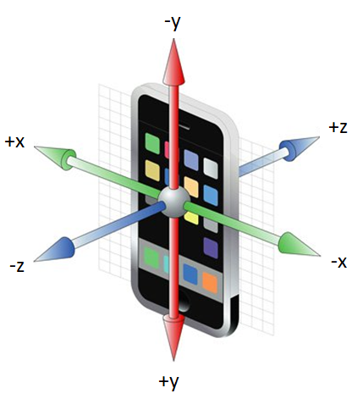
With the phone vertical:
Left
Down
Away

