Slide 1
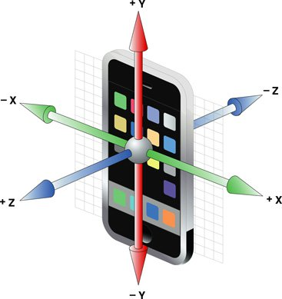
-y
+z
+x
-z
-x
+y

