Slide 1
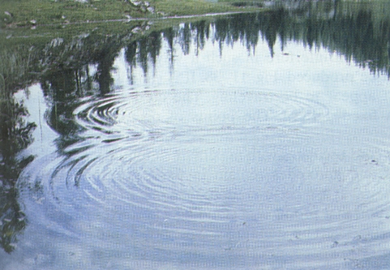
Principle of superposition
Overlapping waves add together
Examples:
People talking at the same time
Shining a flashlight across the room
Ripples on a pond overlapping:

Slide 2
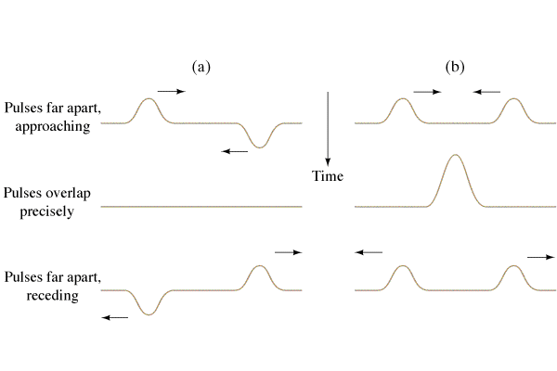
Principle of superposition
Overlapping waves add together
Demo pulses on wave device
Destructive interference
Constructive interference
Noise cancelling headphones

Slide 3
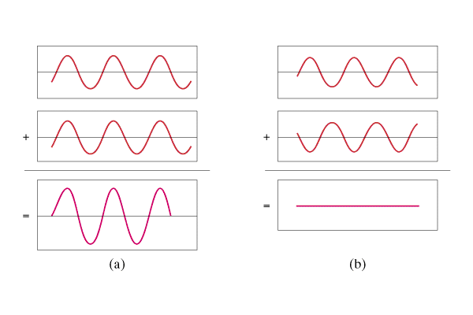
Basic Concept
Superposition - Overlapping waves add.
Constructive interference = crest meets crest
Destructive interference = crest meets trough
Demo – Speakers
180o, switch wires,
move ½ λ
Constructive
Destructive

Slide 4
Interference:
Superposition - Overlapping waves add.
Constructive interference = crest meets crest
Destructive interference = crest meets trough
Constructive
Destructive

Slide 5
λ
A
B
If the difference in distance from the sources is an integer number of wavelengths, you get constructive interference

Slide 6
λ
A
B
If the difference in distance from the sources is an integer number of wavelengths, you get constructive interference

Slide 7
λ
A
B
If the difference in distance from the sources is an integer number of wavelengths, you get constructive interference
Difference is:
0 λ, 1 λ, 2 λ, 3 λ…

Slide 8
λ
A
B
If the difference in distance from the sources has a remainder of a half wavelength, you get destructive interference:

Slide 9
λ
A
B
If the difference in distance from the sources has a remainder of a half wavelength, you get destructive interference:

Slide 10
λ
A
B
If the difference in distance from the sources has a remainder of a half wavelength, you get destructive interference:
Difference
.5 λ, 1.5 λ, 2.5 λ, 3.5 λ…

Slide 11
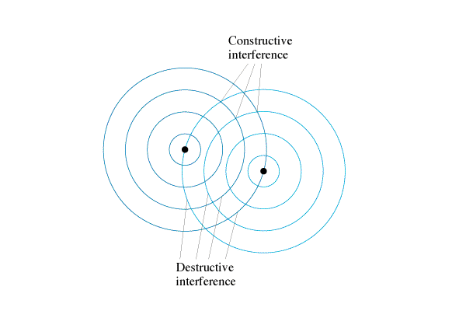
Basic Concept
Two Source Pattern
Constructive:
Crest meets crest
Trough meets trough
Destructive:
Crest meets trough
Demo speakers
Demo Laser Slits
PHET

Slide 12
Young’s Double Slit Experiment
Monochromatic, coherent light
Light spreads out from slits
Screen has sum of two sources
Interference pattern on screen
PHET

