Slide 1
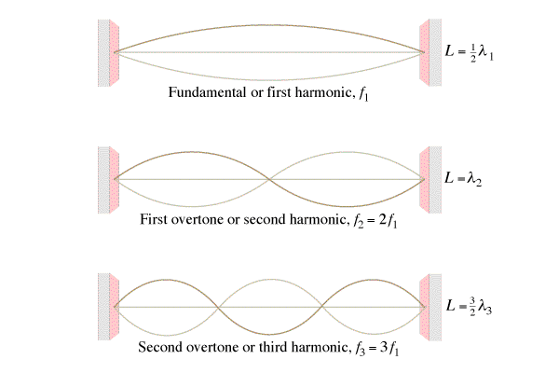
This string is 32.0 cm long, and has a wave speed of 281.6 m/s. Find for each mode 1. The wavelength, 2. The frequency. Hint v = fλ
λ = ____, f = ____
λ = ____, f = ____
λ = ____, f = ____

Slide 2
This pipe is 1.715 m long, sound travels at 343 m/s along the pipe. Find for each mode 1. The wavelength, 2. The frequency. Hint v = fλ
λ = ____, f = ____
λ = ____, f = ____
λ = ____, f = ____

Slide 3
This pipe is also 1.715 m long, sound travels at 343 m/s along the pipe. Find for each mode 1. The wavelength, 2. The frequency. Hint v = fλ
λ = ____, f = ____
λ = ____, f = ____
λ = ____, f = ____
This one is different…

Slide 4
The third harmonic on a flute (both ends open pipe) has a frequency of 480. Hz. How long is the waveform if the speed of sound inside the flute is 335 m/s?
1.05 m

Slide 5
What is the frequency of the 2nd harmonic on a 0.31 m long pan pipe (One end open, one end closed) where the speed of sound is 343 m/s
829.8 Hz

Slide 6
What is the wave speed on a 0.34m long violin string if the first harmonic has a frequency of 440 Hz?
299.2 m/s

Slide 7
What is the frequency of the 3rd harmonic on a violin string that is 0.34 m long where the wave speed is 299.2 m/s
1320 Hz

