Slide 1
Types of waves
Transverse: Wave moves medium moves
Longitudinal: Wave moves medium moves

Slide 2
Types of waves
Sound is longitudinal:

Slide 3
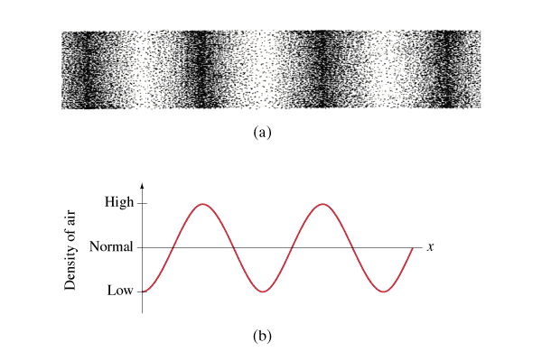
Types of waves
Sound is longitudinal:

Slide 4
Types of waves
Surface Wave: Longitudinal and transverse
Tsunami - longitudinal wave

Slide 5
Types of waves
Electromagnetic Waves - Transverse waves
Require no medium - can travel through vacuum
Travel at 3.00 x 10⁸ m/s in a vacuum (else slower)
Speed is independent of speed of source/observer
Radio, microwave, Infrared, Light, UV, XRay, Gamma Rays are all EM waves. (Cheer)

Slide 6
Types of waves
Mechanical
(requiring a medium)
Electromagnetic
(need no medium)
S (Shear) Earthquake waves
Waves in guitar strings
Surface waves on water
P (Pressure) Earthquake waves
Sound waves
Compression waves in a spring
Surface waves on water
All EM Waves:
Radio, Microwave, IR, Light, UV, X-Ray, Gamma rays
Transverse
Longitudinal

Slide 7
Types of waves
Longitudinal waves can pass through fluids, Transverse cannot.
Only P earthquake waves can pass straight through the earth:
A
S wave
The core of the earth is liquid
(Earth is like an egg)
P wave
B

Slide 8
Energy Transport
Waves transport energy:
Sun to earth
Sound to microphone
Earthquakes
Microwaves
Ocean waves
Demo - speaker, concentrator

