Slide 1
Introduction to Waves
Contents:
Pulses/continuous waves
Anatomy of a wave
v = fλ
Whiteboards
Types of waves
Energy Transport

Slide 2
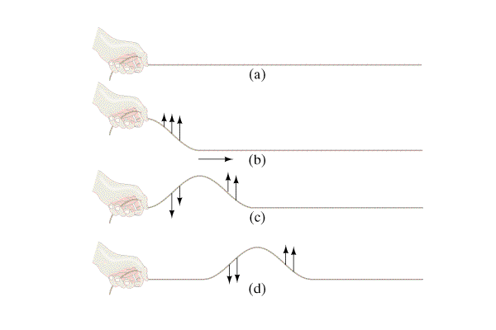
Wave Pulses
Motion of wave
Motion of medium (rope)
Demo

Slide 3
Continuous waves
Motion of wave
Motion of medium (rope)
Demo

Slide 4
Important principle #1
Waves move through the medium
Medium just goes back and forth
Sound and air
Demo wave device

Slide 5
Important principle #2
Wave speed depends on type of wave and medium
Not on amplitude and frequency
Demo big spring (change tension)

Slide 6
Anatomy of a wave
fig 11-23
Medium - material through which the wave travels
Amplitude - how big, bright, loud
Wavelength - λ (Lambda - in m)
Wave speed - v (in m/s) - characteristic of medium
Period - T (Time for one wavelength to pass - in s)
Frequency - (Waves/sec - in 1/s or s⁻¹ or Hz)

Slide 7
Anatomy of a wave
Basic Wave formulas:
f = ¹/_{T} (and of course T = ¹/_{f} )
v = f λ

Slide 8
Basic Wave formulas:
f = ¹/_{T} (and T = ¹/_{f} ) v = f λ
Example 1: What is the frequency of a wave that takes 0.12 s for the whole wave to pass by?
f = ¹/_{T} = 1/0.12 s = 8.3 s⁻¹ or 8.3 Hz
Example 2: What is the wavelength of an A 440.0 Hz if the speed of sound is 343 m/s?
v = f λ, λ = v/f = (343 m/s)/(440.0 Hz) = 0.780 m

Slide 9
Whiteboards
1 | 2 | 3 | 4 | 5 | 6 | 7

Slide 10
What is the period of a 60. Hz wave?
f = ¹/_{T}
T = ¹/_{f} = 1/(60 s⁻¹) = .01666 = .017 s
.017 s

Slide 11
What is the frequency of a wave with a period of 0.003906 s
f = ¹/_{T}
= 1/(.003906 s) = 256.0 Hz
256.0 Hz

Slide 12
What is the velocity of a 1.12 m wave with a frequency of 32 Hz?
v = f λ
= (32 Hz)(1.12 m) = 35.84 m/s = 36 m/s
36 m/s

Slide 13
What is the wavelength of a 89.1 MHz FM radio signal?
MHz = 10⁶ Hz
v = c = 3.00 x 10⁸ m/s (Speed of light)
v = f λ
λ = v/f = (3.00 x 10⁸ m/s)/(89.1 x 10⁶ Hz) = 3.367 m
3.37 m

Slide 14
What is the frequency of a sound wave that has a wavelength of 45 cm, where the speed of sound is 335 m/s
v = f λ
f = v/λ = (335 m/s)/(.45 m) = 744.444 = 740 Hz
740 Hz

Slide 15
What is the period of a 12.0 m long radio wave?
v = c = 3.00 x 10⁸ m/s (Speed of light)
v = f λ
f = ¹/_{T}
f = v/λ = (3.00 x 10⁸ m/s)/(12.0 m) = 25,000,000 Hz
T = ¹/_{f} = 1/(25,000,000 Hz) = 4.00 x 10⁻⁸ s
OR v = s/t, t = s/v = (12 m)/(3.00 x 10⁸ m/s)
4.00 x 10⁻⁸ s

