Slide 1
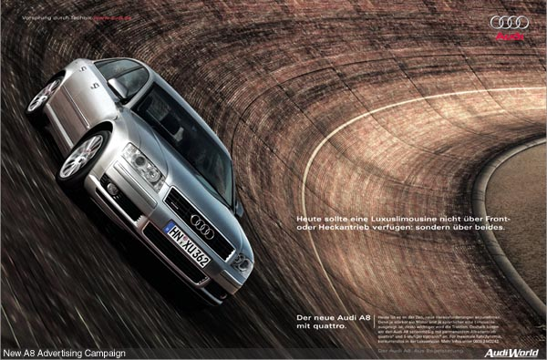
Centrifugal force,
banked corners, and gravity in space

Slide 2
Banked Corners
The Force of the road - perp to surface
Points in and up
tan(θ) = ((mv²/r)/(mg))
θ = tan⁻¹(v²/rg)
θ
mg - to hold it up
mv²/r - to make it go around the corner
θ

Slide 3
Whiteboards:
Banked Corners
1 | 2 | 3
TOC

Slide 4
The on ramp from onto I-5 from Nyberg is 40. m in radius maybe. What should be the bank angle to go 27 m/s around it?
θ = tan⁻¹(v²/rg), v = 27 m/s, r = 40. m, g = 9.8
θ = 62º
W
62 degrees

Slide 5
One of the Terwilliger curves has a radius of 270 m. What is the bank angle for cars to go 29 m/s around it
θ = tan⁻¹(v²/rg), v = 29 m/s, r = 270. m, g = 9.8
θ = 18º
W
18 degrees

Slide 6
The on ramp from onto I-5 from Nyberg is 40. m in radius maybe. What should be the bank angle to go 45. m/s (101 mph) around it?
What about 112. m/s (250 mph) around it?
What does the angle approach?
θ = tan⁻¹(v²/rg), v = 45 m/s or v = 112 m/s, r = 40. m, g = 9.8
θ = 79º, θ = 88º
W
79 degrees and 88 degrees

Slide 7
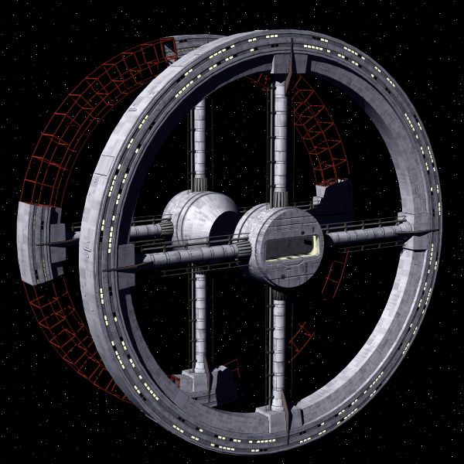
Gravity in space
Movie 2001: a Space Odyssey
Space station
Humans need gravity
Calculate tangential v if r - 500 m
Show the centrifuge

