Slide 1
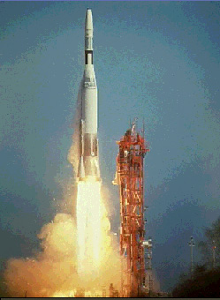
Rocket Propulsion
Contents:
Review
Types of Rockets
New concept 1
Example 1
Whiteboards 1,2,3
Concept 2, Example 2
Whiteboards: 1,2,3,4,5,6,7,8,9,10
Saturn V Apollo stuff
© Microsoft Encarta

Slide 2
Rocket Propulsion
So far we have:
p = mv
Δp = mΔv
Impulse = Δp = FΔt
And finally,
(m)(Δv) = (F )(Δ t)

Slide 3
Rocket Propulsion
So:
F = engine thrust
Δ t = time to burn fuel
m = mass of fuel burned
Δv = exhaust gas velocity
FΔt
=
mΔv

Slide 4
Which Rocket Accelerates faster?
A
B

Slide 5
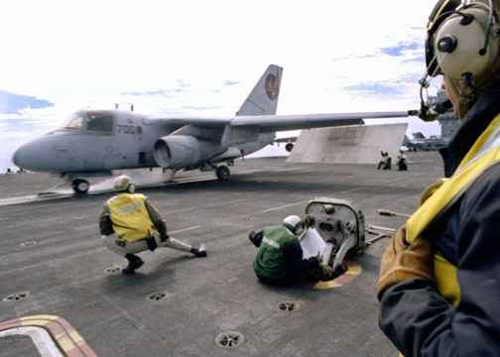

Slide 6
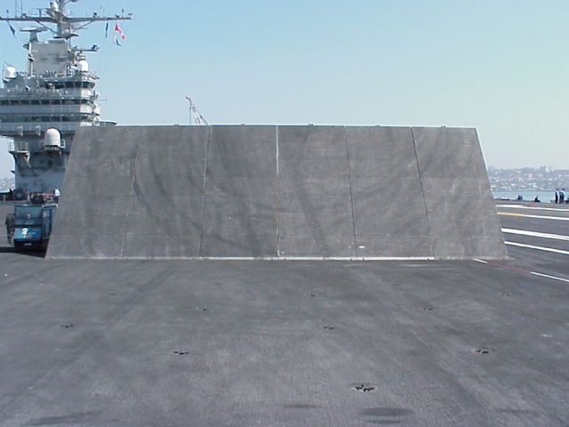

Slide 7
Rocket Propulsion
OK – So let’s learn to be rocket scientists

Slide 8
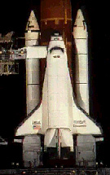
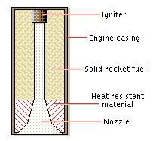
Rocket Propulsion
Solid Fuel Engine:
© Microsoft Encarta

Slide 9
Rocket Propulsion
Thrust of the Engine:
F = mΔv
Δt
Solid Fuel Engine:
Big Δv means big F
Big Δv also means lots of pressure
Danger Will Robinson!
© Microsoft Encarta

Slide 10
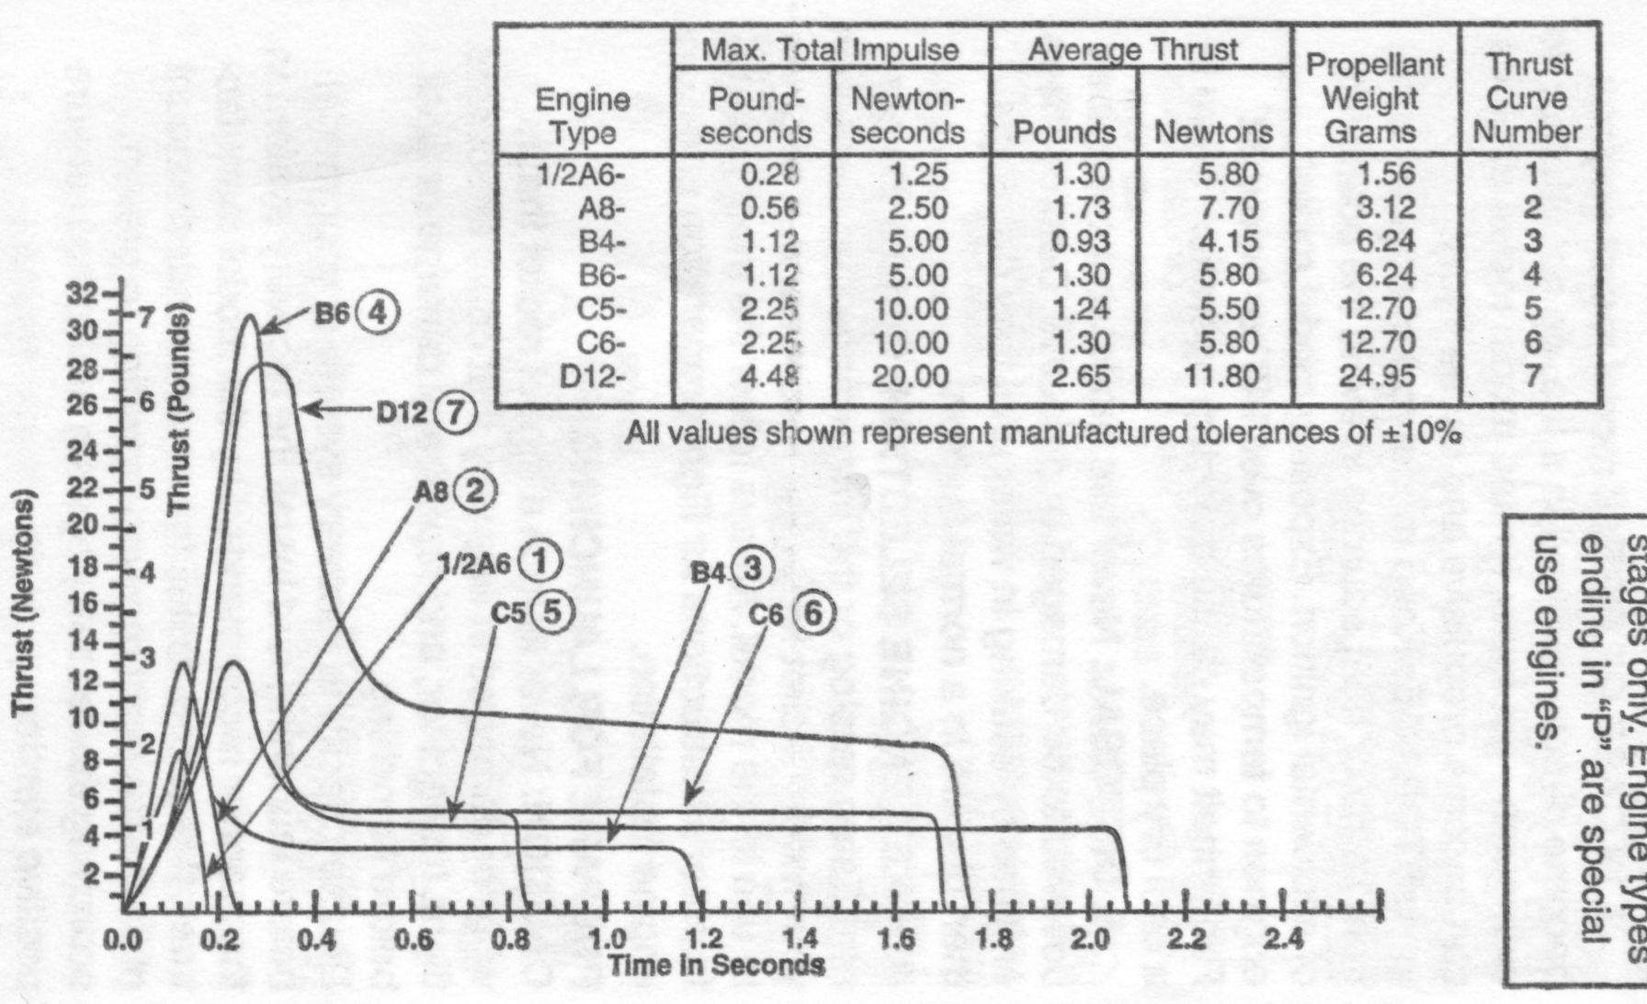
© Estes

Slide 11
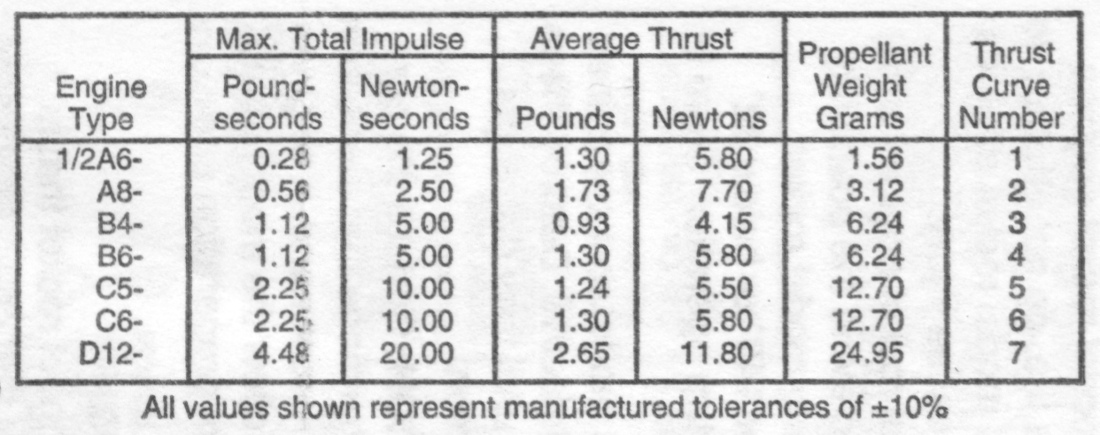
m = .5 kg, FΔt = 20 Ns
FΔt = m Δv
20 Ns = .5kg Δv
Δv = ? (x 2.237 for mph)
Lookout!
© Estes

Slide 12
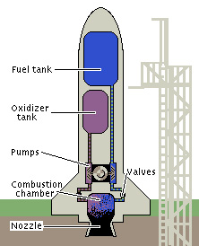
Rocket Propulsion
Liquid Fuel Engine:
How do you keep it from tipping?
Why the “steam” coming off?
© Microsoft Encarta

Slide 13
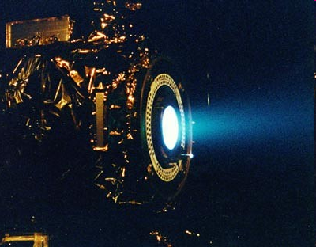
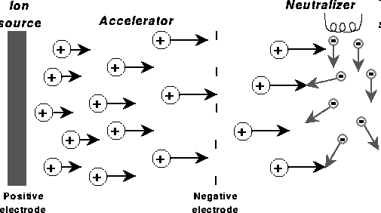
Ion Propulsion systems
Low thrust/high Δv
20-50 km/s exhaust velocity
Dawn

Slide 14
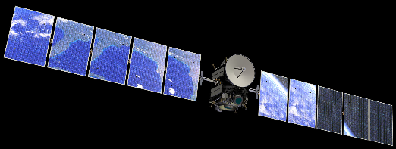
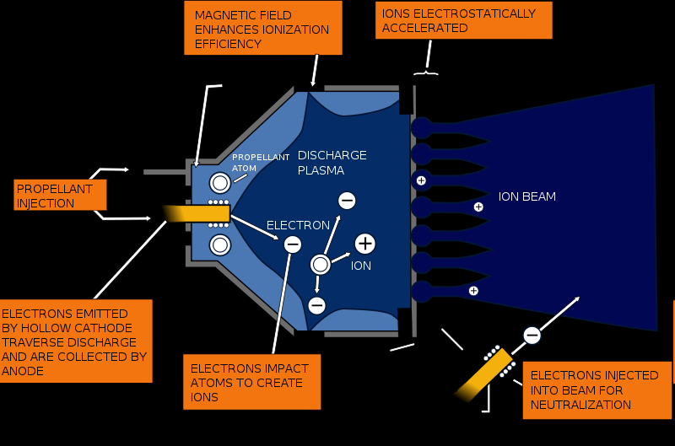
where’s the power come from?
Gridded Xenon ion drive (Like Dawn has)

Slide 15
Rocket Propulsion
If we re-arrange this formula:
mΔv = FΔt
Δt Δt

Slide 16
Rocket Propulsion
You get
F = mΔv
Δt
Where:
F = Engine thrust (N)
m = Fuel burn rate (kg/s)
Δt
Δv = Exhaust velocity (m/s)

Slide 17
Rocket Propulsion
Skill # 1 – dealing with the fuel.
m = Fuel burn rate (kg/s)
Δt

Slide 18
Rocket Propulsion
m = Fuel burn rate (kg/s)
Δt
Example: A rocket burns 1500 kg of fuel in 12 seconds. What is its fuel burn rate?

Slide 19
Rocket Propulsion
Example: A rocket burns 1500 kg of fuel in 12 seconds. What is its fuel burn rate?
1500 kg = 125 kg/s
12 s

Slide 20
Whiteboards
1 | 2 | 3

Slide 21
A rocket burns 35 kg of fuel in 14 seconds. What is its fuel burn rate?
2.5 kg/s
35 kg = 2.5 kg/s
14 s
W

Slide 22
What time will it take a rocket that has a burn rate of 1200 kg/s to consume 56,000 kg of fuel?
46.7 s
56,000 kg = 1200 kg/s
Δt
Δt = 56,000 kg/1200kg/s = 46.7 s
W

Slide 23
A certain solid fuel engine burns at a rate of .012 kg/s. How much fuel does it have if it burns for 1.75 seconds?
.021 kg
m = .012 kg/s
1.75 s
m = (.012 kg/s)(1.75 s) = .021 kg
W

Slide 24
Rocket Propulsion
Skill # 2 – Relating burn rate and exhaust velocity to thrust
F = mΔv
Δt
Δv = Exhaust velocity
m = Mass burn rate
Δt

Slide 25
Rocket Propulsion
F = mΔv
Δt
Example: A model Rocket generates 6.1 N of thrust with a burn rate of .0012 kg/s. What is the exhaust velocity?

Slide 26
Rocket Propulsion
Example: A model Rocket generates 6.1 N of thrust with a burn rate of .0012 kg/s. What is the exhaust velocity?
6.1 N = (.0012 kg/s)Δv,
Δv = (6.1 N)/ (.0012 kg/s)
= 5083 m/s

Slide 27
Whiteboards
1 | 2

Slide 28
A certain rocket engine burns 35.2 grams of fuel per second with an exhaust velocity of 725 m/s. What thrust does it generate?
25.52 N
F = mΔv, F= (.0352 kg/s)(725 m/s)
Δt
F = 25.52 N
W

Slide 29
The Saturn V’s first stage engines generated 33.82 MN of thrust (33.82 x 10⁶ N) with an exhaust velocity of 2254.7 m/s. What was its fuel burn rate?
15,000 kg/s
F = mΔv, 33.82E6 N= (?)(2254.7 m/s)
Δt
m = (33.82E6 N)/(2254.7 m/s) =
Δt 15,000 kg/s
W

Slide 30
A D12 engine generates 11.80 N of thrust burning fuel at a rate of .0143 kg/s. What is the exhaust velocity?
825.2 m/s
F = mΔv, 11.80 N = (.0143 kg/s) Δv
Δt
Δv = (11.80 N)/(.0143 kg/s)
= 825.2 m/s

Slide 31
A D12 engine generates 11.80 N of thrust burning fuel at a rate of .0143 kg/s. If it has .02495 kg of fuel, for what time does it burn?
1.74 s
m = Fuel burn rate (kg/s)
Δt
Δt = (.02495 kg)/(.0143 kg/s)
= 1.74 s

Slide 32
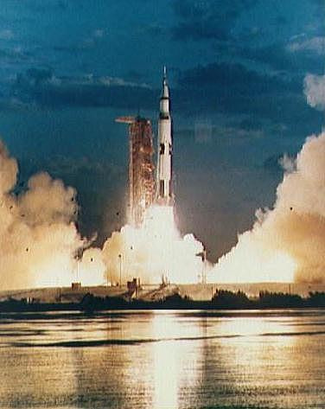
Saturn V Rocket - Apollo missions
Escape Tower
Command Module
L.E.M
Third stage
Second stage
First stage
Saturn V Animation (Flash in IE)

Slide 33
http://xkcd.com/1133/ - Up goer 5 – explanation using most common 1000 words

Slide 34
Example:
A rocket has a total mass of 150. kg, 120. kg of which is fuel. The engine burns the fuel in 8.74 s, with an exhaust velocity of 985 m/s.
What is the mass burn rate of the engine?
What is the thrust of the engine?
What is the initial acceleration of the rocket?
What is the final acceleration of the rocket just before it runs out of fuel?
13.7 kg/s, 13.5 kN, 80.4 m/s/s, 441 m/s/s

Slide 35
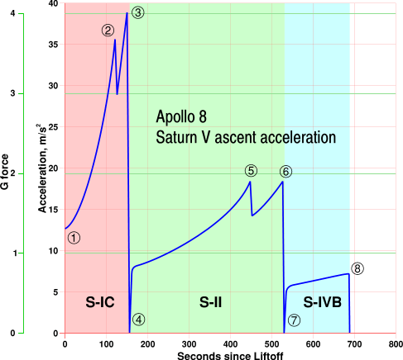
The marked events in the graph are: Launch with ignition of the S-IC. Note how the acceleration rapidly rises with increasing engine efficiency and reduced propellant load.
Cut-off of the centre engine of the S-IC.
Outboard engine cut-off of the S-IC at a peak of 4g.
S-II stage ignition. Note the reduced angle of the graph for although the mass of the first stage has been discarded, the thrust of the S-II stage is nearly one tenth of the final S-IC thrust.
Cut-off of the centre engine of the S-II.
Outboard engine cut-off of the S-II at a peak of approximately 1.8g.
S-IVB stage ignition. Note again the reduced angle of the graph caused by the thrust being cut by a fifth.
With the cut-off of the S-IVB's first burn, the vehicle is in orbit with zero acceleration.

Slide 36
A model rocket has a total mass of 235 grams, 145 grams of which is fuel. The engine burns the fuel in 2.74 s, with an exhaust velocity of 890 m/s. What is the mass burn rate of the engine?
.05292 kg/s
m/Δt = (.145 kg)/(2.74 s) = .05292 kg/s

Slide 37
A model rocket has a total mass of 235 grams, 145 grams of which is fuel. The engine burns the fuel in 2.74 s, with an exhaust velocity of 890 m/s. What thrust does the engine generate?
m/Δt = .05292 kg/s
47.1 N
F = (m/Δt)Δv = (.05292 kg/s)(890 m/s)
= 47.1 N

Slide 38
A model rocket has a total mass of 235 grams, 145 grams of which is fuel. The engine burns the fuel in 2.74 s, with an exhaust velocity of 890 m/s. What are the initial and final rocket masses?
m/Δt = .05292 kg/s, F = 47.1 N
.235 kg and .090 kg
Uh, initial = .235 kg
Final = .235 kg - .145 kg = .090 kg

Slide 39
A model rocket has a total mass of 235 grams, 145 grams of which is fuel. The engine burns the fuel in 2.74 s, with an exhaust velocity of 890 m/s. What is the initial rocket acceleration?
m/Δt = .05292 kg/s, F = 47.1 N
m_{o} = .235 kg, m = .090 kg, <F>=ma (hint)
initial = 191 m/s/s
<47.1 N - (.235 kg)(9.8 m/s²)> =
(.235 kg)(a), a=44.8 N/.235 kg=191 m/s²

Slide 40
A model rocket has a total mass of 235 grams, 145 grams of which is fuel. The engine burns the fuel in 2.74 s, with an exhaust velocity of 890 m/s. What is the final rocket acceleration?
m/Δt = .05292 kg/s, F = 47.1 N
m_{o} = .235 kg, m = .090 kg, <F>=ma (hint)
final = 514 m/s/s
<47.1 N - (.090 kg)(9.8 m/s²)> =
(.090 kg)(a), a=44.8 N/.090 kg=514 m/s²

Slide 41
where’s the power come from?
Gridded Xenon ion drive (Like Dawn has)

Slide 42
The Dawn spacecraft has a mass of about 770 kg, and an ion drive with an exhaust velocity of 35,000 m/s that generates about 92 millinewtons of thrust. (.092 N)
How what is the “burn” rate for this engine?
Ft = mv
(.092 N)(1.0 s) = m(35,000 m/s)
m = 2.62857E-06 kg/s
How big a change in velocity can 50 kg of fuel give the spacecraft?
The final mass will be 770 – 50 = 720 kg, on the average the spacecraft will have a mass of 745 kg
So the delta v is approximately:
(745 kg)(Δv) = (50 kg)(35,000 m/s)
Δv ≈ 2350 m/s

