Slide 1
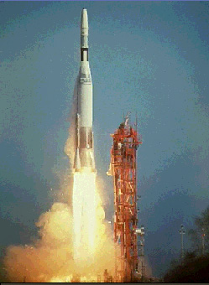
Rocket Propulsion
Contents:
Review
Types of Rockets
New concept 1
Example 1
Whiteboards 1,2,3
Concept 2, Example 2
Whiteboards: 1,2,3,4,5,6,7,8,9,10
Saturn V Apollo stuff
© Microsoft Encarta

Slide 2
Which Rocket Accelerates faster?
A
B

Slide 3
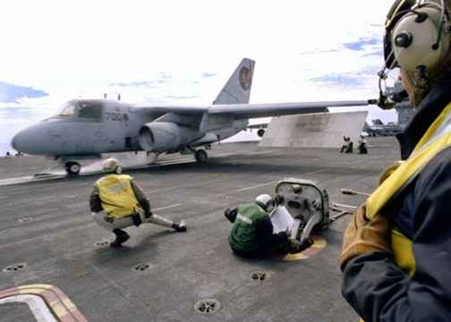

Slide 4
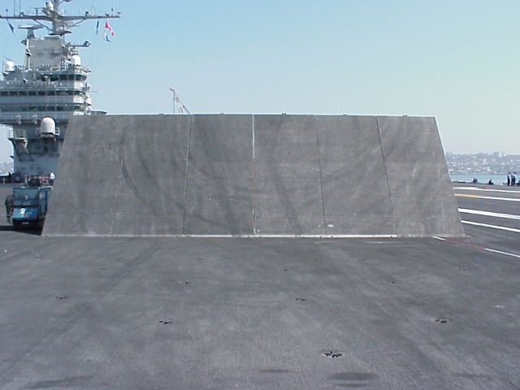

Slide 5
Rocket Propulsion
OK – So let’s learn to be rocket scientists

Slide 6
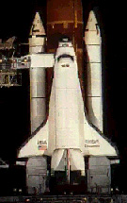
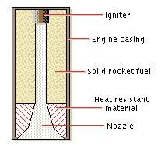
Rocket Propulsion
Solid Fuel Engine:
© Microsoft Encarta

Slide 7
Rocket Propulsion
Thrust of the Engine:
F = mΔv
Δt
Solid Fuel Engine:
Big Δv means big F
Big Δv also means lots of pressure
Danger Will Robinson!
© Microsoft Encarta

Slide 8
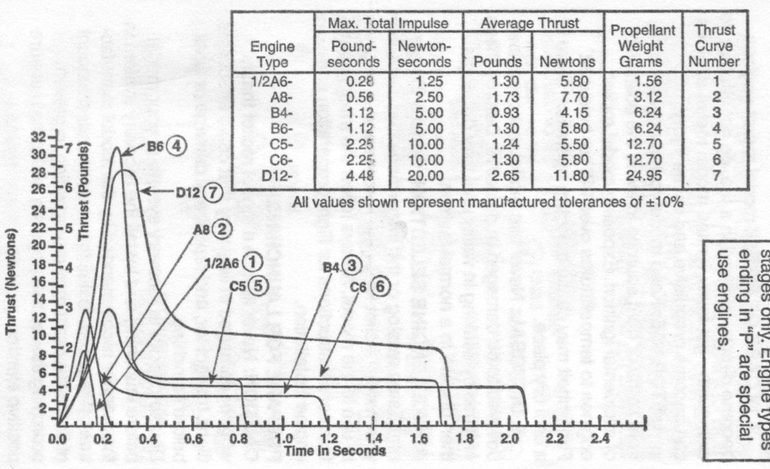
© Estes

Slide 9
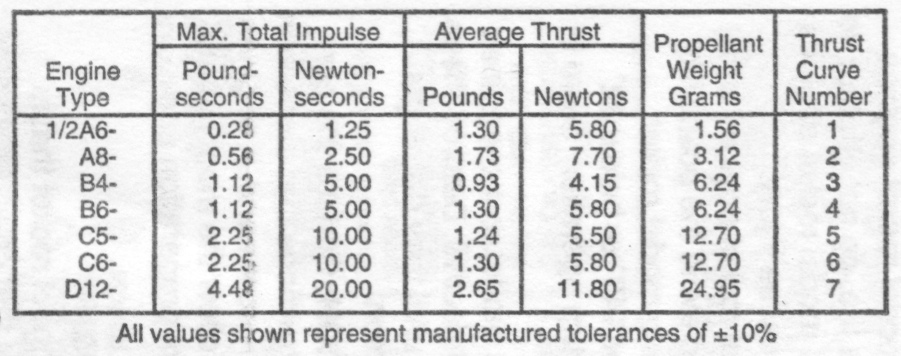
m = .5 kg, FΔt = 20 Ns
FΔt = m Δv
20 Ns = .5kg Δv
Δv = ? (x 2.237 for mph)
Lookout!
© Estes

Slide 10
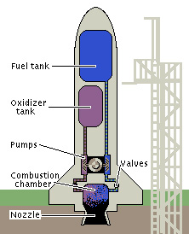
Rocket Propulsion
Liquid Fuel Engine:
How do you keep it from tipping?
Why the “steam” coming off?
© Microsoft Encarta

Slide 11
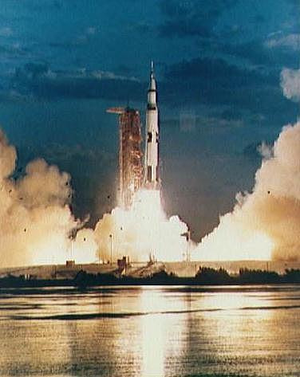
Saturn V Rocket - Apollo missions
Escape Tower
Command Module
L.E.M
Third stage
Second stage
First stage
Saturn V Animation (Flash in IE)

Slide 12
http://xkcd.com/1133/ - Up goer 5 – explanation using most common 1000 words

Slide 13
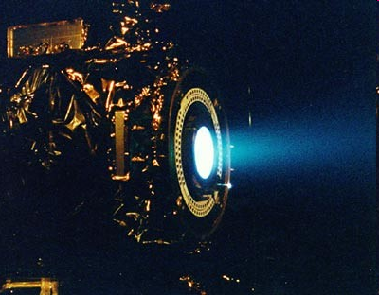
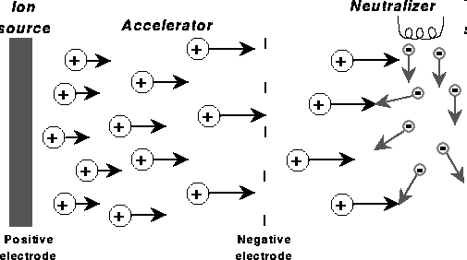
Ion Propulsion systems
Low thrust/high Δv
20-50 km/s exhaust velocity
Dawn
Thrust = 0.094 N

Slide 14
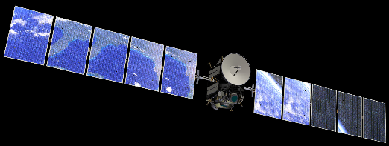
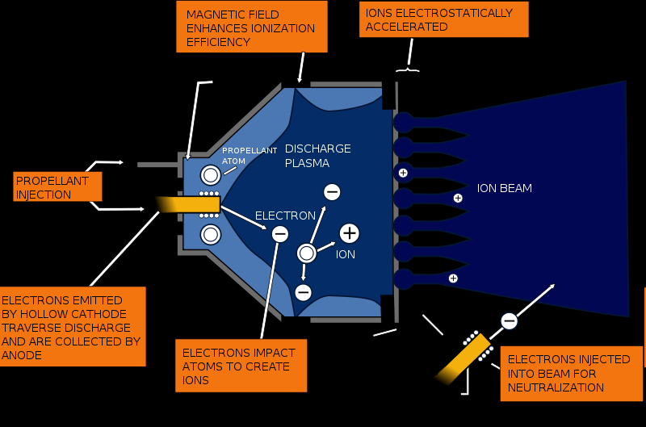
where’s the power come from?
tugboats?
Gridded Xenon ion drive (Like Dawn has)

