Slide 1
Efficiency
Contents:
Definition of Efficiency
Whiteboards

Slide 2
Efficiency- What you get/What you paid
Examples: Furnace, car, electric motor
W_{o} - Work output
W_{i} - Work input
P_{o}- Power output
P_{i} - Power input
Example - 1 HP motor consumes 815 W of power
TOC

Slide 3
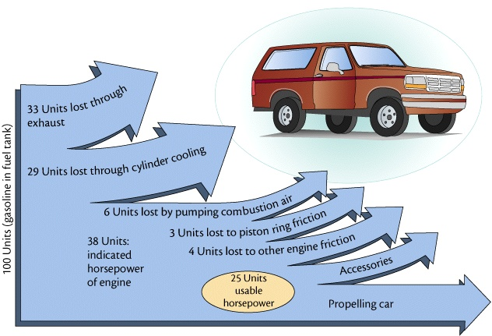
Efficiency- What you get/What you paid
TOC

Slide 4
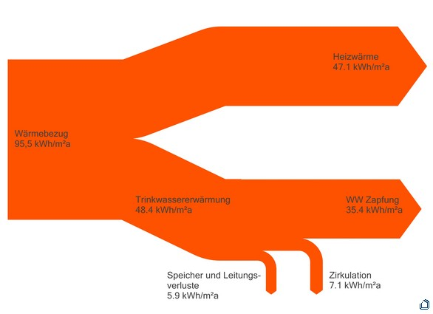
Efficiency- What you get/What you paid
TOC

Slide 5
Notes:
1.055 × 10¹⁸ joules = 1 Quad

Slide 6
Whiteboards:
Efficiency
1 | 2 | 3 | 4
TOC

Slide 7
A motor consumes 425 J of energy and does 300 J of work. e = ?
W_{i} = 425 J, W_{o} = 300. J
e = W_{o}/W_{i} = (300. J)/(425 J) = .706 = 70.6%
W
.71 or 71 %

Slide 8
A person is 13% efficient. How much food energy to do 600. J of work?
e = .13, W_{i} = ? J, W_{o} = 600. J
e = W_{o}/W_{i}
W_{i} = W_{o}/e = (600. J)/(.13) = 4615 = 4600 J
W
4600 J

Slide 9
A 60.% efficient heater uses 800. J of energy. What is its heat output?
e = .60, W_{i} = 800. J, W_{o} = ?
e = W_{o}/W_{i}
W_{o} = eW_{i} = (.60)(800. J) = 480 J
W
480 J

Slide 10
A car is 25% efficient. What energy input does it need to climb a 320 m tall hill if its mass is 1200 kg?
e = .25, W_{i} = ? J,
W_{o} = mgh = (1200 kg)(9.80 N/kg)(320 m) = 3763200 J
e = W_{o}/W_{i}
W_{i} = W_{o}/e = (3763200 J)/(.25) = 15052800 J = 1.5 x 10⁷ J
W
1.5 x 10⁷ J

