Slide 1
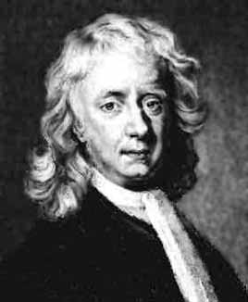
Newton’s Laws of motion

Slide 2
Newton’s Three Laws of motion:
1. An object at rest will remain at rest, an object in motion will remain in motion at a constant speed, in a straight line (constant Velocity) unless acted upon by an outside force.
Inertia - the tendency of an object to resist a change in its motion.
2. F = ma (an outside force causes an a = F/m)
3. For every action there is an equal but opposite reaction
(rockets, throwing, pushing, airplanes)

Slide 3
F = ma

Slide 4
Example: What force causes a 4.0 kg object to accelerate at 6.0 m/s/s?

Slide 5
Example: A 2.1 kg hammer accelerates from rest under the influence of a net force of 120 N. What is its final velocity if the force is exerted over a distance of 78 cm
9.44 m/s

Slide 6
Whiteboards:
Newton’s Second Law
1 | 2 | 3 | 4 | 5

Slide 7
What unbalanced force causes a 892 g object to accelerate at -9.81 m/s/s?
-8.75 N

Slide 8
What is the acceleration of a 12 kg object if you exert 37 N of unbalanced force on it?
3.1 m/s/s

Slide 9
What is the mass of an object if when there is a 128 N net force acting on it, it accelerates at 3.7 ms⁻²?
35 kg

Slide 10
A 16 kg object going 23 ms⁻¹ is stopped by a force in 0.125 s. What force?
-2900 N

Slide 11
A 3.84 kg object going 42.0 ms⁻¹ experiences a force of -23.5 N for 2.60 s. What is the final velocity of the object?
26.1 m/s

Slide 12
A 143 gram baseball going 39 m/s caught by the catcher. In stopping, the baseball travels 7.5 cm. What is the average force exerted on the ball?
-1450 N

Slide 14
A 4.2 g rifle bullet reaches a speed of 890 m/s in a distance of 61 cm. What is the average force exerted on the bullet? What is that in pounds if 4.45 N = 1 pound?
+2730 N 613 lbs

Slide 16
Aristotle - Science by observation.
Moving objects
Galileo - Science by experiment.
Rate of fall
Moving objects

Slide 17
Aristotle - Science by observation.
Moving objects
Galileo - Science by experiment.
Rate of fall
Moving objects

