Slide 1
Boat Crossing River QL 3.4

Slide 2
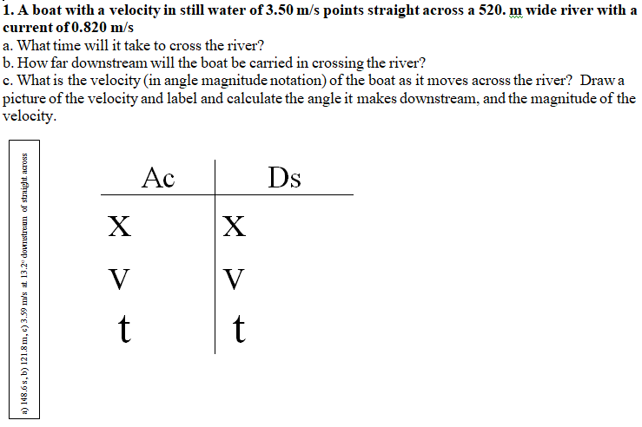

Slide 3
