Slide 1
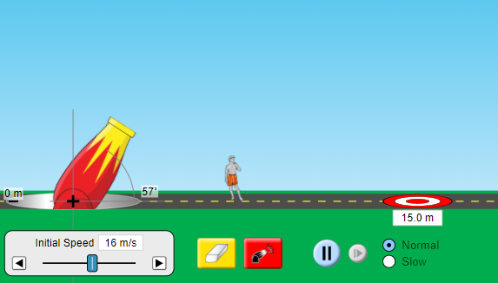
Calculate range, move target to spot:

Slide 2
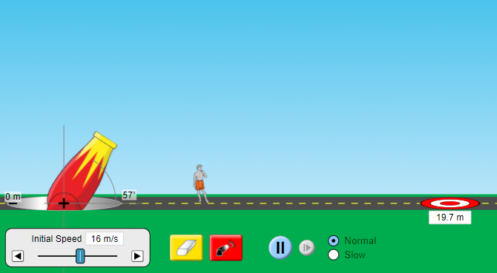
Calculate angle to hit target

Slide 3
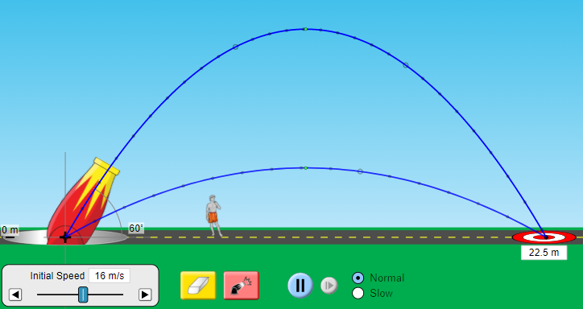
Showing that ϴ and 90 - ϴ hit the same spot:

Slide 4
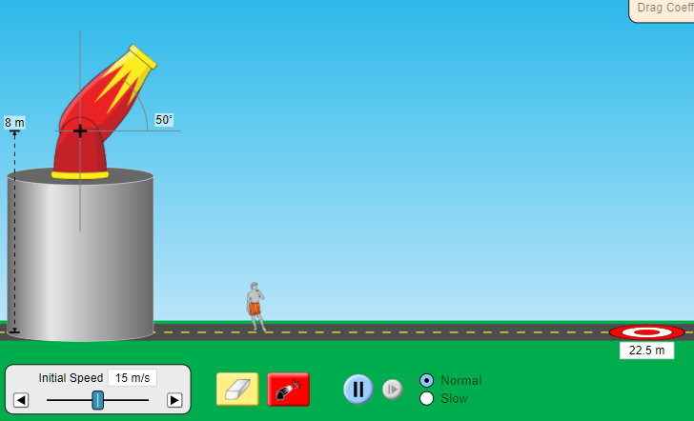
EC – The Cliff Arc!!!!

