Slide 1
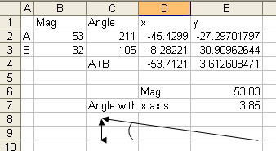
Add these two vectors. Fill in the table
Vector Mag. Trig Angle x y
A
A
B
31º
Angle = Tan⁻¹(O/A)
53 N
Mag = √(x² + y²) =
15º
32 N
B

