Slide 1
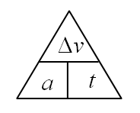
1. A car accelerates from rest to 21.0 m/s in 2.45 seconds. What is its acceleration? (8.57 m/s/s)

Slide 2
2. A rock accelerates at 9.81 m/s/s for 1.25 s. What is its change in velocity?
(12.3 m/s)

Slide 3
3. A car can accelerate at 4.50 m/s/s. What time will it take to accelerate from rest to 12.0 m/s (2.67 s)

Slide 4
4. A car goes from 37.0 m/s to 21.0 m/s in 3.50 seconds. What is its acceleration?
(-4.57 m/s/s)

Slide 5
5. A car has a final velocity of 23.0 m/s after having accelerated at 1.75 m/s/s for 7.80 seconds. What was its initial velocity? (9.35 m/s)

