Slide 1
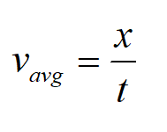
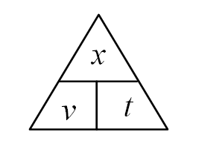
1. A car goes 30.0 m in 1.80 seconds. What is its speed? (16.7 m/s)

Slide 2
2. A car going 25 m/s goes 13.4 m. What time does it take? (0.536 s)

Slide 3
3. A baseball going 41 m/s travels how far in 0.34 s? (13.9 m)

Slide 4
4. Convert 55 mph to m/s (24.6 m/s)

Slide 5
5. Convert 8.94 m/s to mph (20.0 mph)

