Slide 1
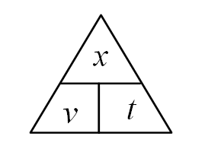
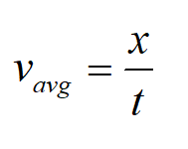
Speed –– the rate of motion
v_{avg} - average speed (m/s, f/s, mph, km/hr)
x, Δx - distance (m, cm, feet, miles, km)
t, Δt - elapsed time (seconds, minutes, hours)
Use math to solve for Δx and Δt (triangle of mystery)
The units must match!

Slide 2
Example 1:
A car is going 25 m/s. How far does the car go during the 1.3 seconds it takes you to change songs?
32.5 m

Slide 3
Example 2:
A winch moves a cable 12.5 cm per second. What time will it take to reel in 15 m of cable?
120 s

Slide 4
Whiteboards:
Speed
1 | 2 | 3 | 4 | 5

Slide 5
How fast are you going if you run 27.0 m in 3.2 seconds?
8.4 m/s

Slide 6
In what time will a car that is traveling 95.3 f/s go 13.45 feet?
0.141 s

Slide 7
How far will a bullet traveling 350 m/s go in 6.34 seconds?
2200 m

Slide 8
A car traveling 80. km/hr will go how far (in meters) in 2.7 seconds?
1000 m = 1 km
3600 s = 1 hour (60x60)
60 m

Slide 9
What time (in days) will it take a glacier that moves 15.6 feet/day to travel 100 yards?
19.2 days

