Slide 1
Linear Kinematics - Free Fall
Contents:
Graph
Definition of and Terminal velocity

Slide 2
A
B
C
0 m/s
Velocity
Time
A - Free Fall - only gravity acts (a = -9.8 m/s/s)
B - Transition from free fall to terminal velocity (a goes to zero)
C - Terminal velocity (a = 0)
(forces, vertical wind tunnels, type of object)
(Demo - feather in vacuum, ping pong ball in vacuum, race twixt steel ball and pp ball)

Slide 3
A
B
C
0 m/s
Velocity
Time
Objects in free fall (region A) experience a zero g situation
Demo - water bottle

Slide 4
Demos:
Feather, Ping pong ball, Steel marble
vertical wind tunnel
terminal velocity
definition of Free Fall
Zero Gravity
gravity detector
Drop
Fling
DC-9
filming Apollo 13
YouTube(NASA Water Balloons in Zero G (High Quality))
YouTube(Symphony of Spheres in Microgravity)
Show our experiments (DIME 2006)

Slide 5
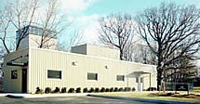

Slide 7
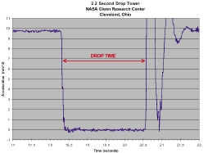

Slide 8
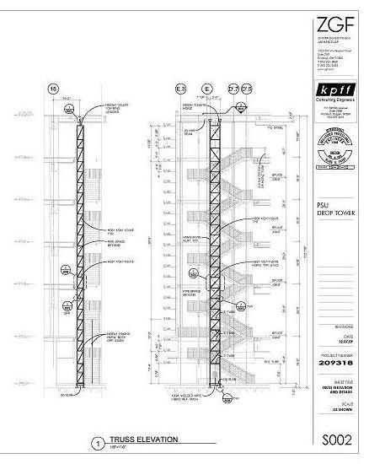
PSU:
http://ddt.pdx.edu/node/605

