Slide 1
Linear Kinematics - Free Fall
Contents:
Graph
Definition of and Terminal velocity
Handy Truths
Examples and demos
Whiteboards

Slide 2
Problem Solving tips for free fall
1. Acceleration is always -9.8 m/s/s
2. Even at the top
3. v at the top is zero
Iff start and end at same elevation
4. ¹/₂ time up, ¹/₂ time down
5. Vf = -Vi

Slide 3
Example 1 (Make down negative)
An egg is dropped from the top of a 26.0 m tall tower
What time does it take to reach the ground?
What is its velocity of impact with the ground?
X
V_{i}
V_{f}
a
t
2.30 s
-22.6 m/s

Slide 4
Example 2 (Make down negative)
An object is launched straight up with a velocity of +33 m/s, and strikes the ground at the same elevation from which it is launched.
When is it at the top? What total time is it in the air?
How high does it go at the highest?
X
V_{i}
V_{f}
a
t
3.37 s, 6.73 s,
55.6 m

Slide 5
Whiteboards:
Free Fall
1-6

Slide 6
A steel marble falls from the roof of a building and strikes the ground going downwards at 18.0 m/s. a. What time did it take to hit the ground, and b. what is the height of the roof?
X
V_{i}
V_{f}
a
t
a.1.84 s b. 16.5 m

Slide 7
A can of SPAM falls from the roof of a building that is 43 m tall. a. In what time does it reach the ground, and b. what is its velocity of impact?
X
V_{i}
V_{f}
a
t
x = -43 m, v_{i} = 0 m/s, v_{f} = ??, a = -9.8 m/s/s, t = ??
x = v_{i}t + ¹/₂at²
.:. t = 2.9623 s 3.0 s
v_{f} = v_{i} + at
.:. v_{f} = -29.0458 m/s -29 m/s
a. 2.96 s b. -29.0 m/s

Slide 8
A scone falls from a tree, striking the ground in 0.714 s. a. What is the velocity of impact with the ground? b. From what height did it fall?
X
V_{i}
V_{f}
a
t
a. -7.00 m/s b. 2.50 m

Slide 9
A rocket in the rocket lab is launched straight upwards at 24.0 m/s. It lands at the same elevation as it was launched.
a. What time does it take to reach the top? What total time in the air? b. What height does it reach?
X
V_{i}
V_{f}
a
t
a. 2.45 s up and 4.90 s total b. 29.4 m

Slide 10
A rocket is launched straight up in the rocket lab, and is in the air for a total of 6.40 s.
a. What was its initial velocity?
b. What was its greatest height?
X
V_{i}
V_{f}
a
t
a. +31.36 m/s, b. 50.2 m high

Slide 11
A frozen hot pocket is launched upwards from the ground and reaches a height of 82.0 m. a. What was its initial upward velocity? b. What was its total time in the air?
X
V_{i}
V_{f}
a
t
a. +40.1 m/s, b. 8.18 s

Slide 12
Demos
-Feather and ping pong ball
-Zero G

Slide 13
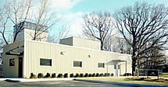

Slide 15
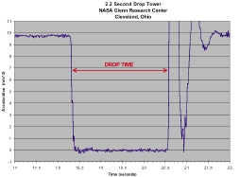

Slide 16
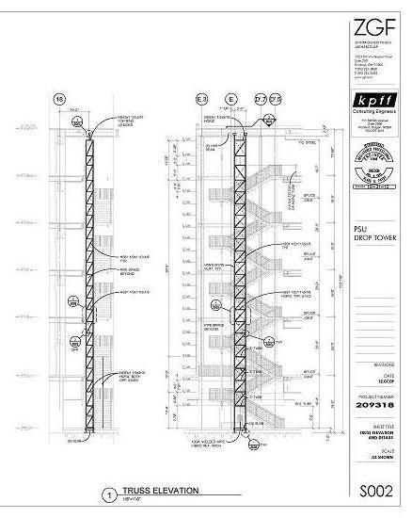
PSU:
http://ddt.pdx.edu/node/605

Slide 17
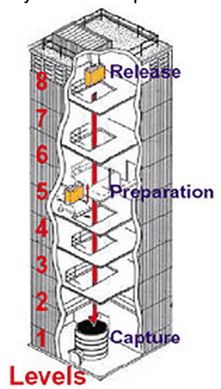
A 2.20 second drop tower drops packages from rest.
a. What is the fall distance?
b. What is the velocity of impact with the recovery?
c. What time does it take to fall a distance of 18.0 m?
d. What is the velocity at a fall distance of 18.0 m
e. What are its velocity and displacement at 2.10 s?
solution
a. 23.7 m b. -21.56 m/s c. 1.92 s d. -18.8 m/s e. -21.6 m and -20.6 m/s

Slide 19
Bottom (start)
Velocity v time
+ V
Top
0 m/s
Bottom
(end)
- V
Time
Slope unbroken, top: a != 0

Slide 20
An object is launched straight up with a velocity of +33 m/s. Use the acceleration of gravity to be -9.81 m/s/s, and neglect air friction
When is it at the top?
How high does it go at the highest?
launch to top:
x
vi = +33 m/s
vf = 0 (at the top)
a = -9.8 m/s/s
t
use vi = vf + at, 0 = 33 + (-9.8)t, t = 3.367… ≈ 3.4 s
use v² = vf² + 2ax, (0)² = (33)² + 2(-9.8)x, x = 55.561 ≈ 56 m
What total time is it in the air?
This would be twice the time to the top since up is presumably the same distance as down:
total time = 3.367 + 3.367 = 6.735 ≈ 6.7 s
What is its velocity at an elevation of 45 m?
launch to 45 m elevation:
x = 45 m
vi = +33 m/s
vf = ?
a = -9.8 m/s/s
t
use vf² = vi² + 2ax, vf² = (33)² + 2(-9.8)(45), |vf| = 14.387 ≈ (+14 m/s OR -14 m/s)
It is + 14 m/s on the way up, and -14 m/s on the way down, as it passes 45 m twice on the way to 56 m

Slide 21
Example 2
A pop fly remains airborne for 8.42 seconds and is caught at bat level. Ignore air friction.
What time did it spend going up?
What was its initial velocity? Its final?
What maximum height does the ball reach?
What are the two possible velocities at an elevation of 60. m?
Why are there two answers to the previous?
(4.21 s, 41.3 m/s and -41.3 m/s, 86.8 m, +22.9 m/s and -22.9 m/s, up and down)

