Slide 1
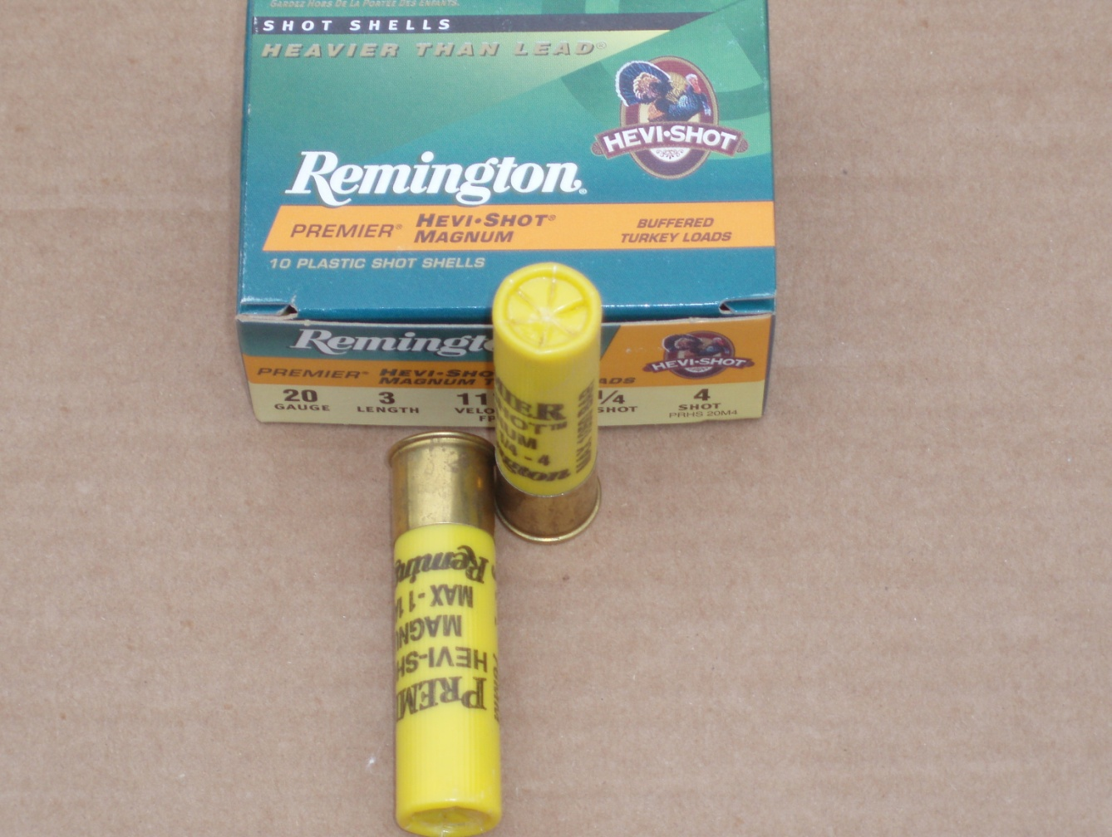
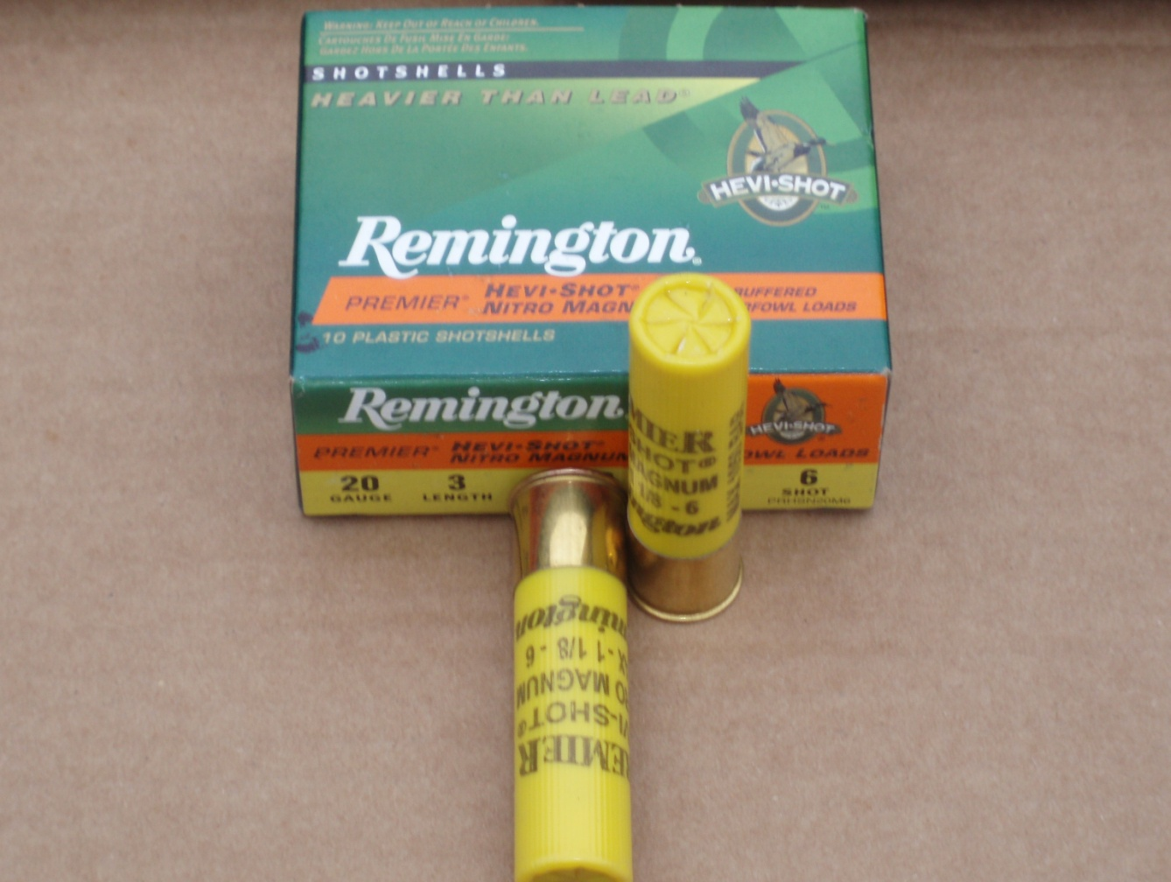
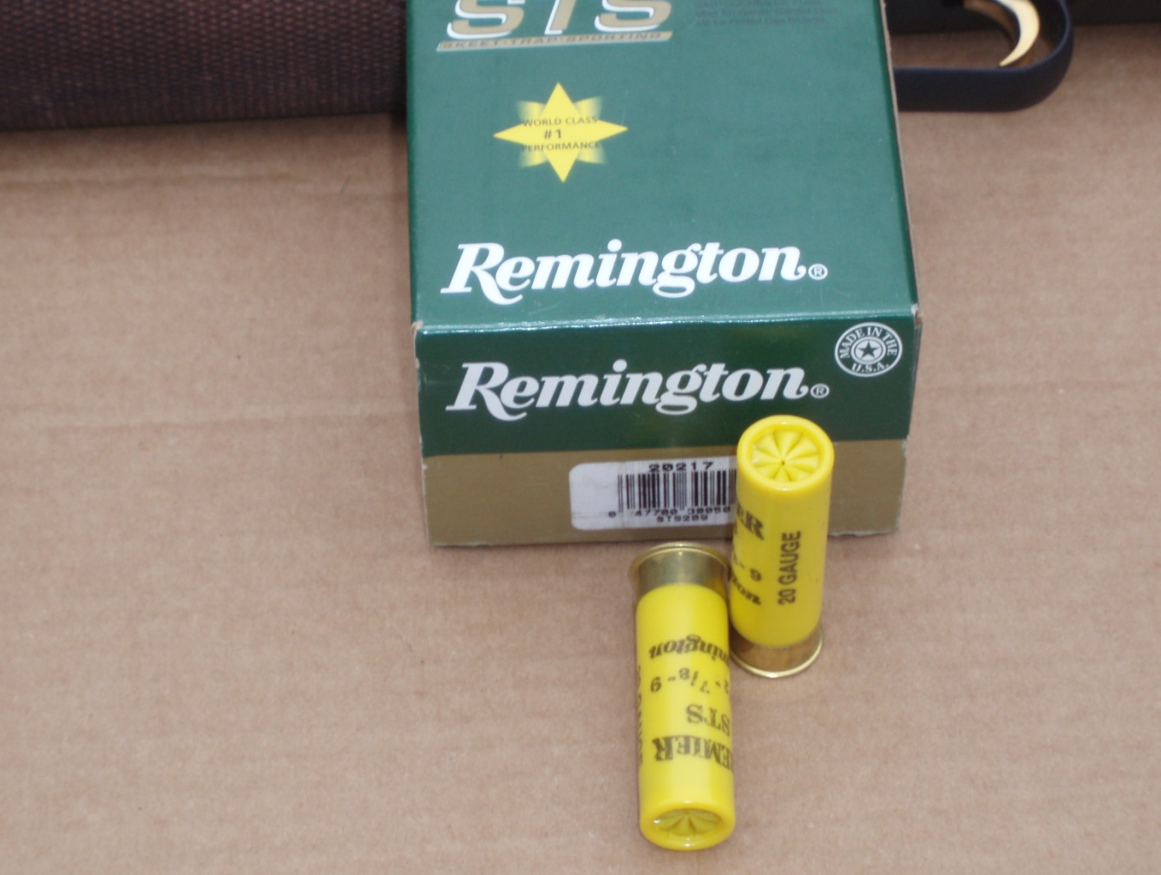
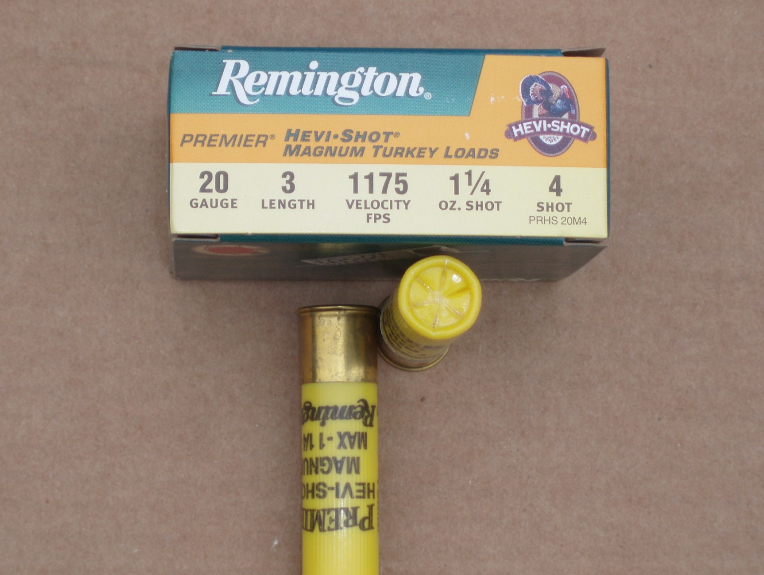
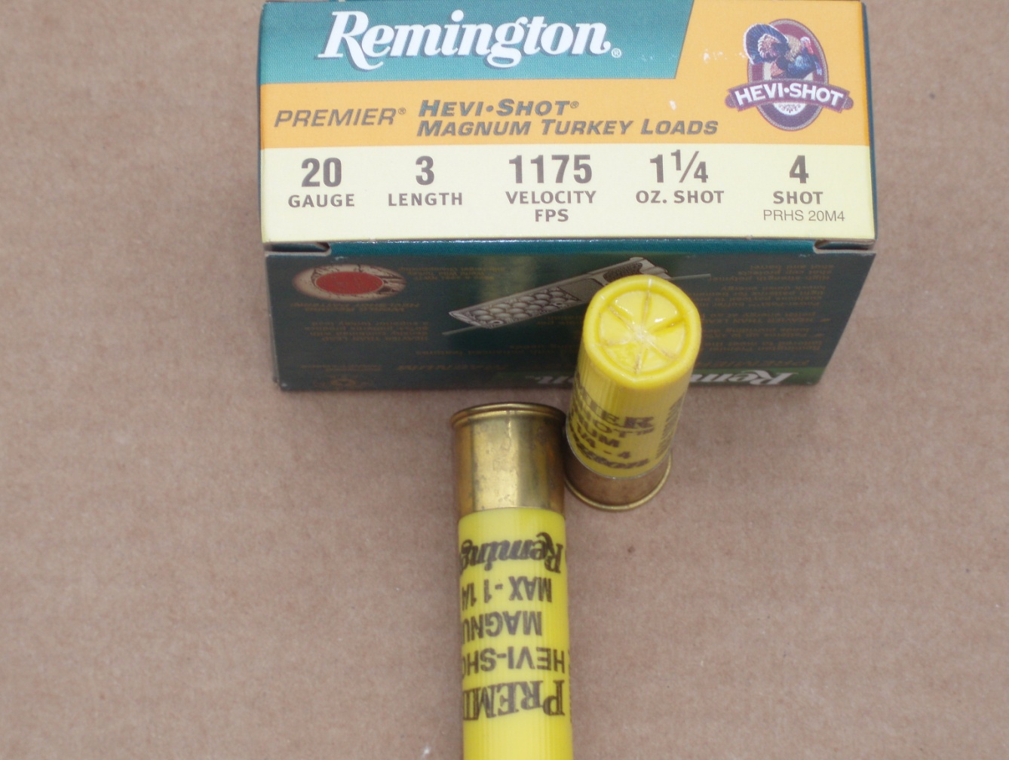
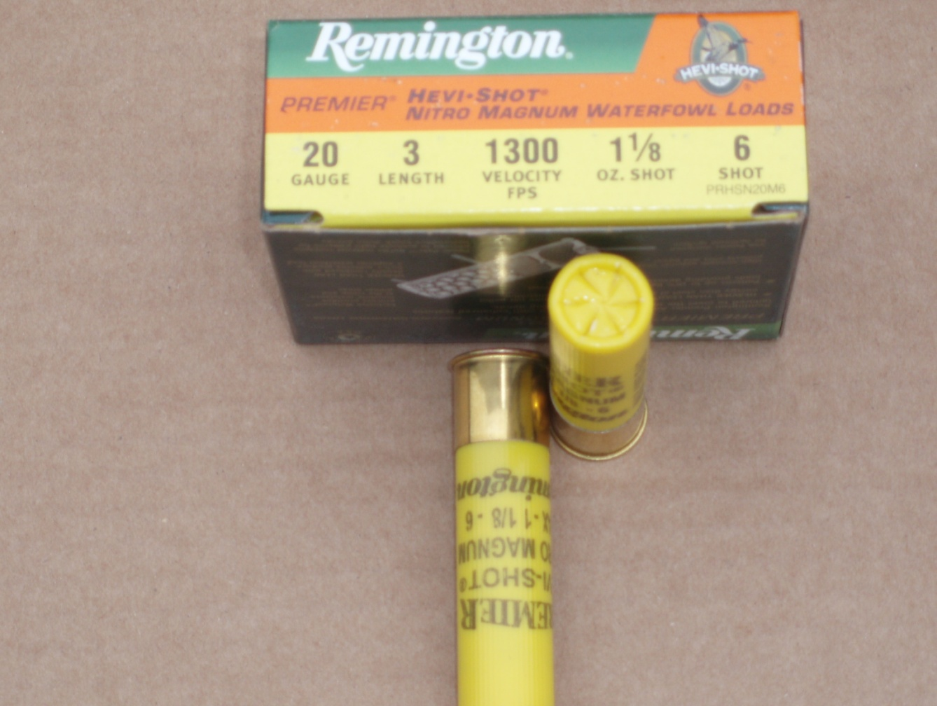
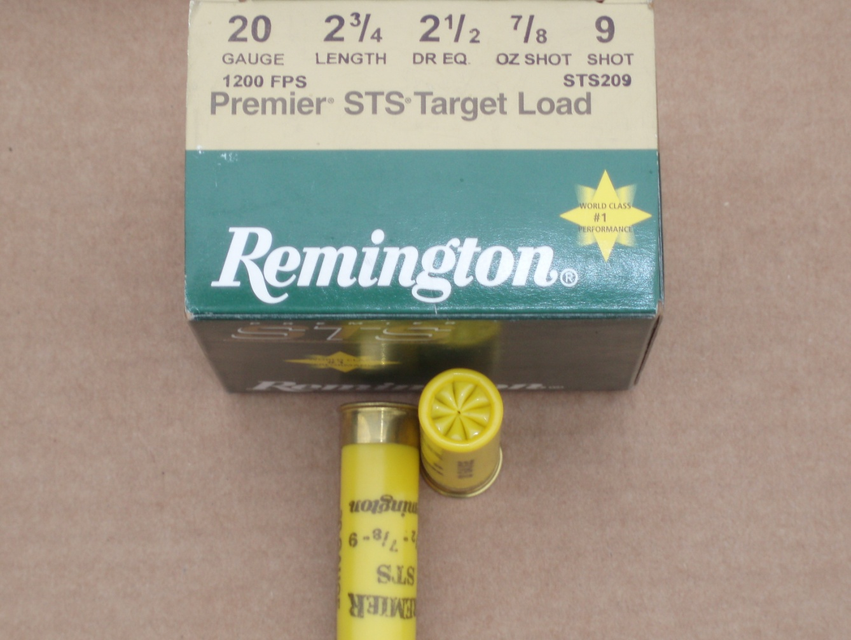
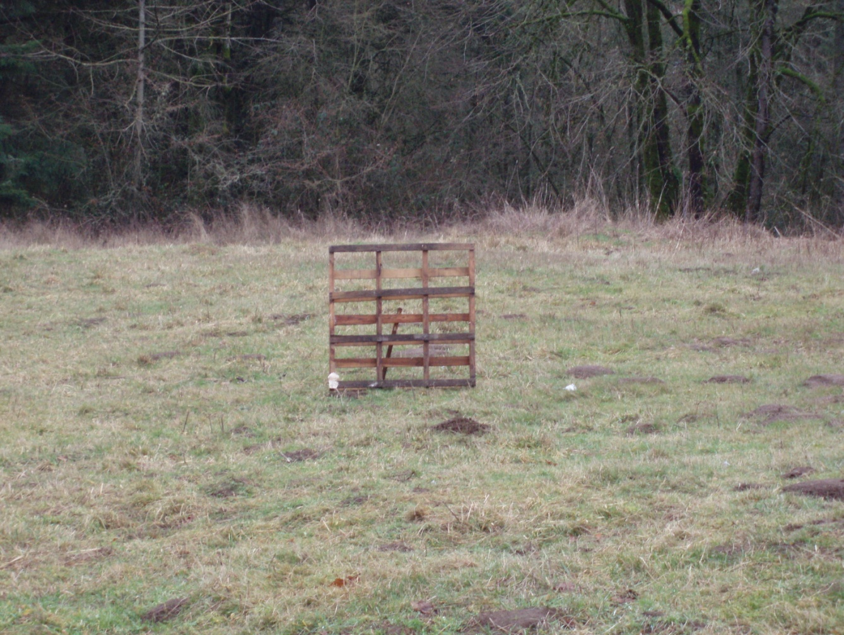
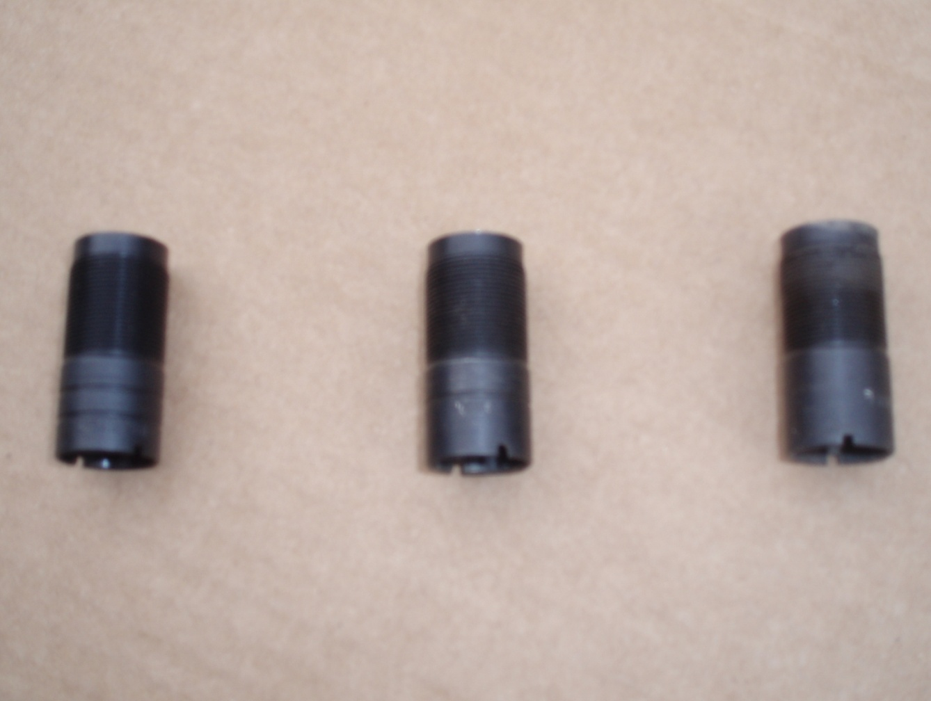
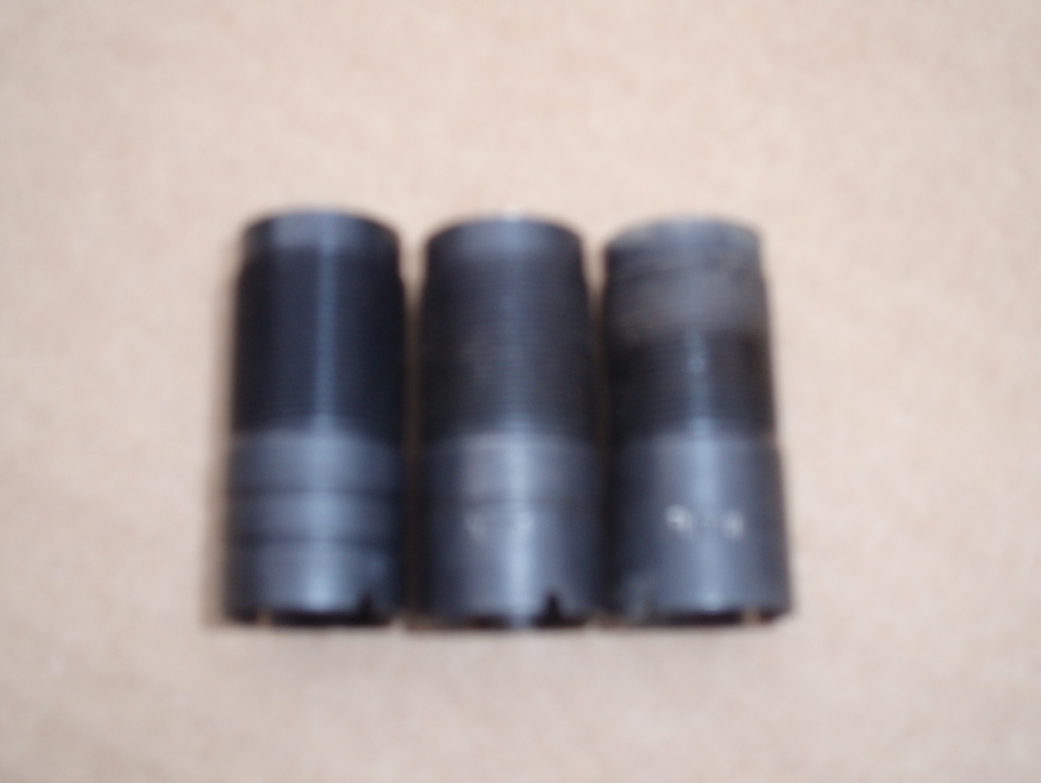
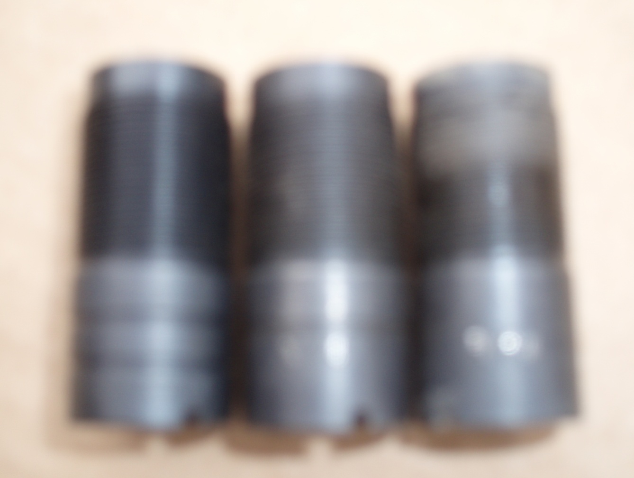
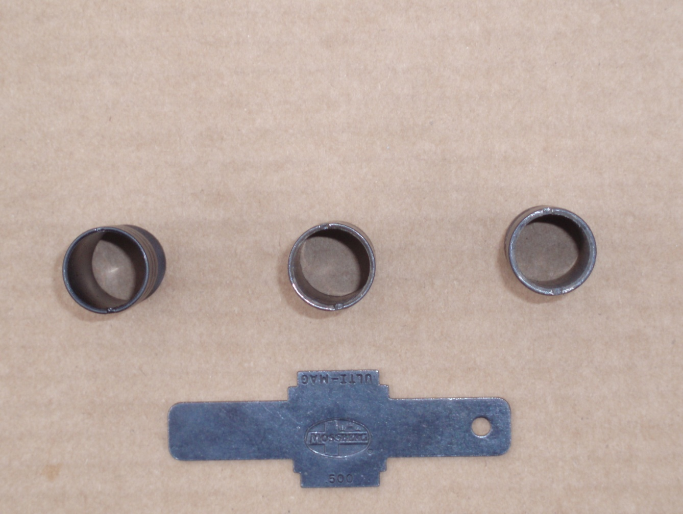
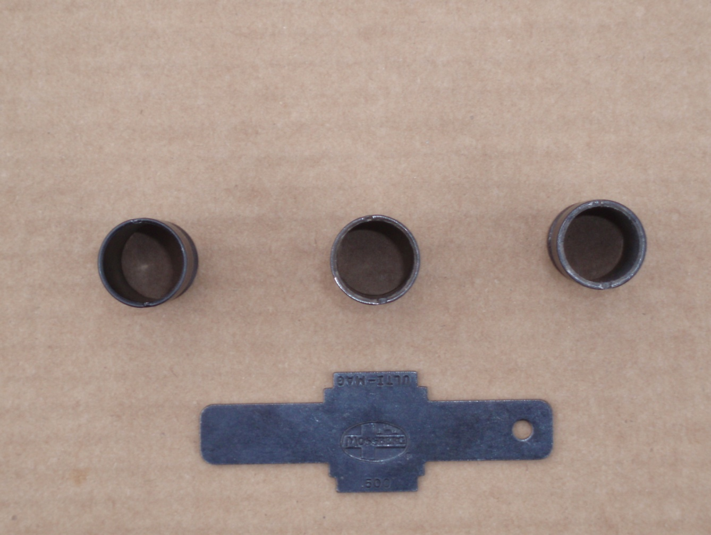
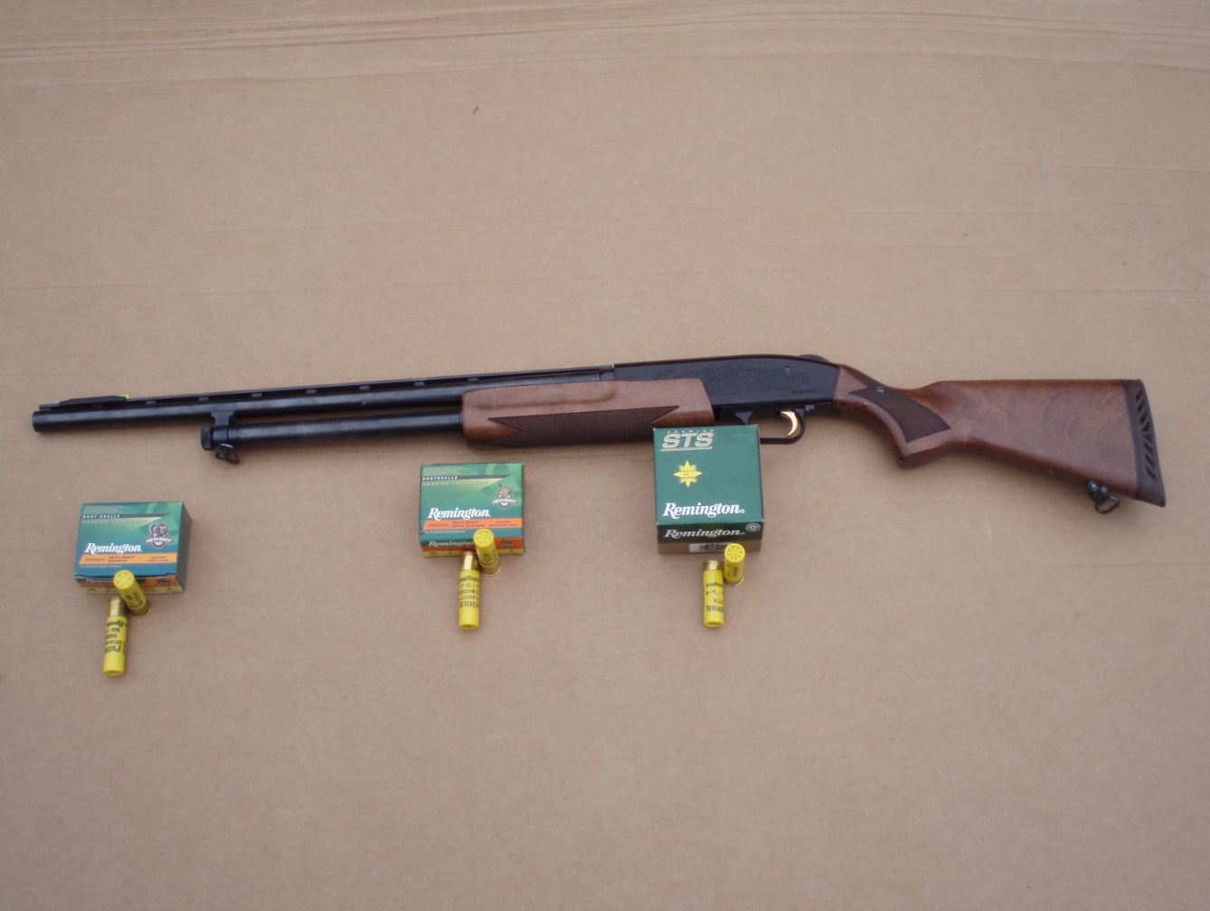
``` 20 Gauge Spread```
By : Ben Andrews &
John James

Slide 2
# 4 shot
# of Pellets : 135

Slide 3
# 6 Shot
# of Pellets : 225

Slide 4
# 9 Shot
# of Pellets : 585

Slide 5
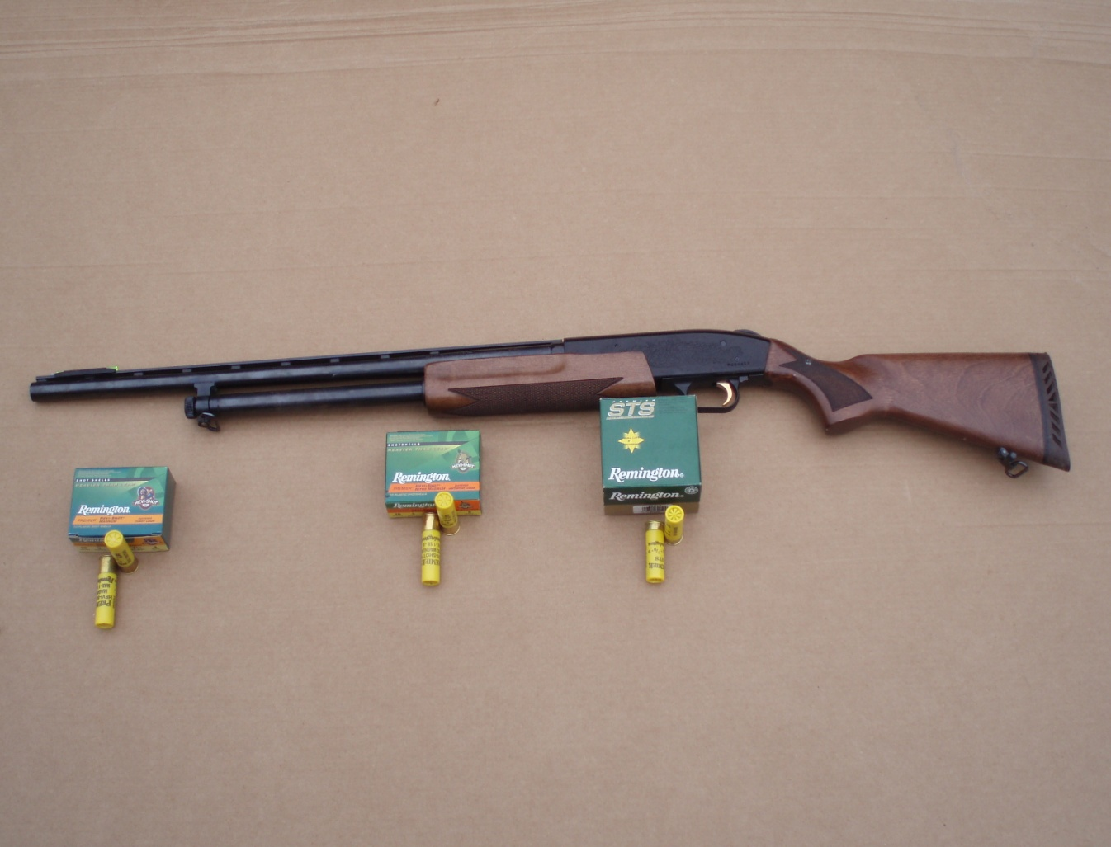
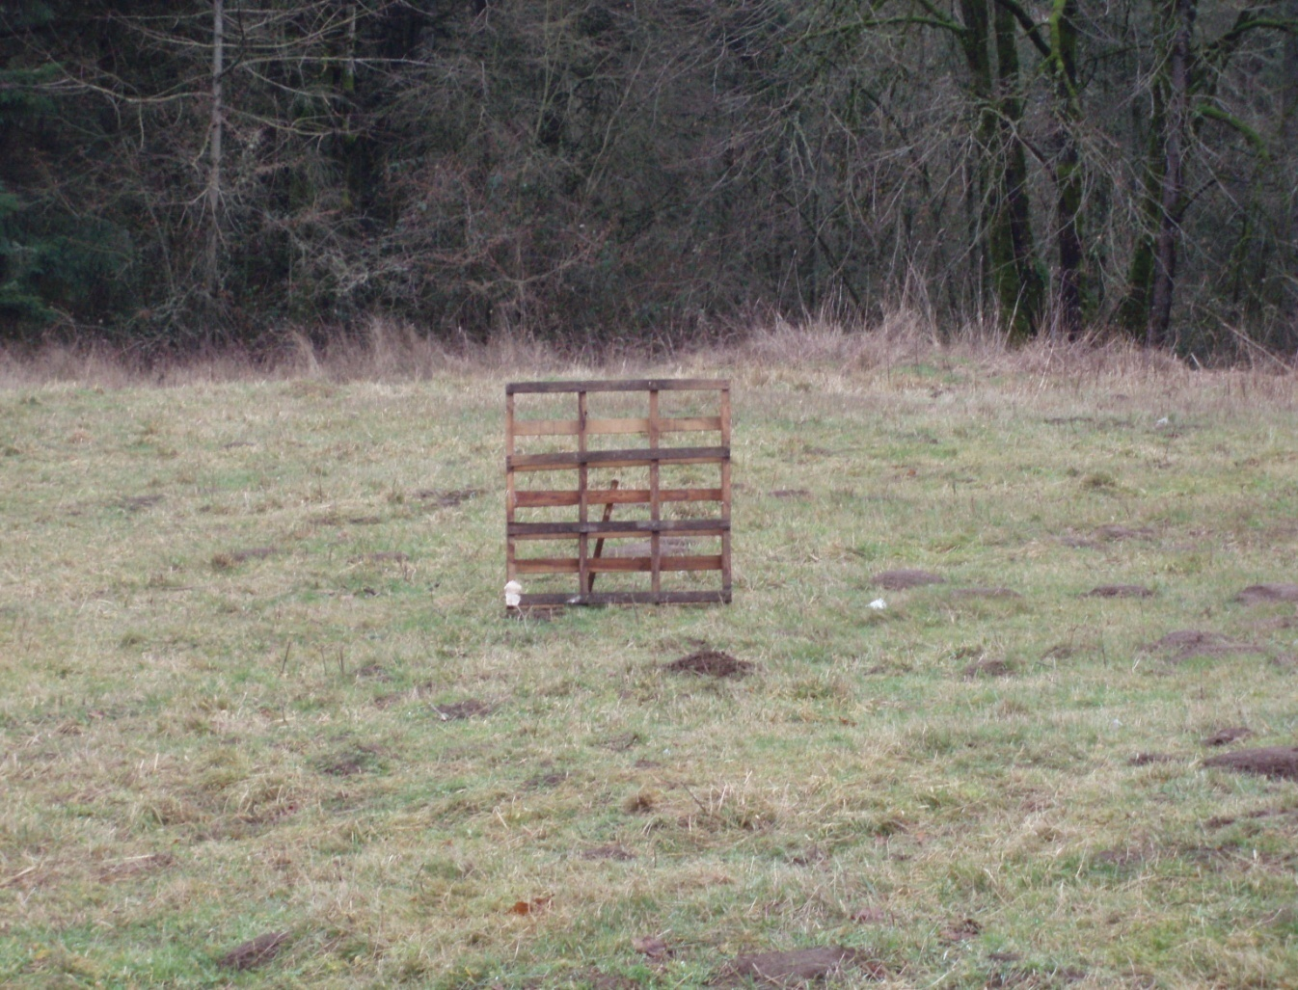
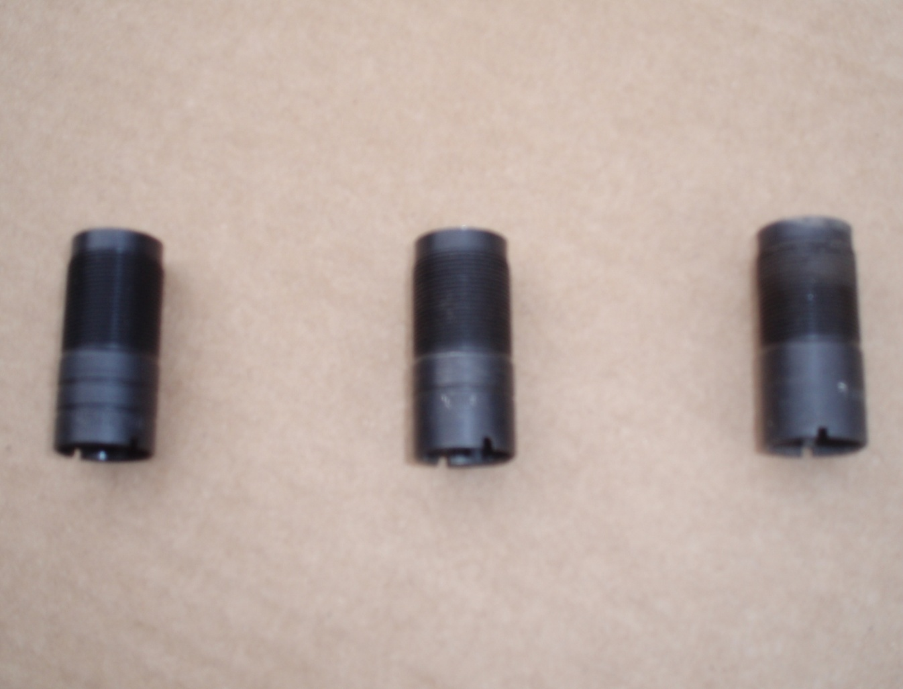
( Left ) Improved Choke , ( Middle ) Modified Choke, ( Right ) Full Choke

Slide 6
^ ^ ^ IMP MOD FULL
Inside : 1.6 cm / Inside : 1.6 cm / Inside : 1.6 cm
End : 1.5 cm / End : 1. 55 cm / End : 1.6 cm

Slide 7
Wood Pallet used to sand up cardboard
Distance : 17 m

