Slide 1
Find the missing Force. Torque about the pivot point.
182 N
F = ???
1.1 m
1.9 m
3.2 m
97.0 N
50.4 N up

Slide 2
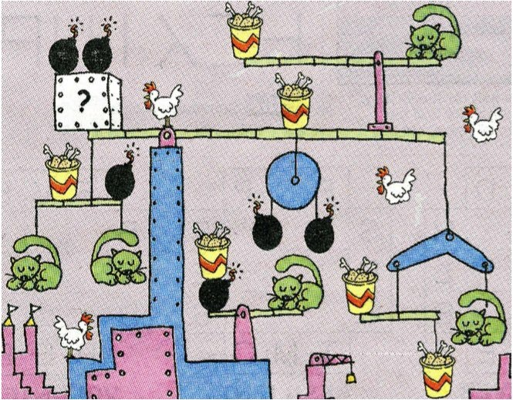
= ____ cats?
= ____ cats?
How many cats in the “?” box with the two bombs on it?
(Hint – figure out the cat equivalent of the bomb and the bucket o’ chicken – neglect the masses of other things)

