Slide 1
Vertical Circle
Feel 1g - ride
Feel 1g + ride

Slide 2
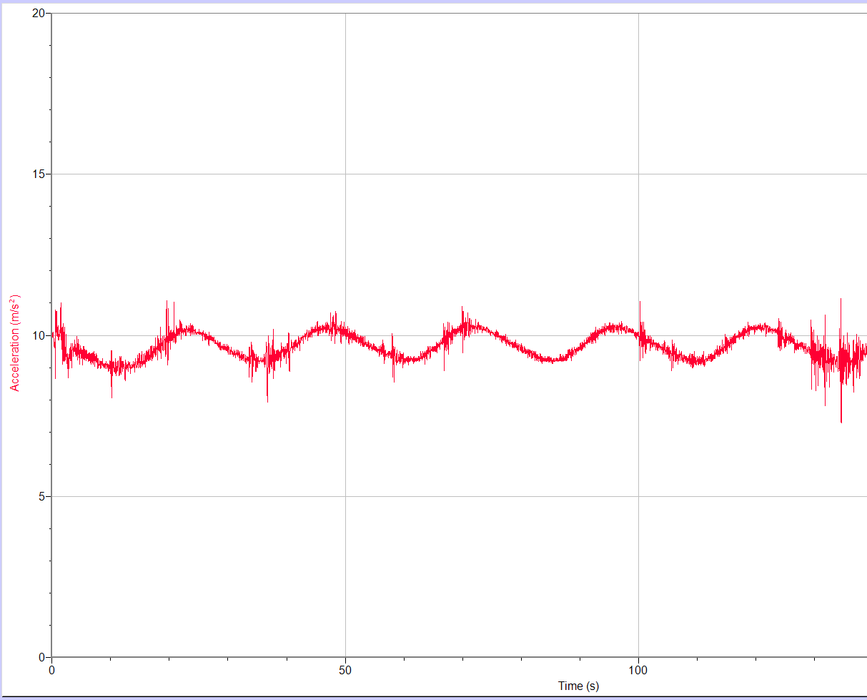
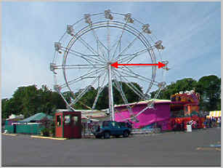
Ferris Wheel at Oaks Park!!!

