Slide 1
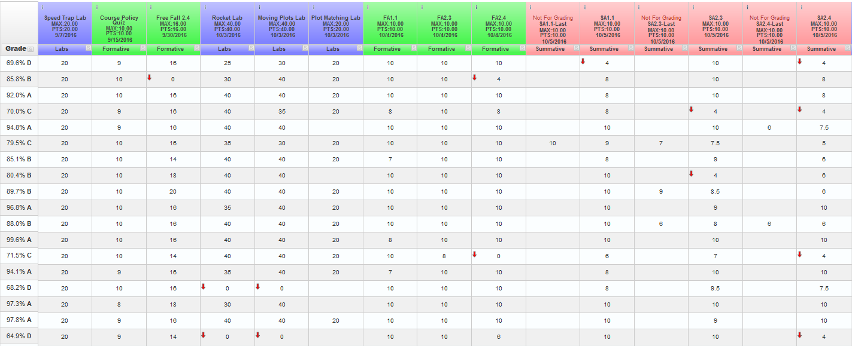
IB Physics I
grade in progress
categories
missing assignments
21 day rule 11/3
labs
SAs – M/Th 7:20

Slide 2
IB Physics I
video flips
formative work
show website

