Slide 1
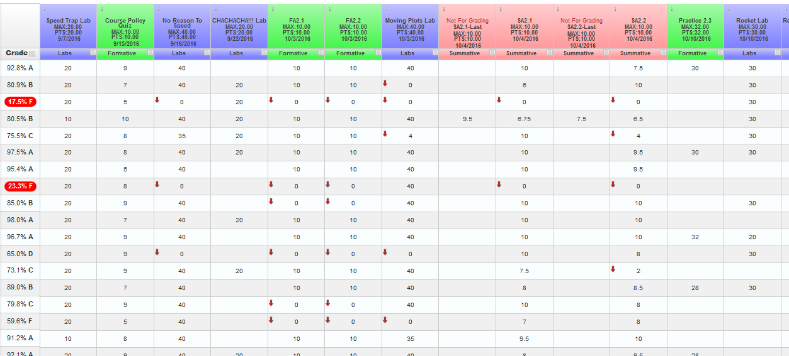
Physics
grade in progress
categories
missing assignments
21 day rule 10/27
labs
SAs – M/Th 7:20

Slide 2
Physics
video flips
formative work
show website

