Slide 1
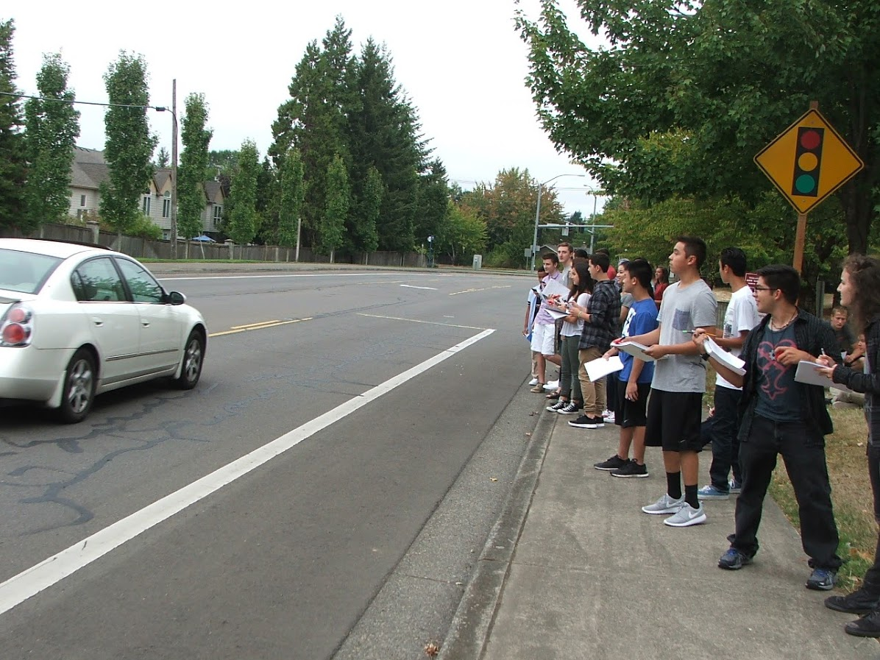
Students Clock Speeders on Boones Ferry

Slide 2
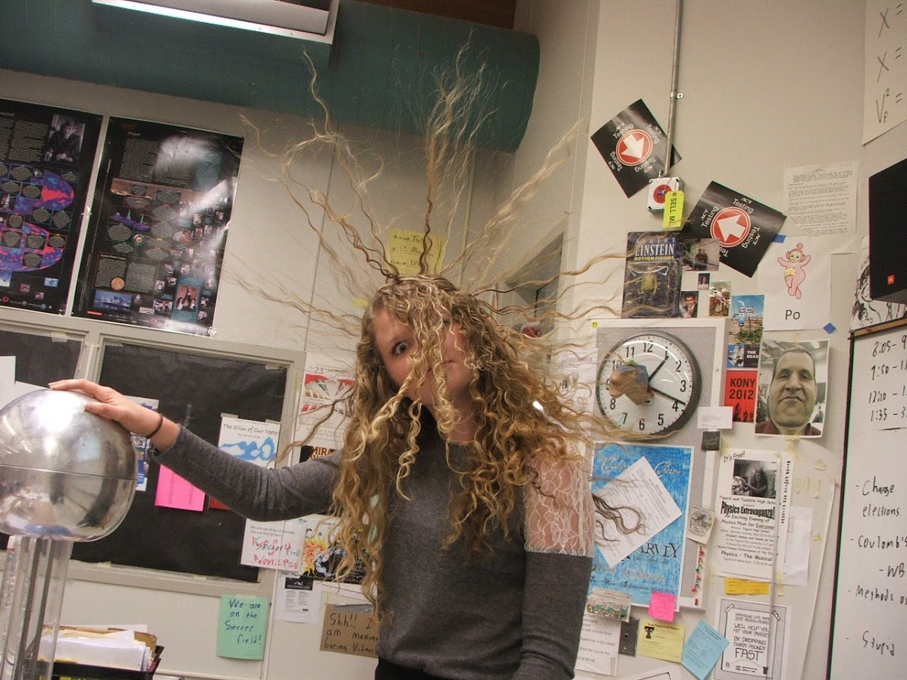
Hair Raising experiences

Slide 3
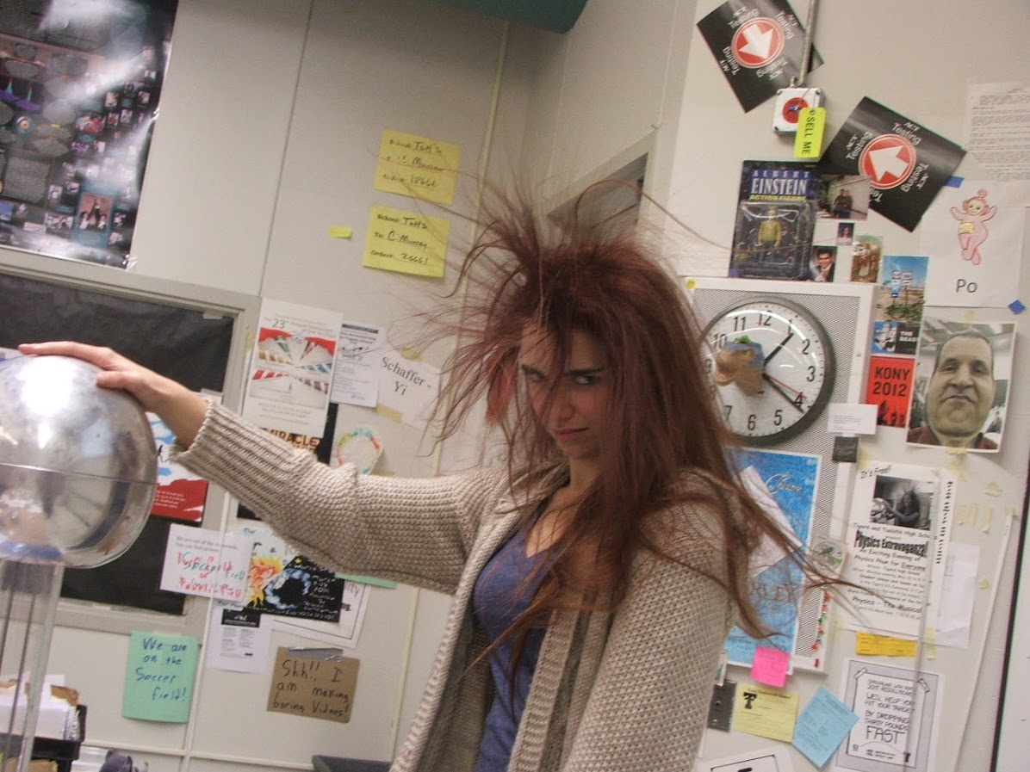
Mom - do I need to comb my hair?

Slide 4
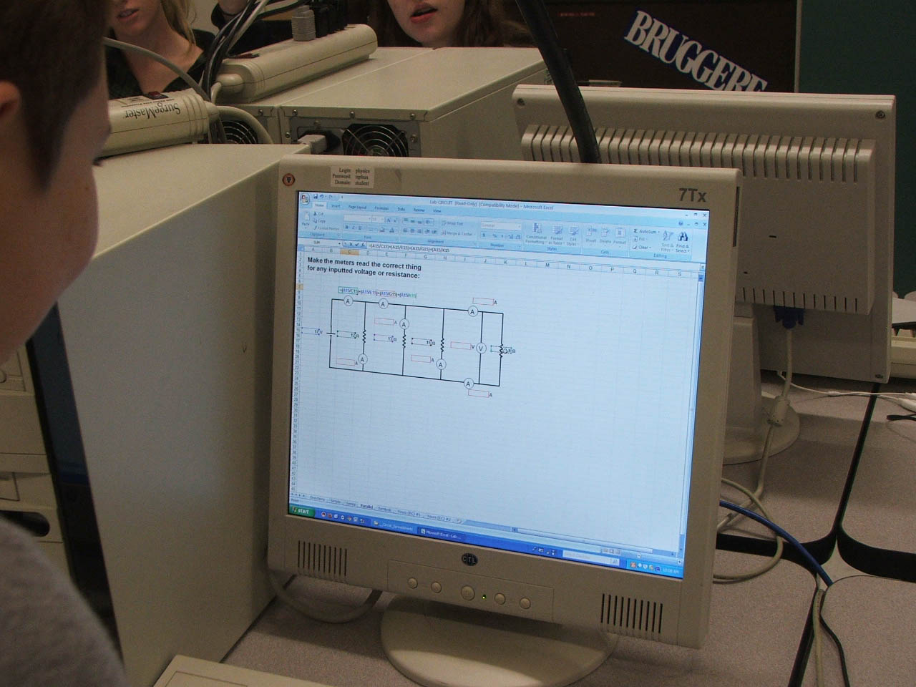
Spreadsheets are our friends!

Slide 5
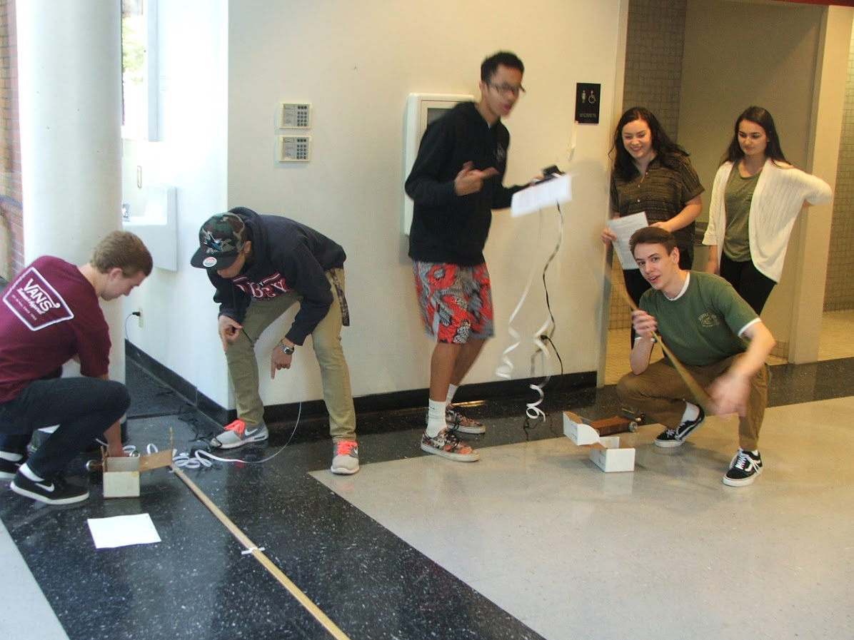
We’re not messing around - we’re doing physics!

Slide 6
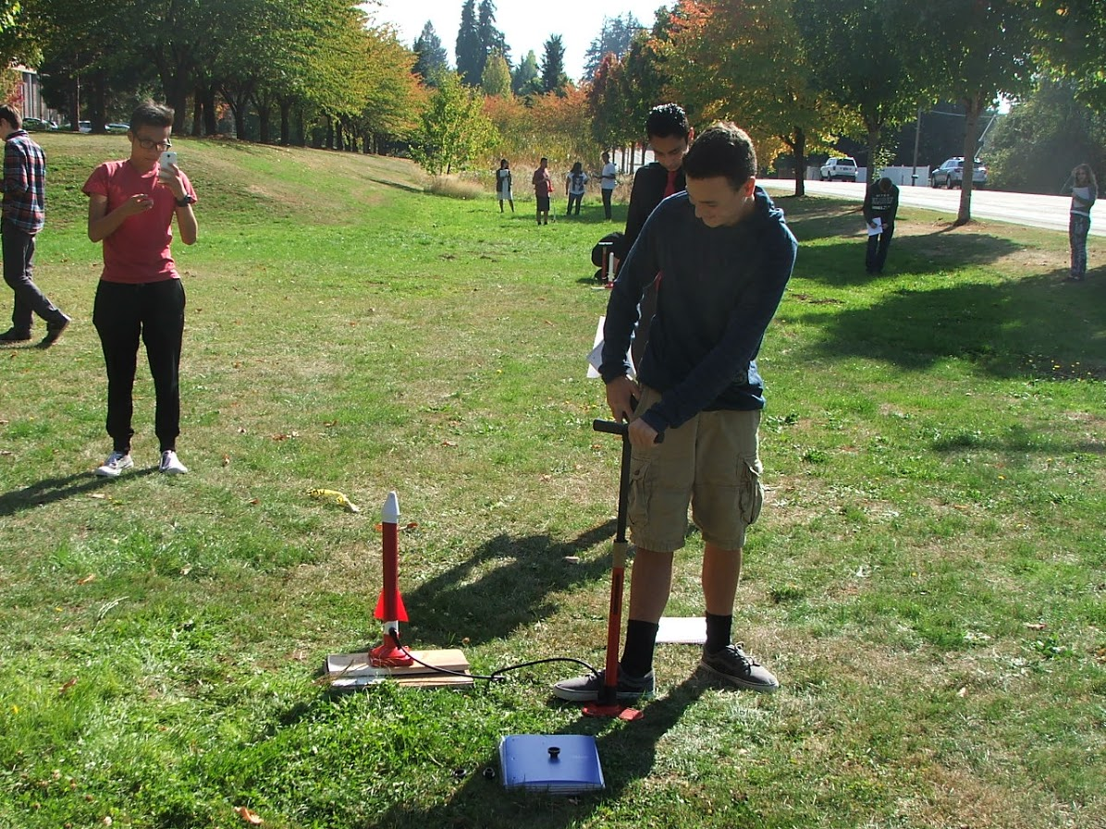
Measuring the initial velocity of an air rocket

Slide 7
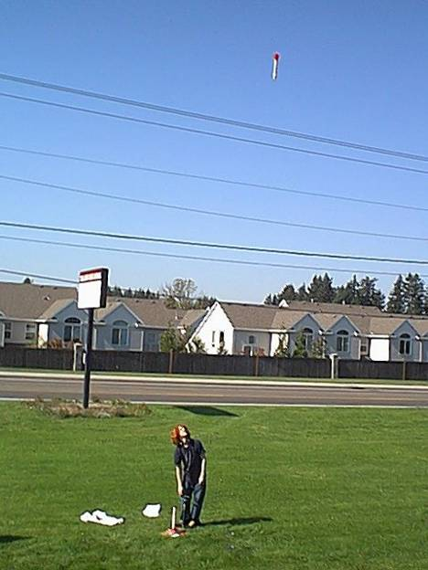
Heads Up!!!

Slide 8
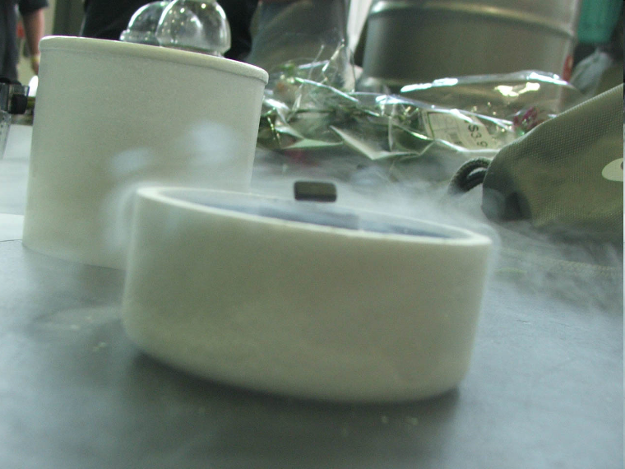
Where is the physics here?

Slide 9
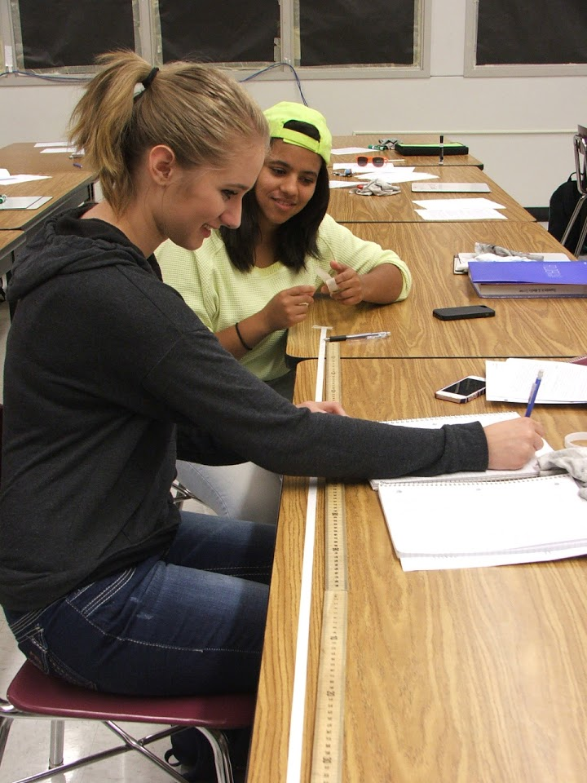
How long can it be?

Slide 10
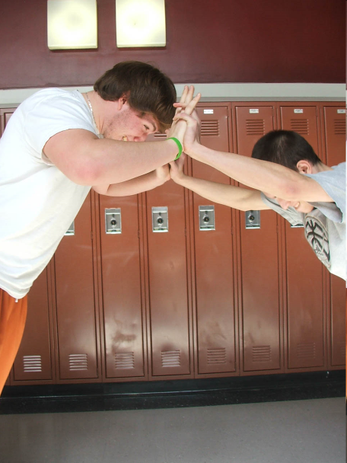
Sometimes... You don’t need math to figure out physics...

Slide 11
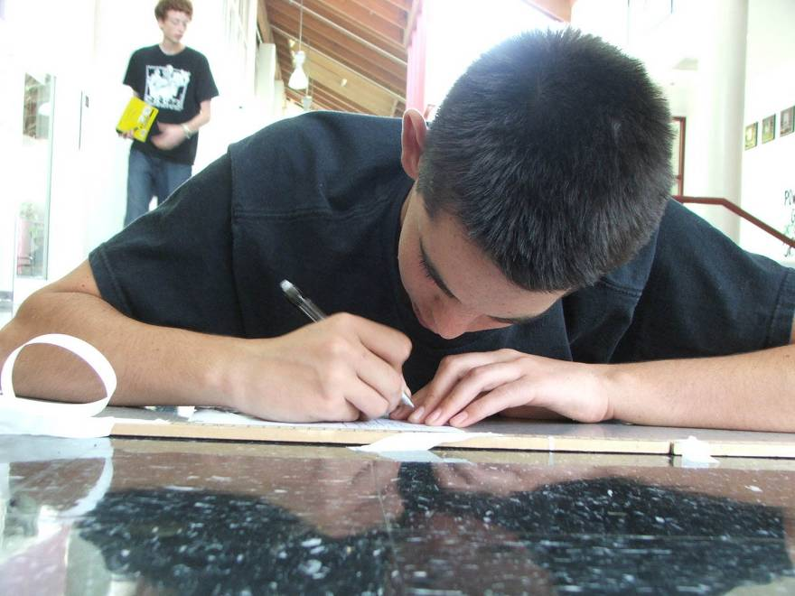
Such concentration!

Slide 12
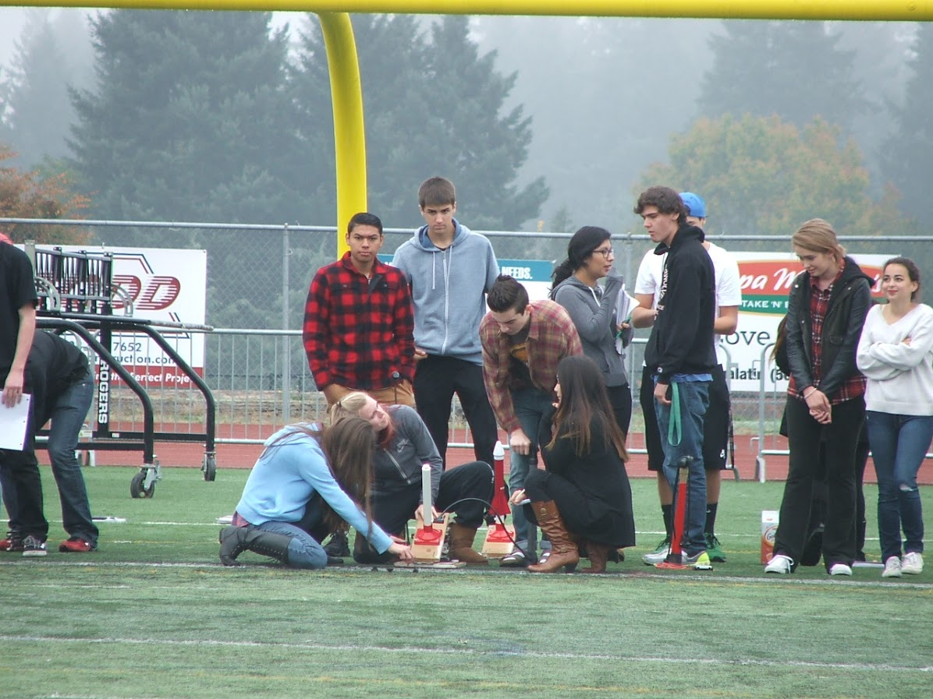
Rocket target competition

Slide 13
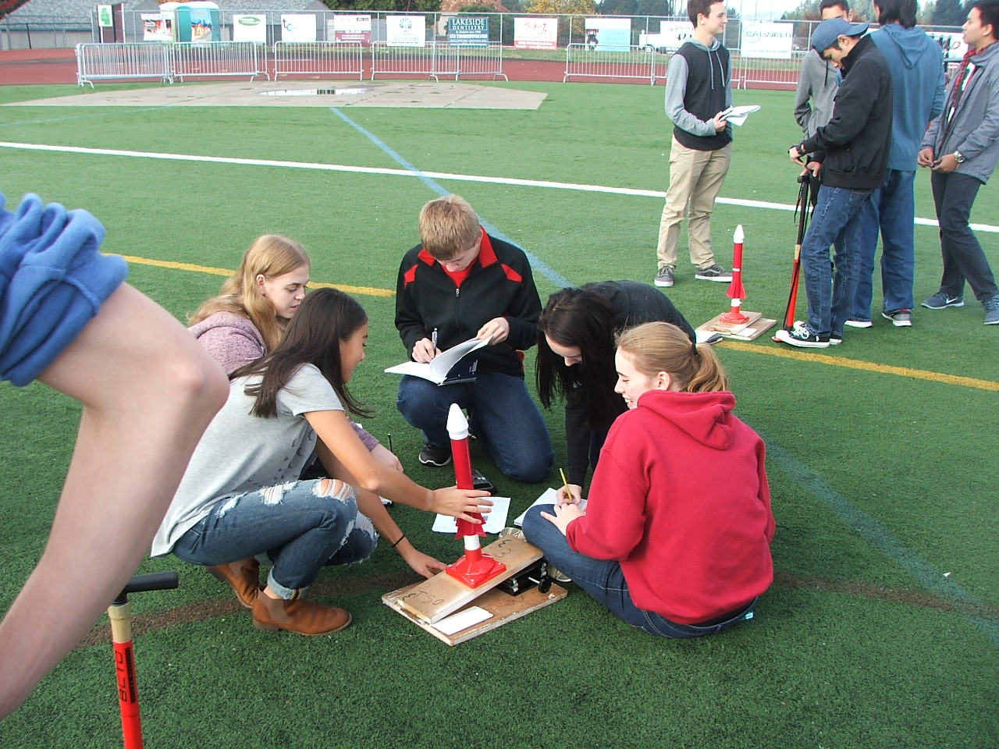
Target bearing two nine seven niner…..

Slide 14
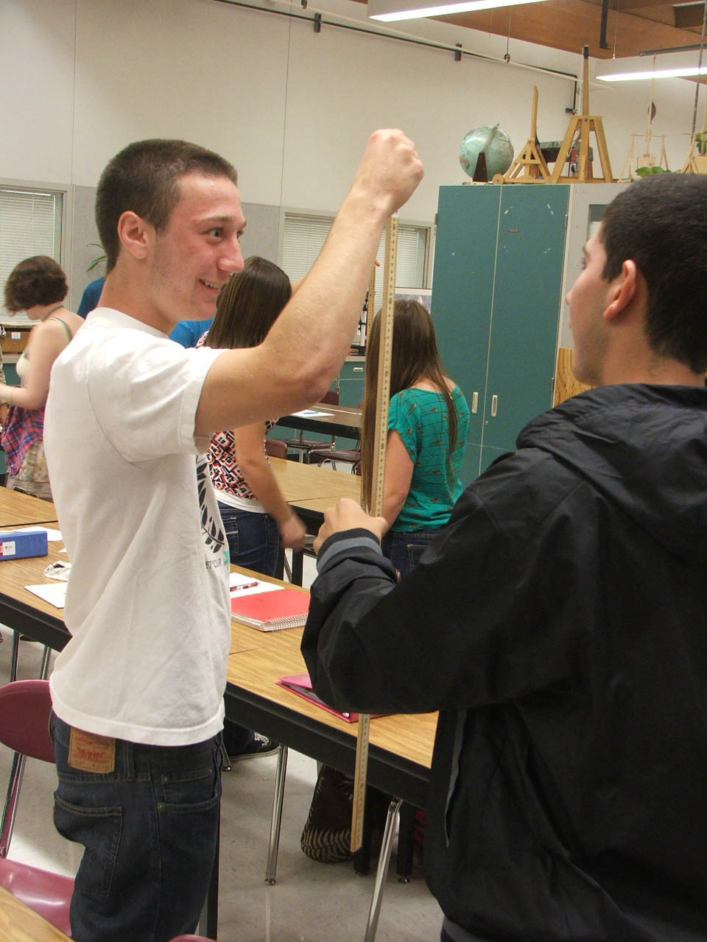
Reaction Time Lab

Slide 15
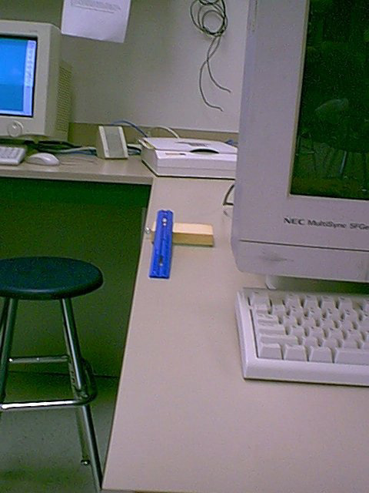
Where will the marble land?

Slide 16
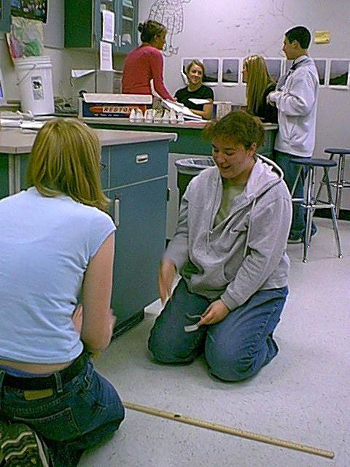
Predictions are made…

Slide 17
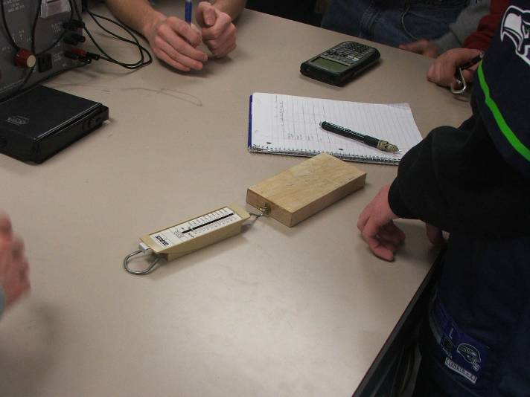
On what does friction depend?

Slide 18
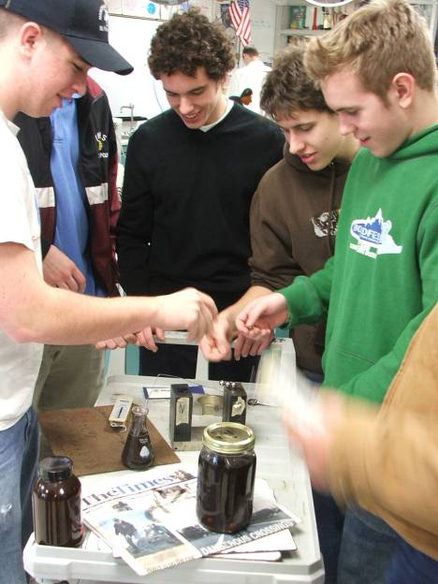
Magnetic Fluids

Slide 19
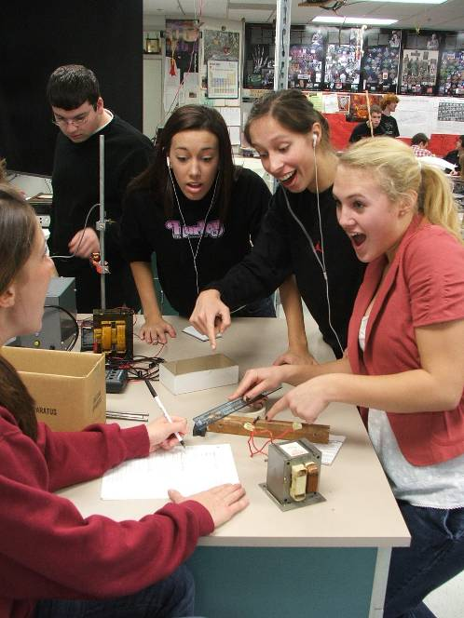
How far will the magnets go when you release them?

Slide 20
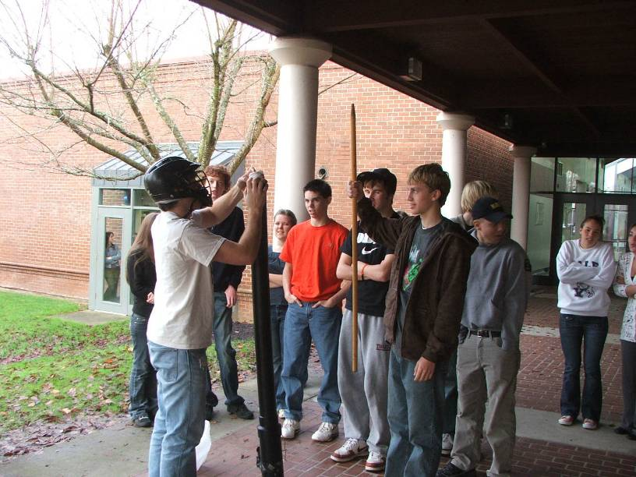
I’m a-goin’ Lion Huntin’

Slide 21
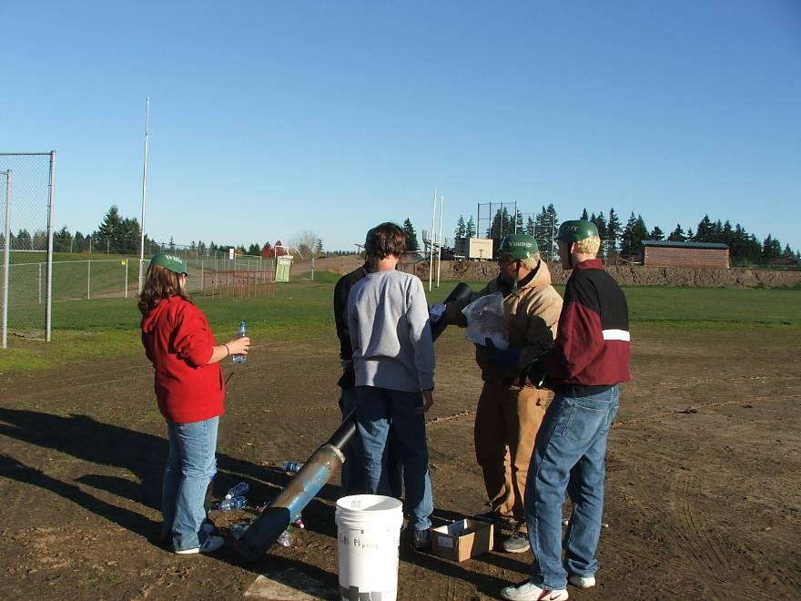
Don’t do this at home (dry ice cannon)

Slide 22
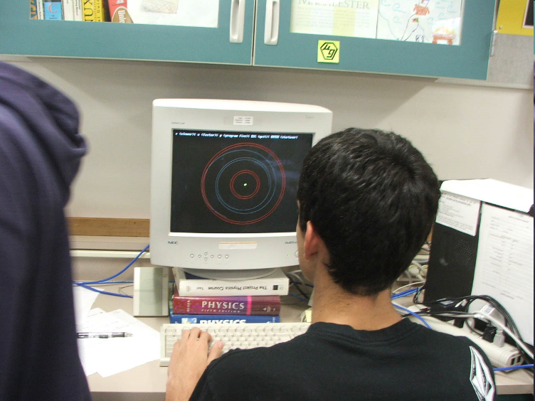
Computer simulation of orbit

Slide 23
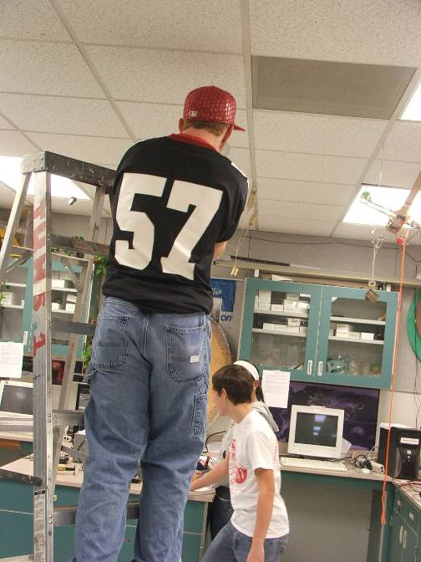
Advanced Statics

Slide 24
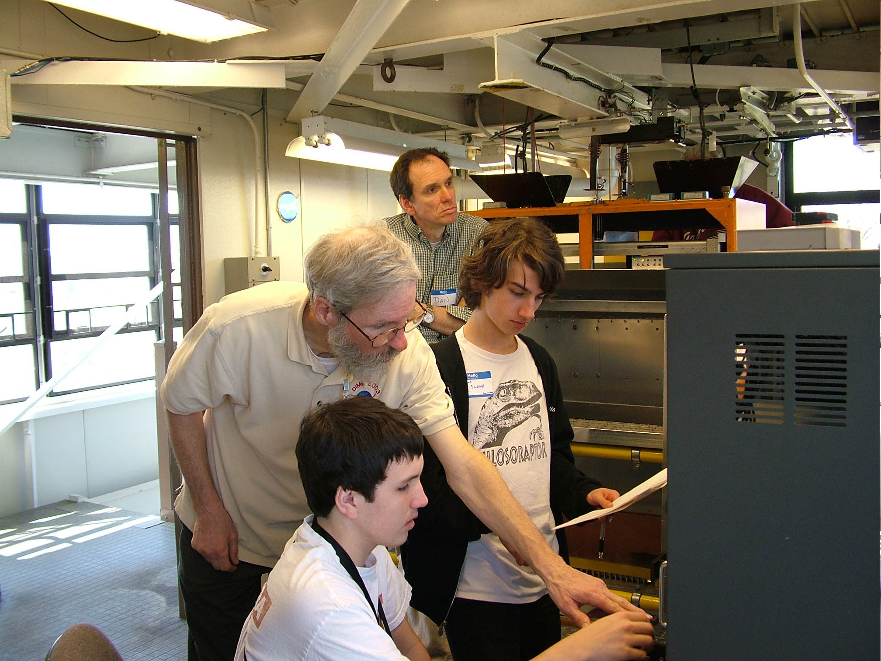
Creating a droplet in zero gravity at NASA GRC

Slide 25
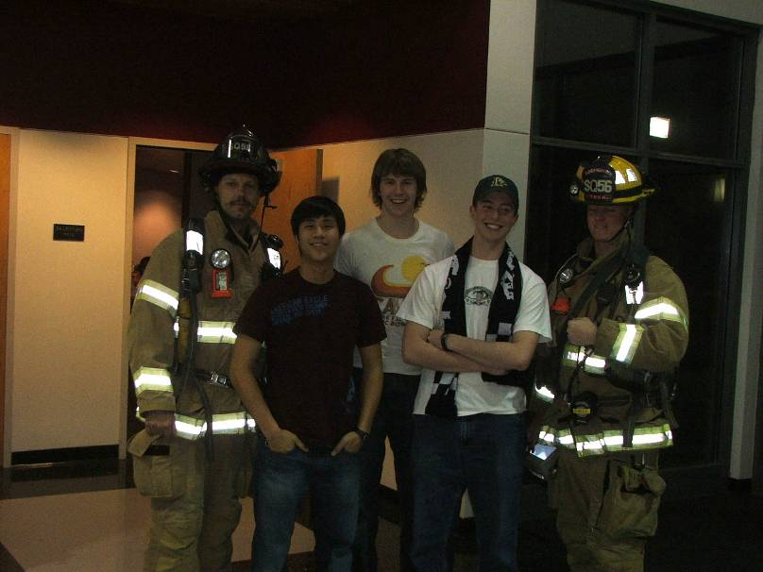
Where there’s smoke, there’s Physics!

Slide 26
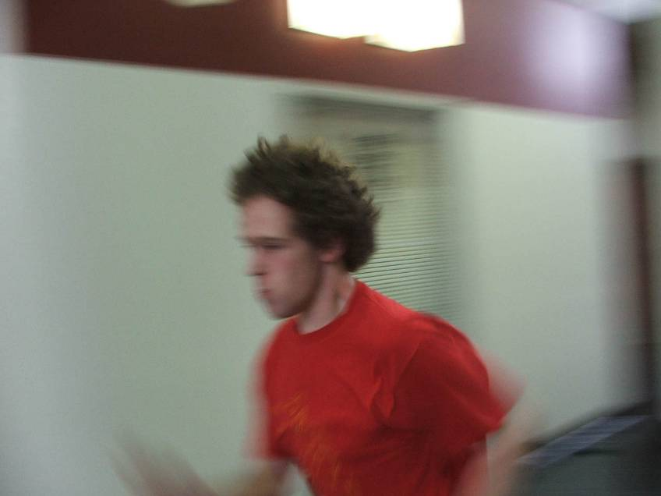
Faster than a speeding bullet (Human power output)

Slide 27
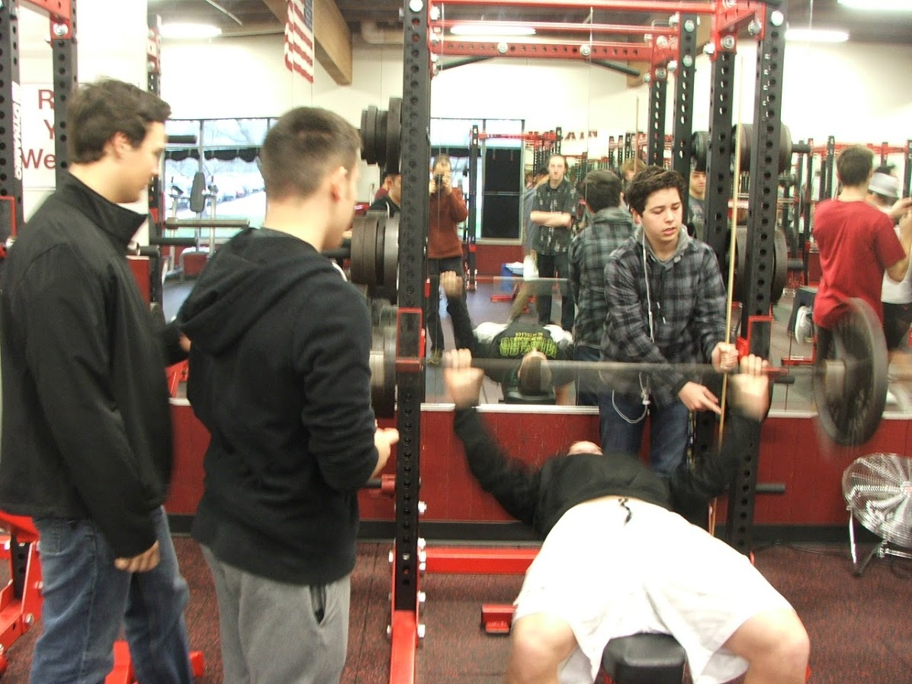
Check out those muscles!

Slide 28
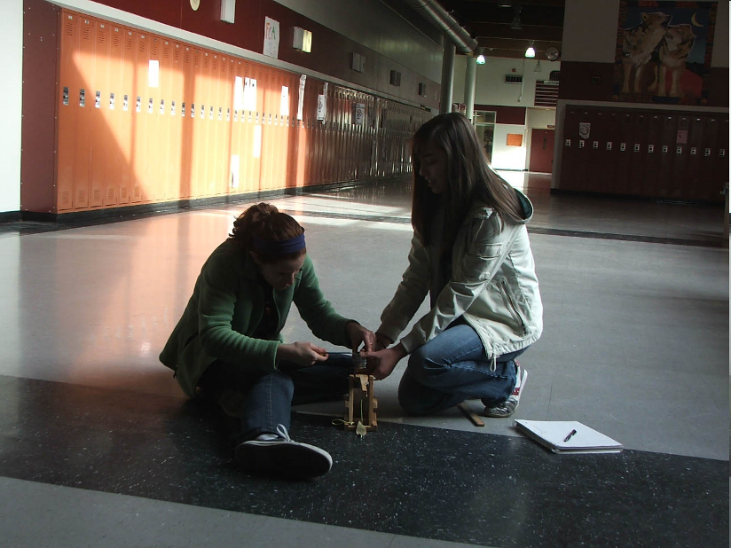
Even a very small trebuchet is fun for all…

Slide 29
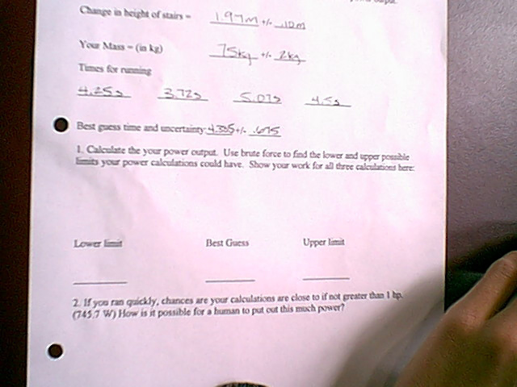
What do I do now, Teacher?

Slide 30
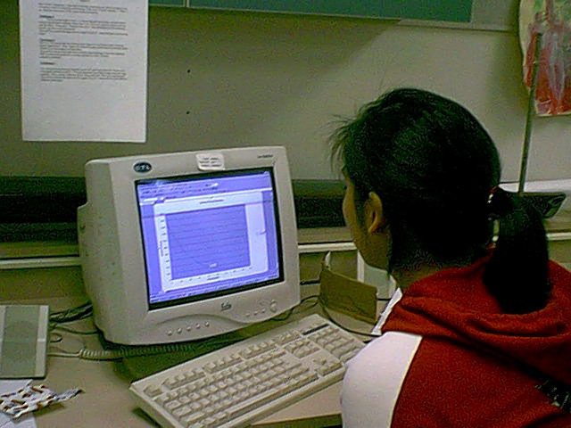
Nuclear decay simulation

Slide 31
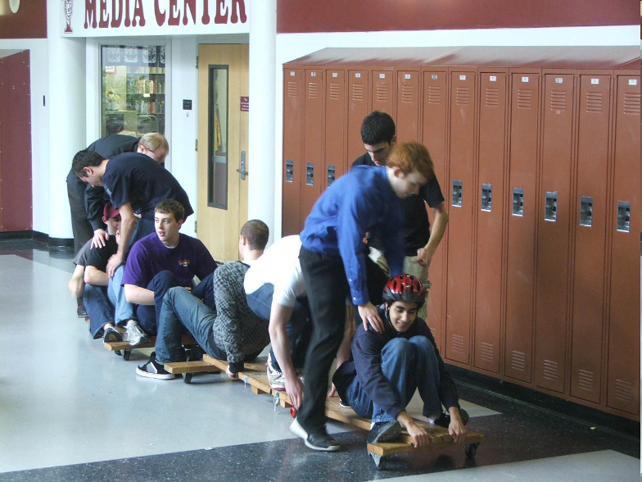
Three stage human rocket

Slide 32
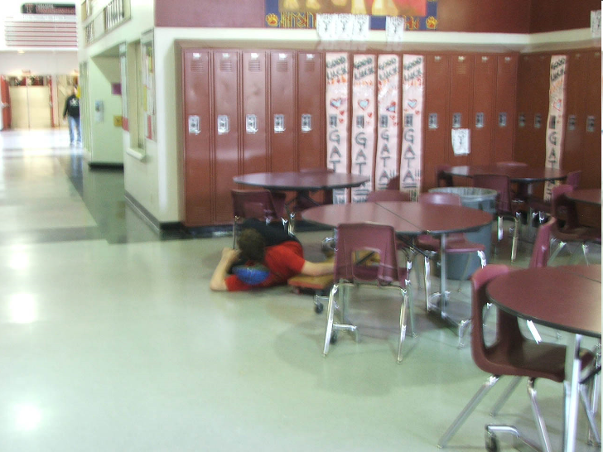
OK…That didn’t work

Slide 33
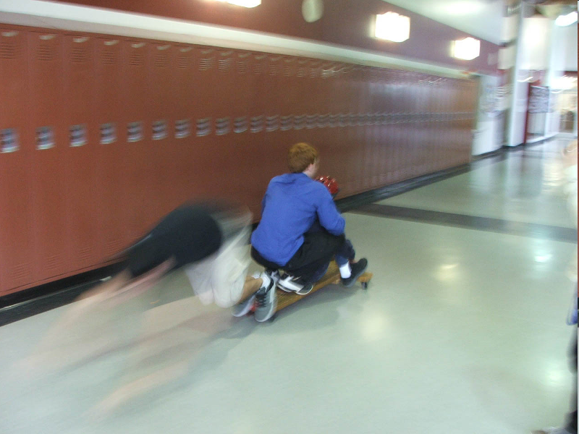
We who are about to die salute you

Slide 34
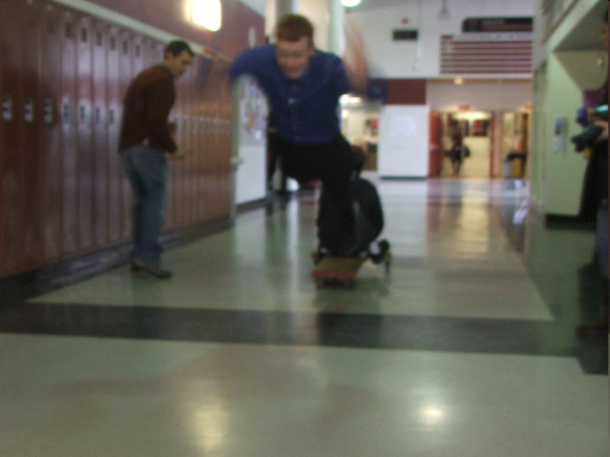
It’s a little too late to reconsider your options!

Slide 35
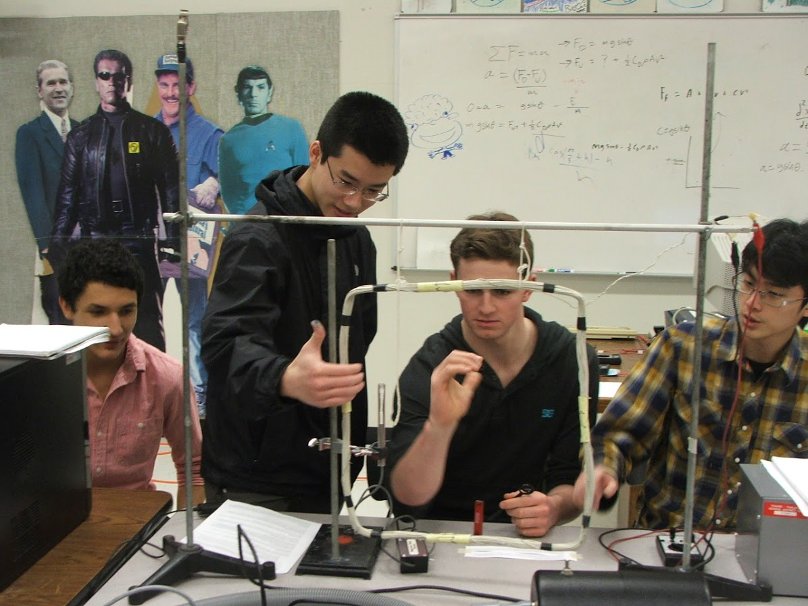
What are we doing?

Slide 36
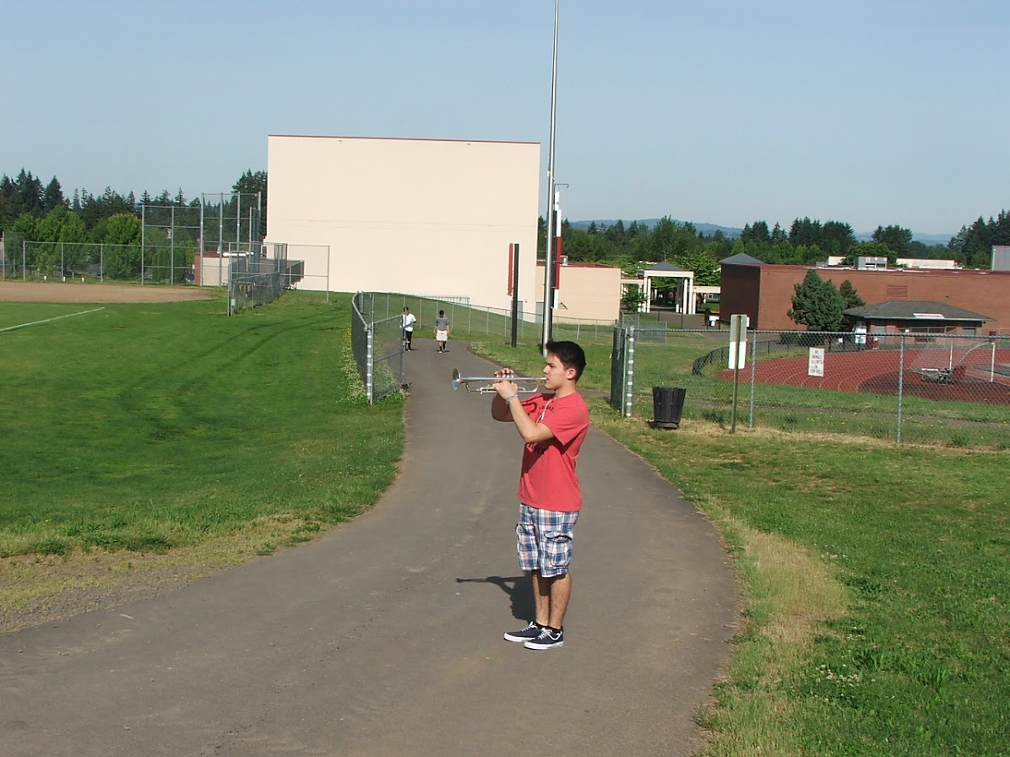
Measuring the speed of sound

Slide 37
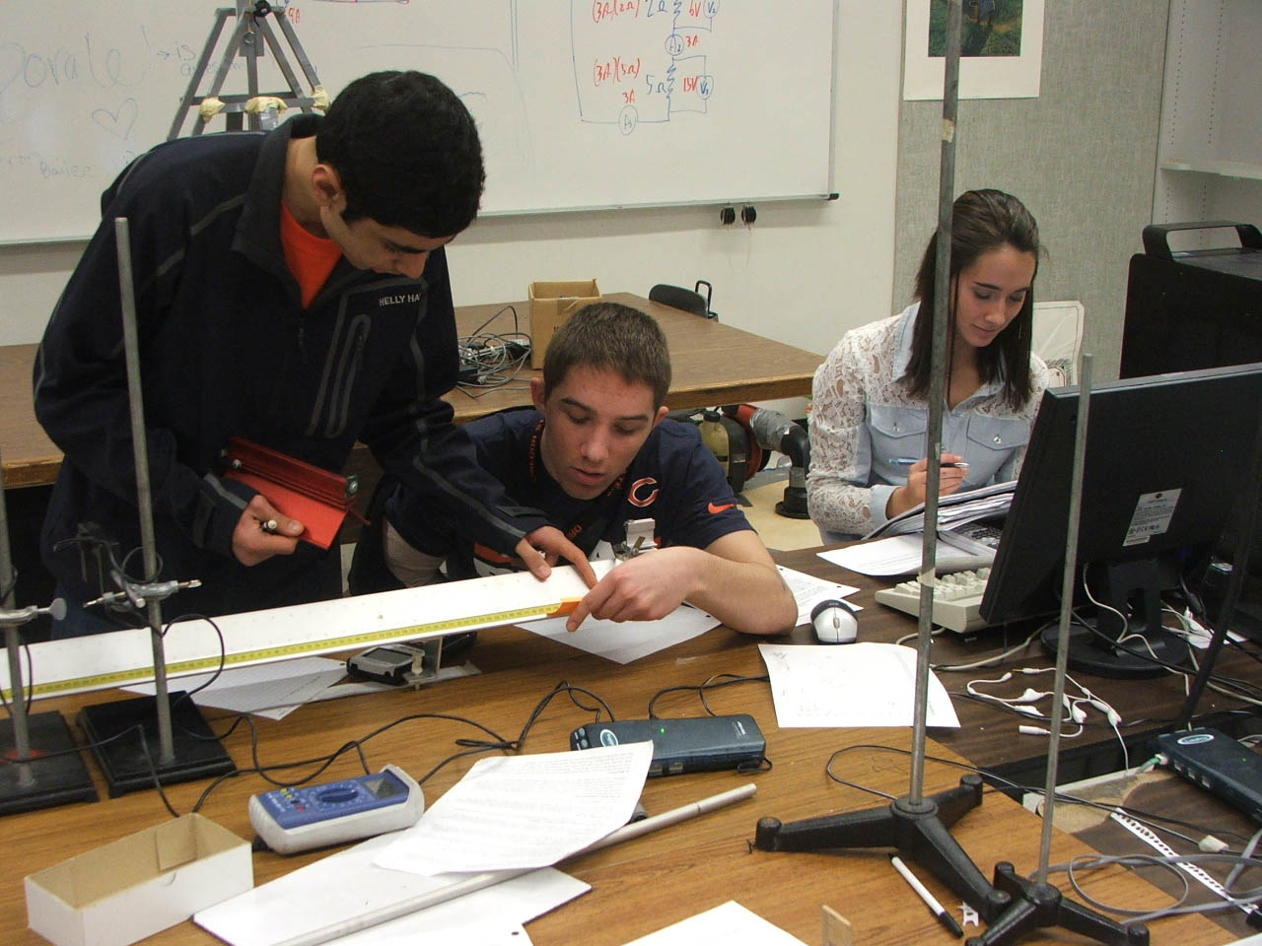
Conservation of momentum

Slide 38
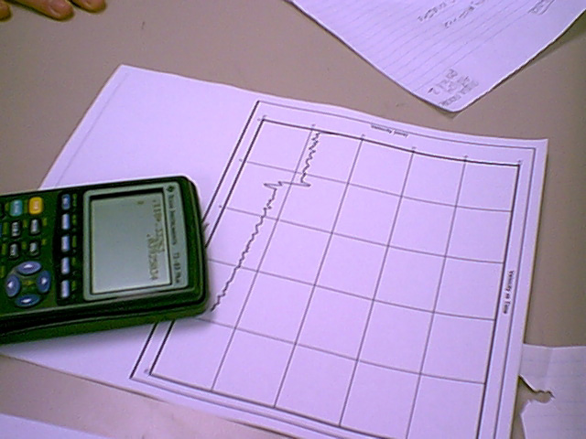
The speed goes down in the collision..

Slide 39
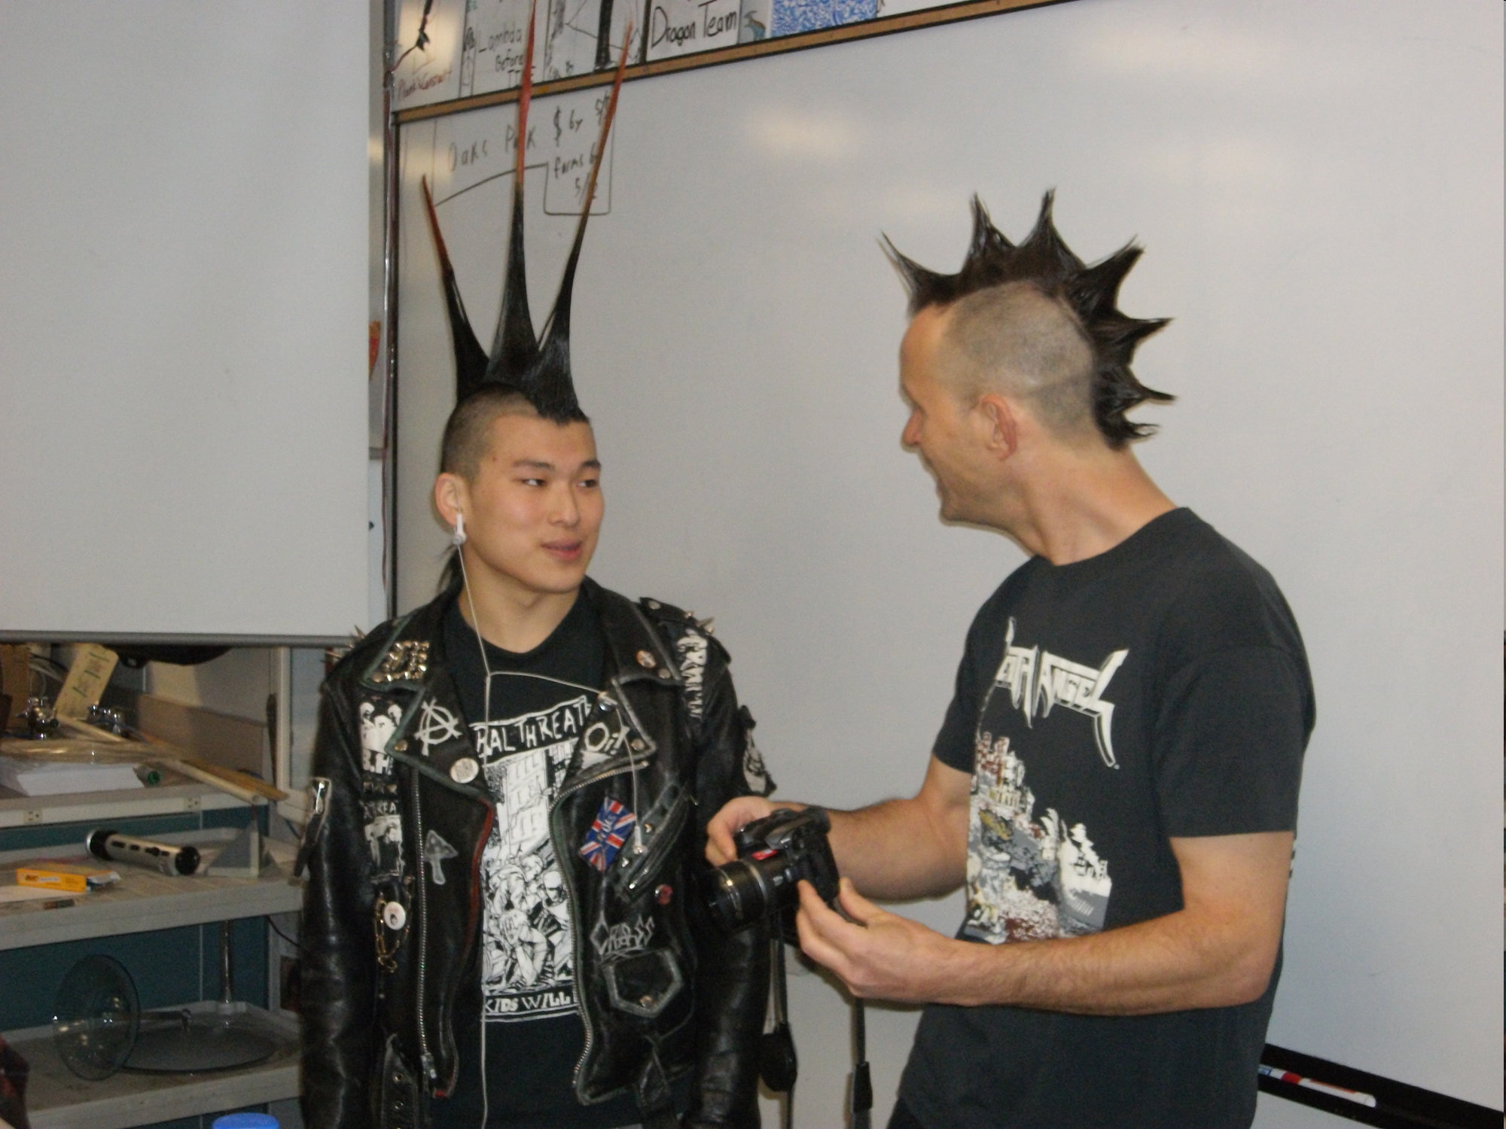
Mohawk meet mohawk comin through the rye

Slide 40
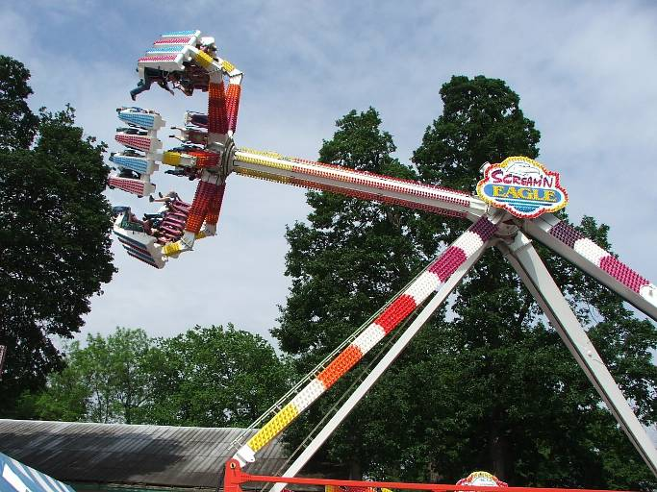
Oaks Park!!!

Slide 41
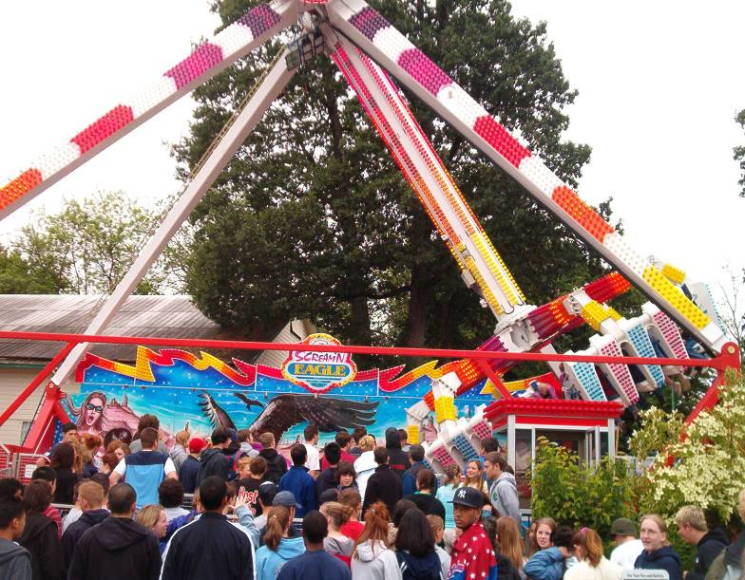
The Screaming Eagle!

Slide 42
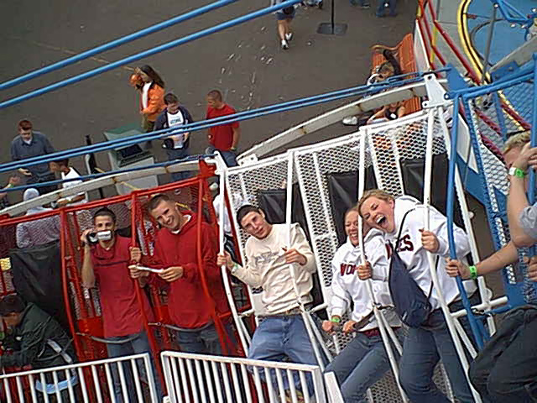
Round Up!

Slide 43
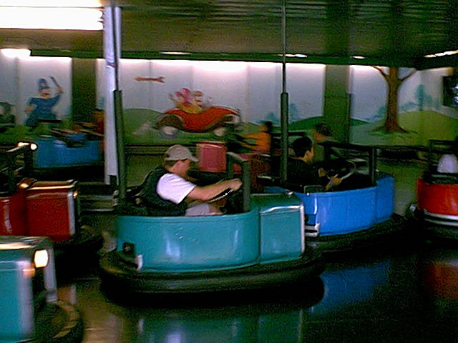
Duggan homing in for the kill…..

Slide 44
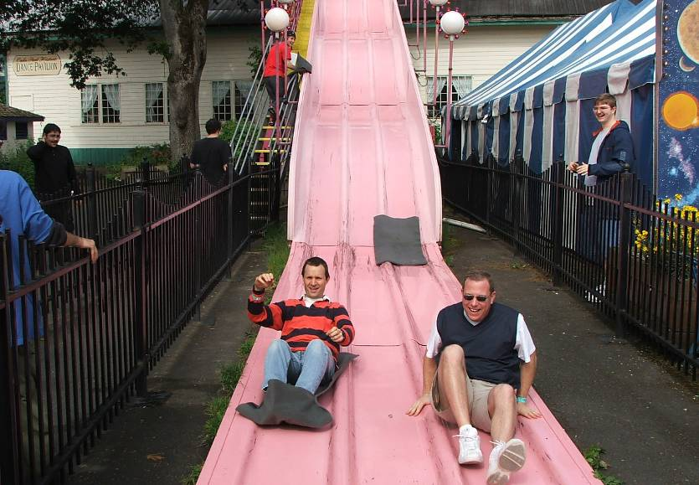
Mr. Murray won…

Slide 45
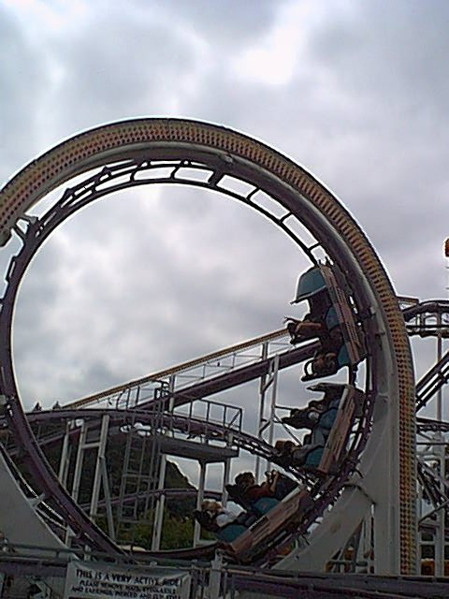
Yes - it goes upside down

Slide 46
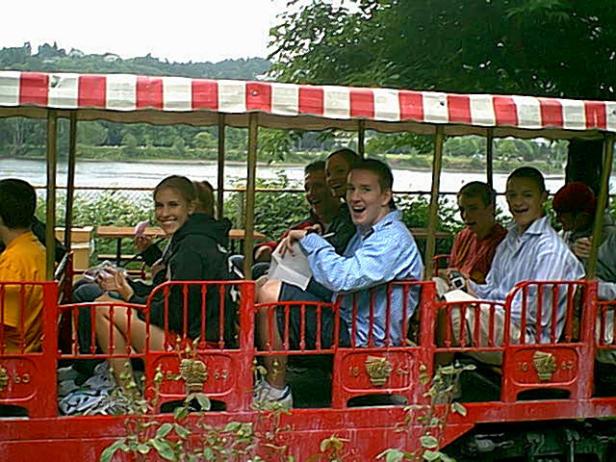
The train is very fun for all!

Slide 47
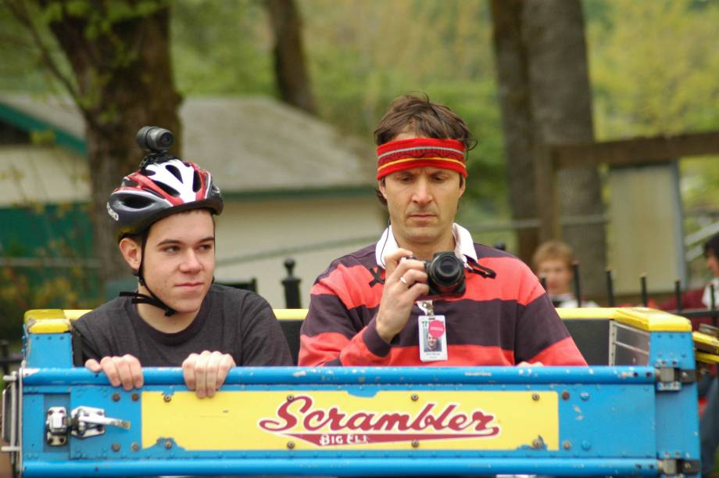
The Uber Geeks

Slide 48
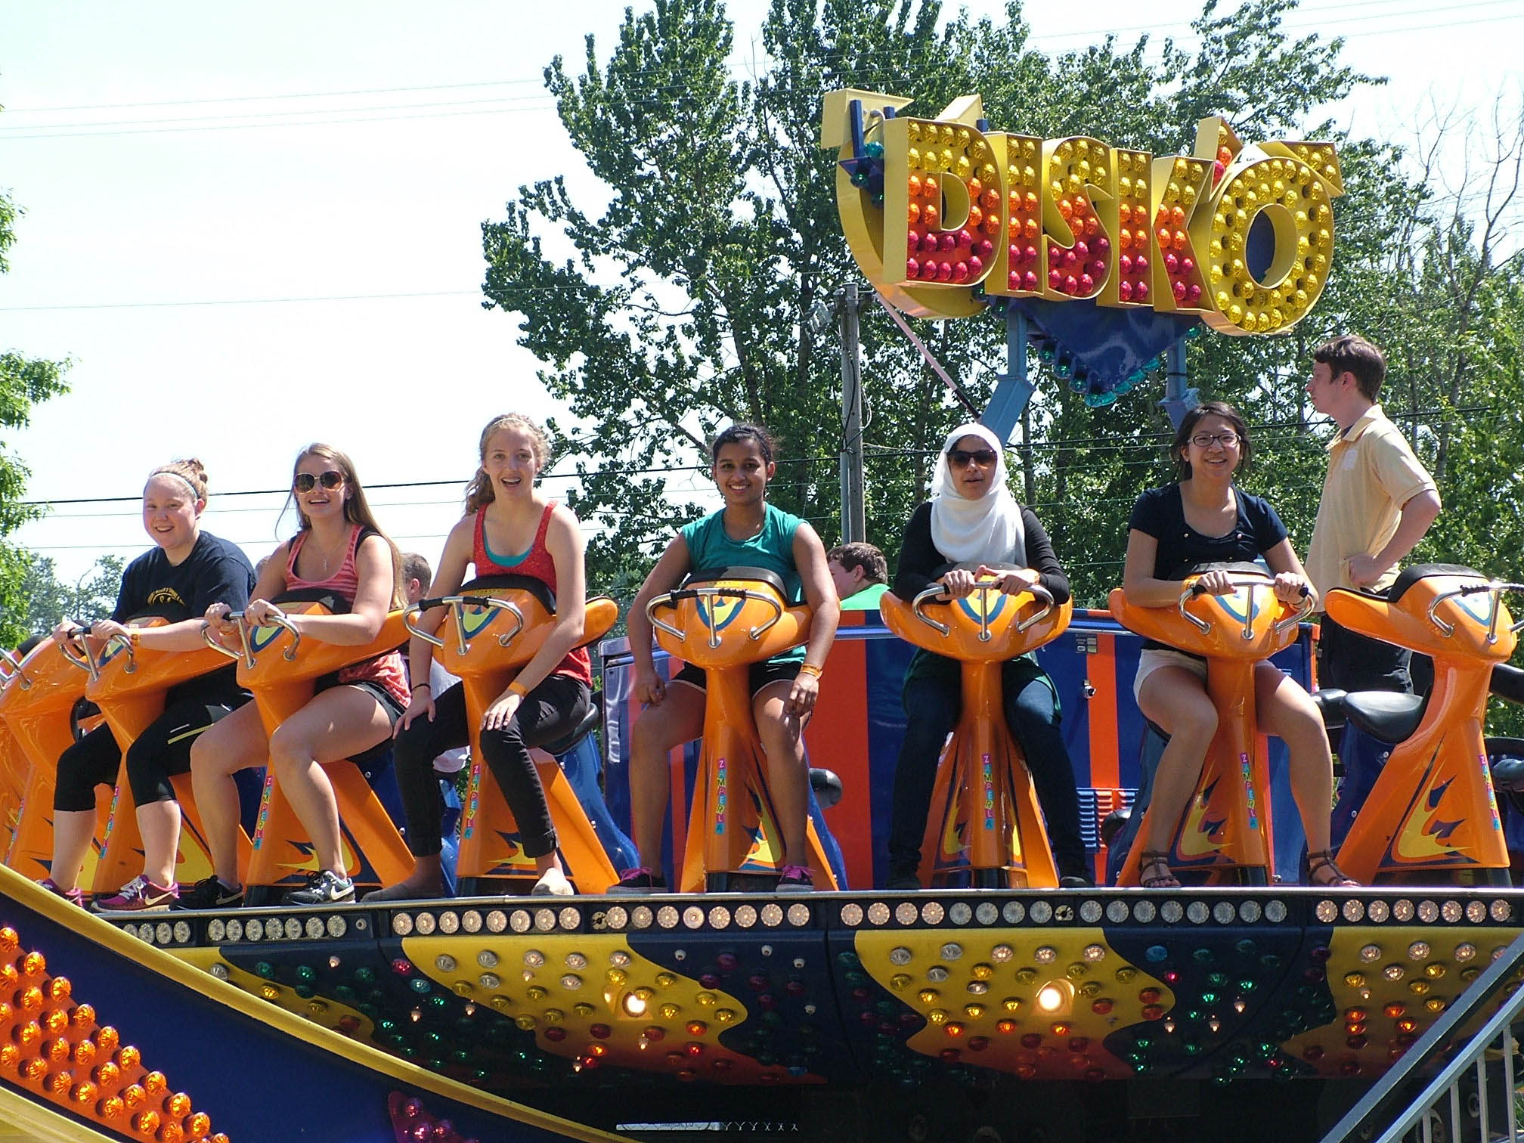
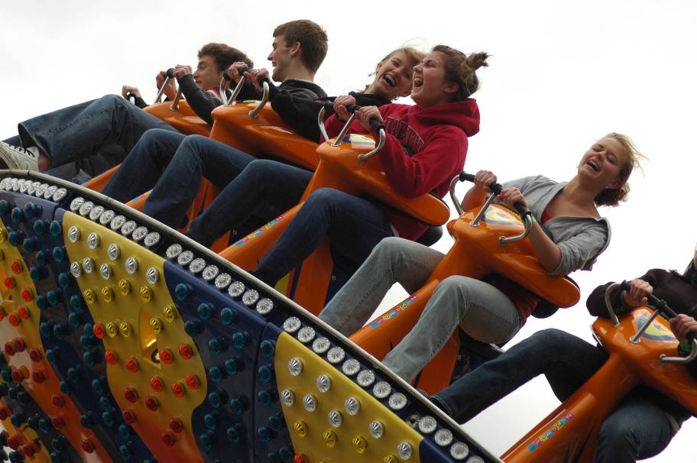
The Disk-O is fun for some, but not for all

Slide 49
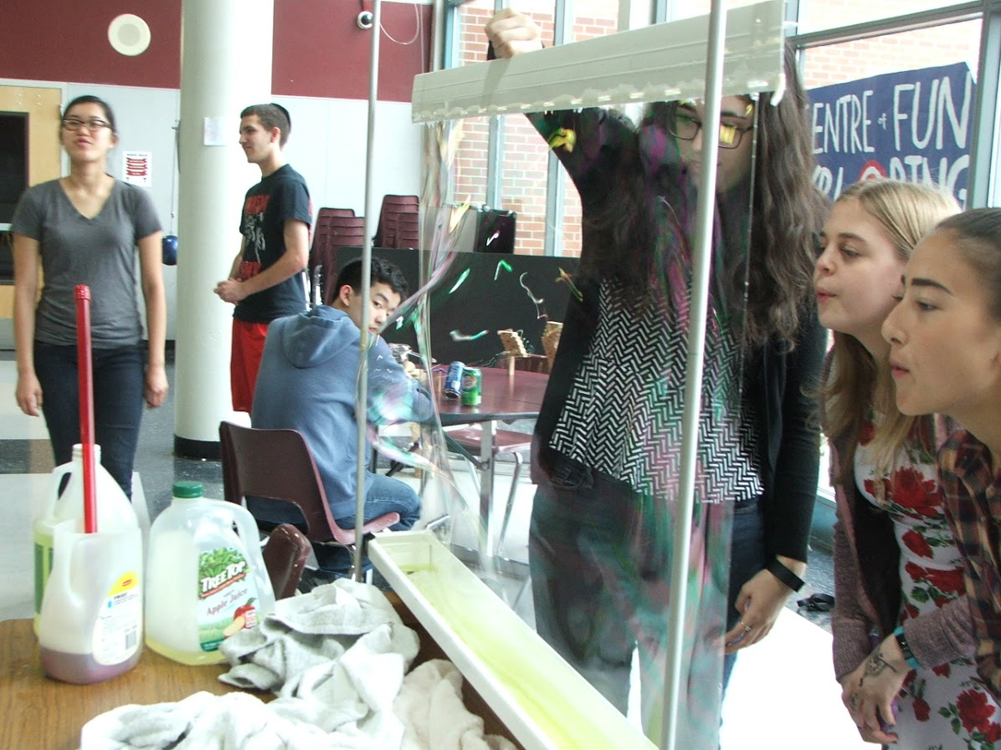
Physics Extravaganza at TuHS

Slide 50
Harmonographs

Slide 51
A harmonograph is fun for everyone

Slide 52
Our drop tower

