Slide 1
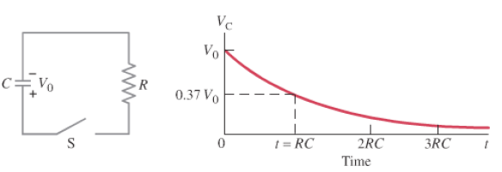
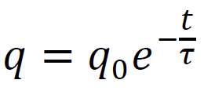
Discharge
derive, dV/dt =
-(dq/dt)/C
demo - RC
R is in V/A, C is in C/V
V = electrical potential (V)
V_{o} = initial (etc)
q = charge (C)
I = current (Amperes A (C/s))
t = time (s)
R = resistance (ohms Ω (V/A))
C = capacitance (F)

Slide 2
A 47.0 μF capacitor is charged to 12.0 V initially, and discharged through a 100. kΩ resistor.
What is its voltage at 13.0 s into the discharge? (0.755 V)
At what time does it reach 6.0 V? (3.26 s)

Slide 3
Whiteboards:
RC decay
1-4

Slide 4
A 100. µF capacitor is attached in parallel with a 1.00 MΩ resistor. If it is initially charged to 5.00 V, what is the voltage 35.0 seconds after it starts to discharge?
solution
3.52 V

Slide 5
A 4.7 µF capacitor is attached to a 2.2 MΩ resistor in parallel. After 78 seconds of discharge there is 0.023 µC of charge on the capacitor. What was the original charge?
solution
43 µC

Slide 6
A discharging parallel RC circuit starts at 12.00 V, and after 312 s has reached 4.00 V. A. What is the time constant? B. What is the resistance if the capacitor has a value of 22.0 µF?
solution
284 s, 12.9 MΩ

Slide 7
A discharging parallel RC circuit has an initial discharge current of 195 mA, and is at a current of 162 mA at a time of 35.0 seconds into its discharge. What will be the current at 72.0 s?
solution
133 mA

