Slide 1
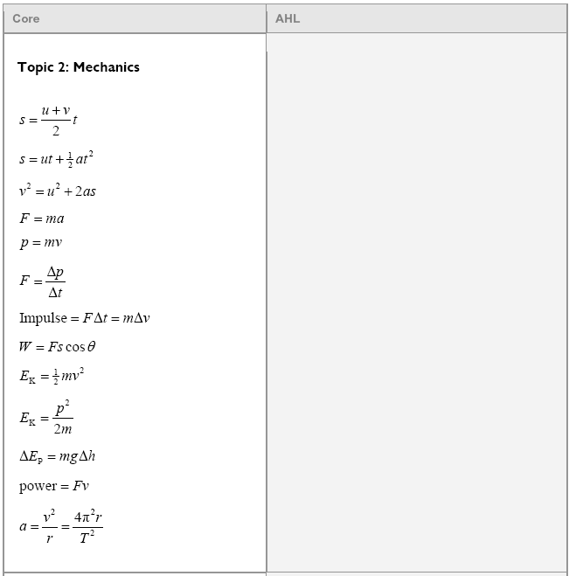
v = u + at ?????
Linear Kinematics

Slide 2
An air rocket leaves the ground straight up, and strikes the ground 4.80 seconds later.
What time does it take to get to the top?
How high does it go?
What was its initial velocity?
What is the velocity at elevation 21.0 m?
2.4 s, 28.2 m, 23.5 m/s, + or - 11.9 m/s

Slide 3
2-Dimensional Motion
H
V
s
u
v
a
t
s
u
v
a
t
A_{v} = A sinθ
θ
A_{H} = A cosθ
Pythagorean x² + y² = hyp²

Slide 4
V = 9.21 m/s
t = 2.17 s
How far out does she land?
How high is the cliff?
What is the velocity of impact in VC Notation?
What is the velocity of impact? (in AM Notation)
20.0 m, 23.1 m,
9.21 m/s x + -21.3 m/s y
23.2 m/s 66.6º below horiz

Slide 5
Find vector components
Fill in your H/V table of suvat
Find the horizontal distance traveled
Find velocity of impact in angle magnitude
v = 126 m/s
angle = 43.0º
The cliff is 78.5 m tall
1690 m, 133 m/s@ 46.3º

Slide 6
Dynamics

Slide 7
Find the force:
F = ma,
wt = 1176 N downward
<F – 1176 N> = (120. kg)(-4.50 m/s/s)
F – 1176 N = -540 N
F = 636 N
…
F
120. kg
a = -4.50 m/s/s
(DOWNWARD)
636 N

Slide 8
A 120 mW laser uses a wavelength of 656 nm.
What is the energy and momentum of a photon of light at this wavelength?
How many photons per second does it emit?
What force would it exert on an object that absorbs the photons?
How would that change if the photons were reflected?
3.030E-19 J, 1.010E-27 kg m/s, 3.960E17 photons/sec, 4.00E-10 N

Slide 9
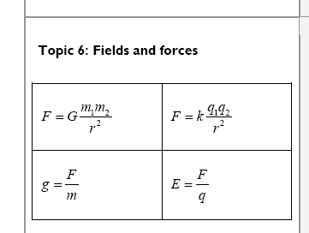
Also on page 8:
Gravity and Circular Motion

Slide 10
A Volkswagen can do .650 “g”s of lateral acceleration. What is the minimum radius turn at 27.0 m/s? (3)
a = v²/r
1g= 9.81 m/s/s
a = (9.81 m/s/s)(.650) = 6.3765 m/s/s
6.3765 m/s/s = (27.0 m/s)²/r
r = (27.0 m/s)²/(6.3765 m/s/s) = 114.326 m
r = 114m
114m

Slide 11
What should be the period of motion if you want 3.5 “g”s of centripetal acceleration 5.25 m from the center of rotation?
a = 4π²r/T²
a = (3.5)(9.8 m/s/s) = 34.3 m/s/s
34.3 m/s/s = 4π²(5.25 m)/T²
T = 2.5 s
…
2.5 s

Slide 12
Ice skates can give 420 N of turning force. What is r_{min} for a 50.kg skater @10.m/s?
F=ma, a=v²/r
F=mv²/r
420 N = (50 kg)(10.m/s)²/r
r = (50 kg)(10.m/s)²/(420 N)
r = 11.9m
11.9m

Slide 13
The moon has a mass of 7.36 x 10²² kg, and a radius of 1.74 x 10⁶ m. What does a 34.2 kg mass weight on the surface?
r = Center to center distance
m₁ = One of the masses
m₂ = The other mass
G = 6.67 x 10⁻¹¹ Nm²/kg²
F = Gm₁m₂
r²
F = 55.5 N
…
55.5 N

Slide 14
At what distance from the moon’s center is the orbital velocity 52.5 m/s?
M_{m} = 7.36 x 10²² kg
m_{s}v²
r
= Gm_{s}m_{c}
r²
r = Gm_{c}
v²
1781086621 m
1.78 x 10⁹ m

Slide 15
Also
Power = work/time
E_{elas} = ¹/₂kx²
Energy

Slide 16
15 kg
v_{i} = 5.8 m/s
What speed at the bottom?
h = 2.15 m
Fd + mgh + ¹/₂mv² = Fd + mgh + ¹/₂mv²
0 + mgh + ¹/₂mv² = 0 + 0 + ¹/₂mv²
(15 kg)(9.8 N/kg)(2.15 m) + ¹/₂(15 kg)(5.8 m/s)²= ¹/₂(15 kg)v²
v = 8.7 m/s
…
8.7 m/s

Slide 17
Ima Wonder can put out 127 W of power. What time will it take her to do 671 J of work?
P = W/Δt,
Δt = W/P = (671 J)/(127 W) = 5.28 s
5.28 s

Slide 18
Frieda People can put out 430. W of power. With what speed can she push a car if it takes 152 N to make it move at a constant velocity?
P = Fv
v = P/F = (430. W)/(152 N) = 2.83 m/s
2.83 m/s

Slide 19
What must be the power rating of a motor if it is to lift a 560 kg elevator up 3.2 m in 1.5 seconds?
11700 W

Slide 20
Momentum

Slide 21
Jolene exerts a 50. N force for 3.00 seconds on a stage set. It speeds up from rest to .25 m/s. What is the mass of the set?
(m)(Δv) = (F )(Δ t)
(m)(.25 m/s) = (50. N )(3.0 s)
m = (50. N )(3.0 s)/(.25 m/s) =
600 kg = 6.0 x10² kg
…
6.0 x10² kg

Slide 22
Before
+
After
6.20m/s
1.20 m/s
v = ?
13.0 kg
17.0 kg
13.0 kg
17.0 kg
(13kg+17kg)(6.2m/s) = (13kg)(-1.2m/s)+(17kg)v
186kgm/s = -15.6kgm/s+(17kg)v
201.6kgm/s = (17kg)v
(201.6kgm/s)/(17kg) = 11.9 m/s = v
…
11.9 m/s

