Slide 1
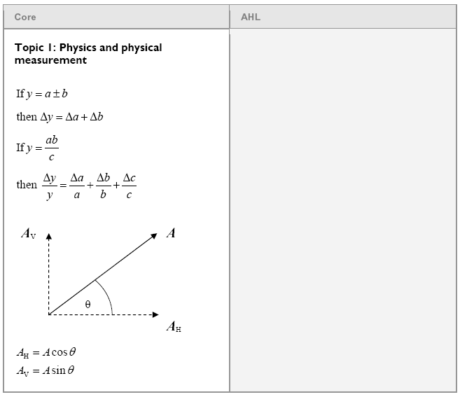
Topic 1: Uncertainty and vector components

Slide 2
Rule for addition and subtraction
The uncertainty of a sum or difference is always the sum of the uncertainties
If y = a + b then Δy = Δa + Δb
Δ - uncertainty in
(2.3 ± .1)
+ (3.6 ± .3)
5.9 ± .4
(7.6 ± .4)
- (2.5 ± .3)
5.1 ± .7
TOC

Slide 3
Express the answer with the correct uncertainty
(45 ± 3) + (12 ± 2) = ??
57 ± 5
57 ± 5
W

Slide 4
Uncertainty and vector components

Slide 5
Rule for multiplication and division
The fractional uncertainty of a product or quotient is the sum of the fractional uncertainty of the operands: (??)
Example -
(5 ± 10%)
x (20 ± 15%)
(100 ± 25%)
TOC

Slide 6
Express the answer with the correct % uncertainty
(6 ± 3%) x (8 ± 2%) = ??
6x8 = 48
uncty = 3% + 2% = 5%
48 + 5%
W
48 + 5%

Slide 7
Rule for multiplication and division
The fractional uncertainty of a product or quotient is the sum of the fractional uncertainty of the operands: (??)
If y = ab, then Δy = Δa + Δb + Δc
c y a b c
Δ - uncertainty in…
TOC

Slide 8
Rule for multiplication and division
If y = ab, then Δy = Δa + Δb + Δc
c y a b c
Example:
A metal plate measures 21.1 + .5 cm by 15.3 + .1 cm. What is its area?
Find the area:
21.1 x 15.3 = 322.83
Use the formula:
Δy = .5 + .1
322.83 21.1 15.3
Δy = 9.76 ≈ 10
320 + 10 cm²
TOC

Slide 9
Express the answer with the correct uncertainty
(45 ± 1) x (12 ± 1) = ??
12 x 45 = 540
uncty = 540(1/45+1/12) = 57
540 ± 60
540 ± 60
W

Slide 10
Uncertainty and vector components

Slide 11
Vectors - Finding Components - step by step
θ = 180º – 27º = 153º
12 m
x = (12 m)Cos(153º) = -10.692 m
27º
y = (12 m)Sin(153º) = +5.448 m
Step 2: Figure the sides
using Cos and Sin:
x = mag Cos(θ)
y = mag Sin(θ)
(iff θ = trig angle)
TOC

Slide 12
Vectors - Finding Components - step by step
12 m
27º
Step 3: Write it in Vector Component notation:
Vector = -11 m x + 5.4 m y (With sig figs)
Reality Check:
(+ and -),
relative size
TOC

Slide 13
Vectors - Try this yourself
31.0º
23.0 m/s
Draw the Components
Figure the components with sin and cos
Write the answer in VC Notation
θ = 90 + 31 = 121º
23cos(121) x + 23sin(121) y
-11.846 x + 19.715 y
TOC
-11.8 m/s x + 19.7 m/s y

Slide 14
27.0 km
32.2º
θ = 32.2º
27.0cos(32.2) x + 27.0sin(32.2) y
22.84721549 14.38765945
22.8 km x + 14.4 km y
W
22.8 km x + 14.4 km y

