Slide 1
Paper 3

Slide 2
Data Based Questions

Slide 3
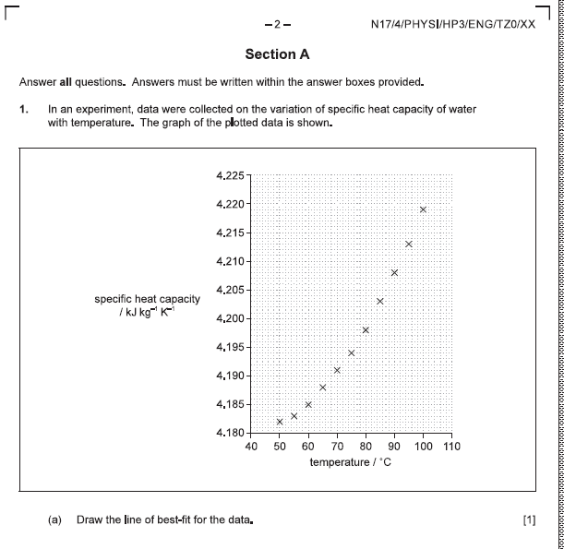

Slide 4
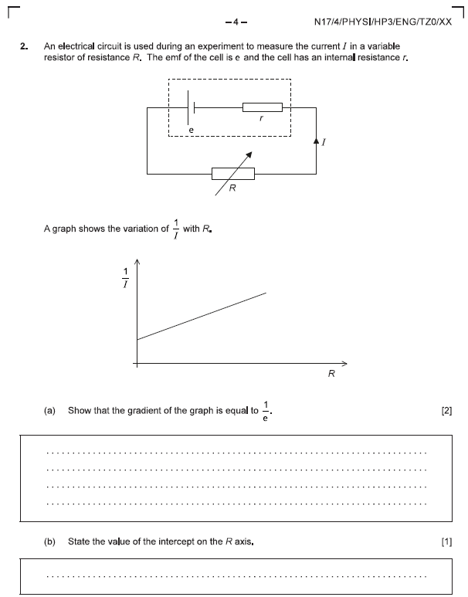

Slide 6
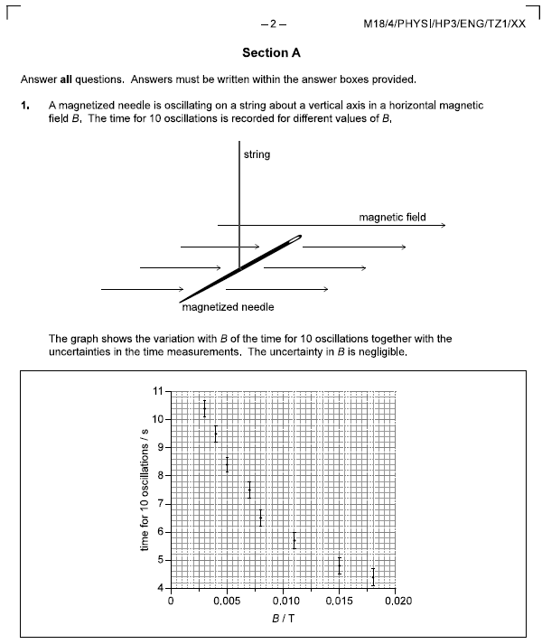

Slide 7
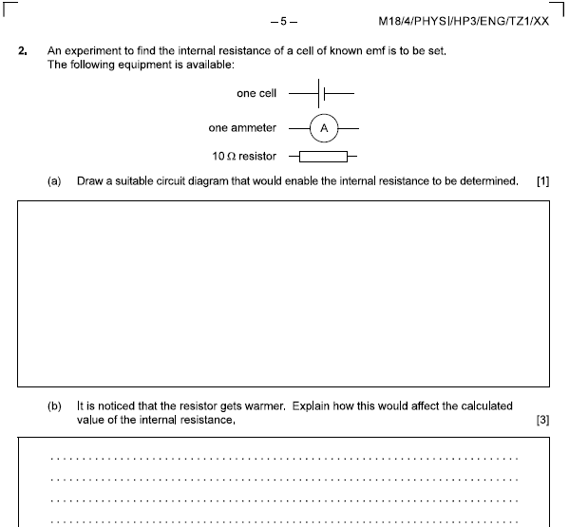

Slide 8
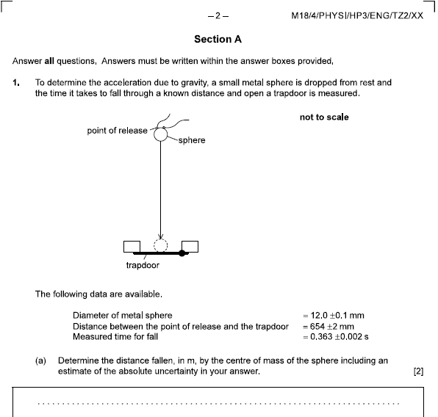

Slide 9
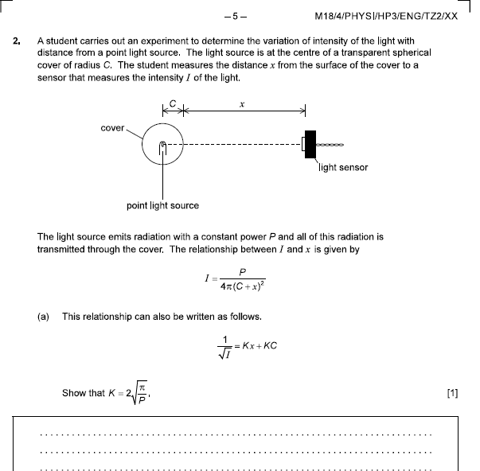

Slide 10
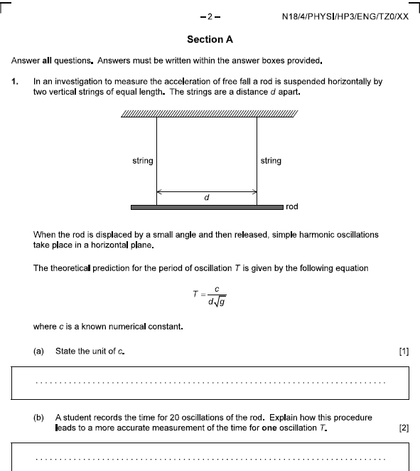

Slide 11
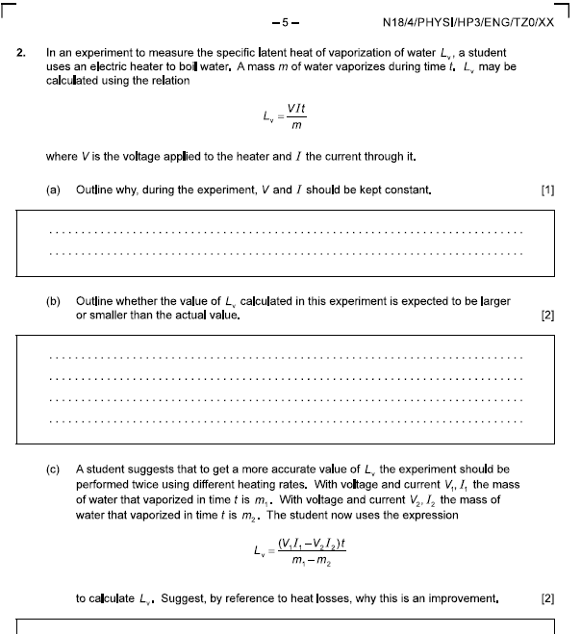

Slide 12
Rotational Motion

Slide 13
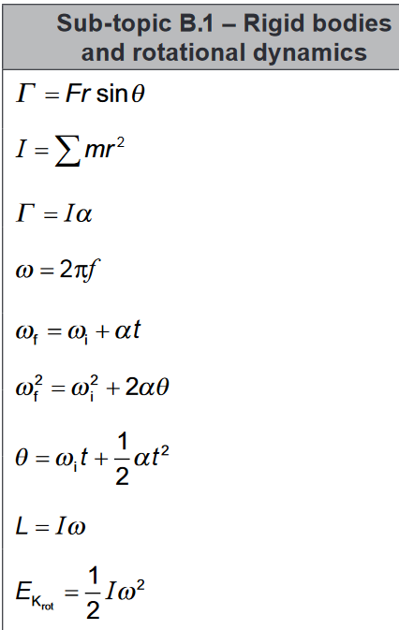

Slide 15
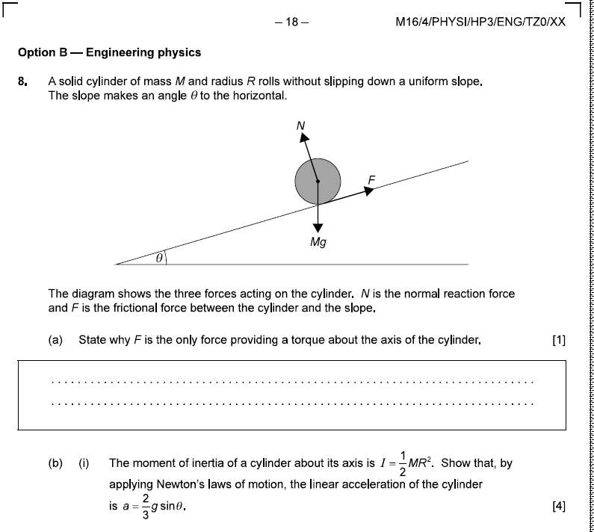

Slide 16
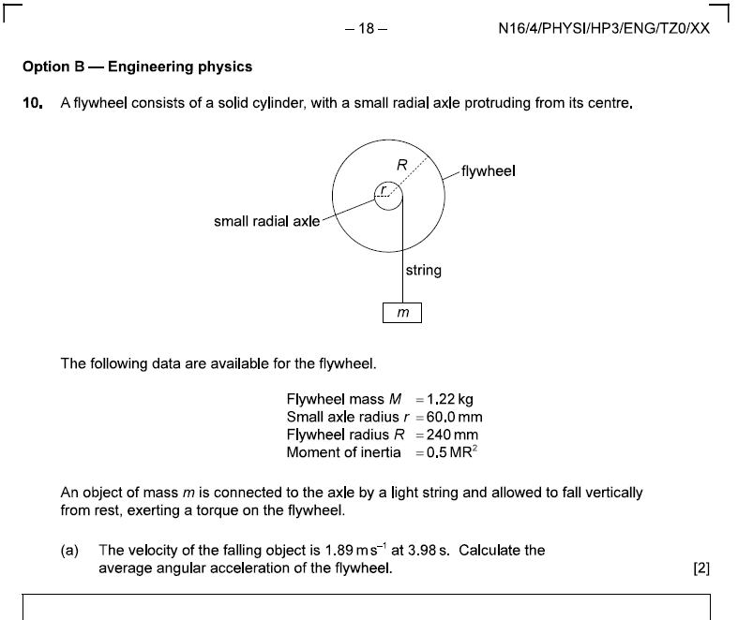

Slide 18
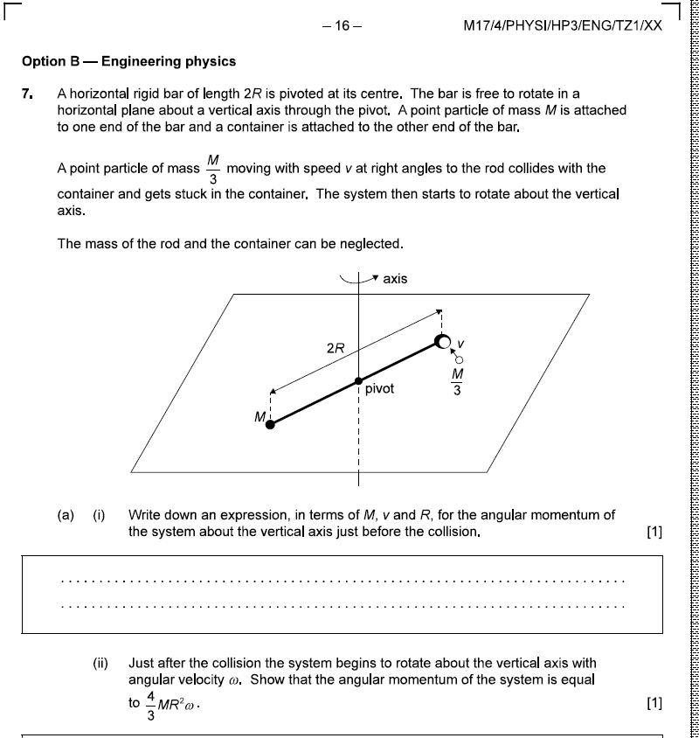

Slide 19
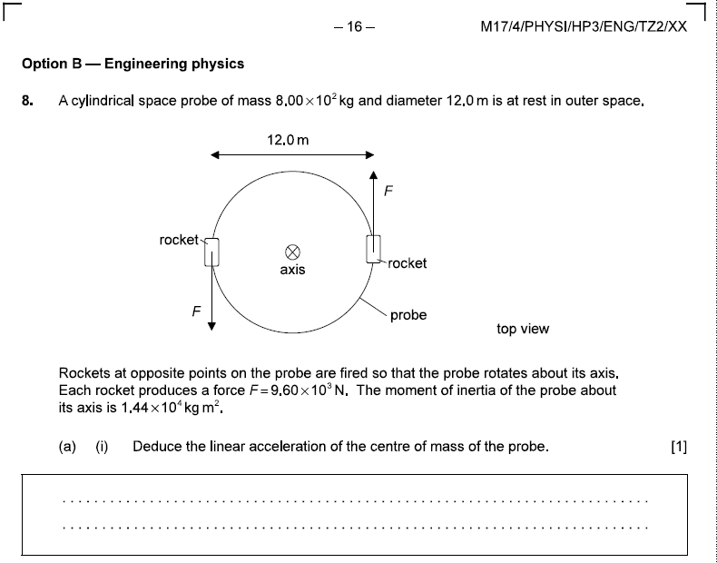

Slide 20
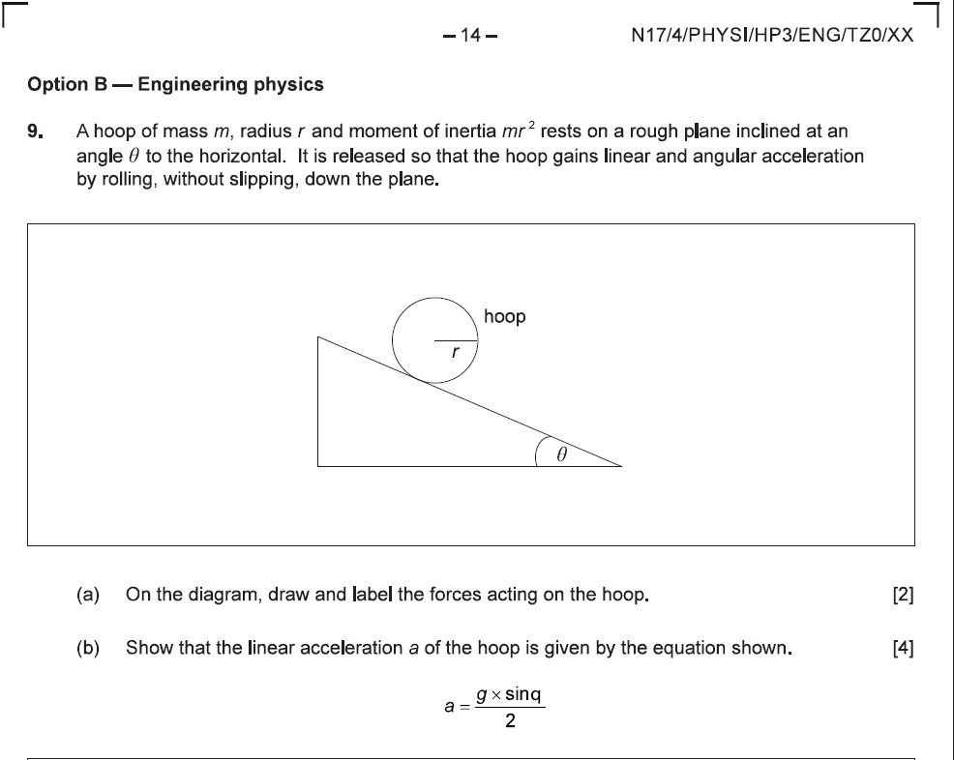

Slide 21
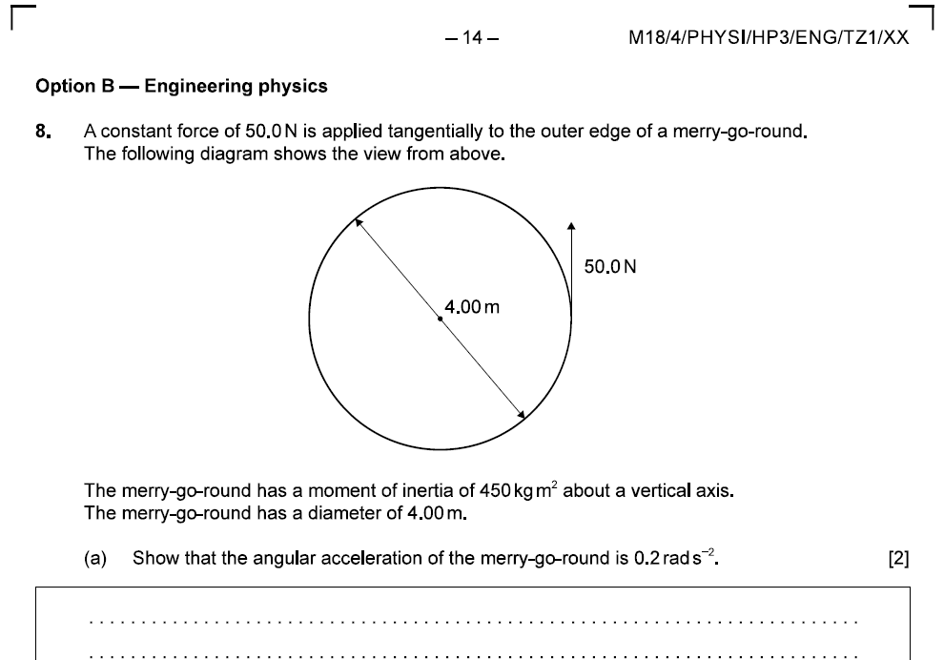

Slide 22
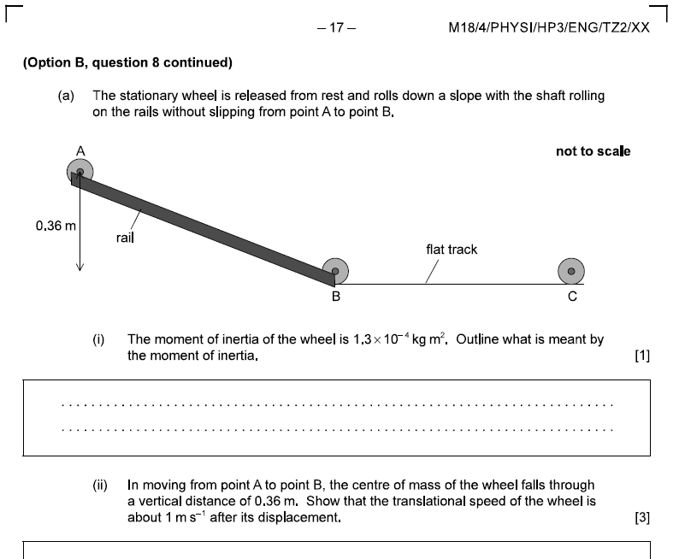

Slide 23
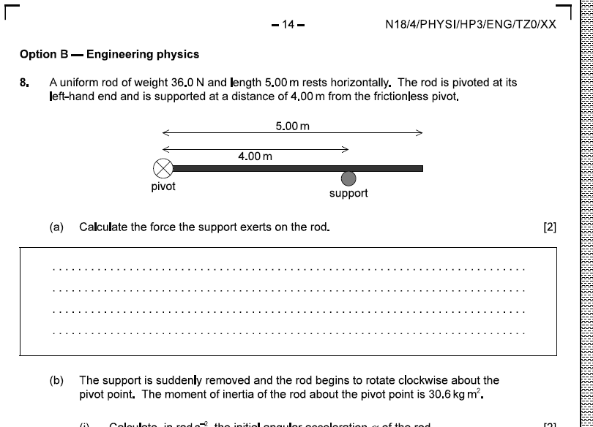

Slide 24
Thermodynamics

Slide 25
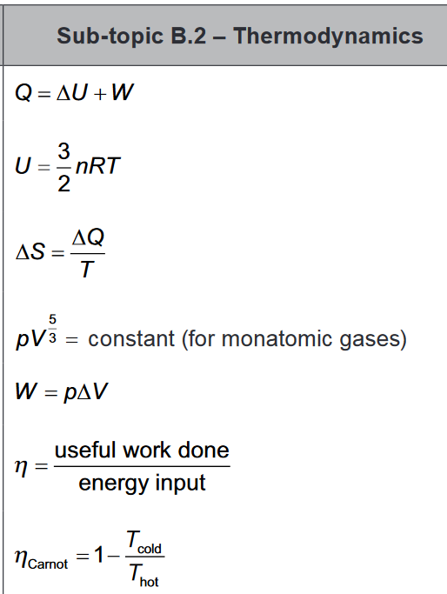
(For isobaric processes)

Slide 26
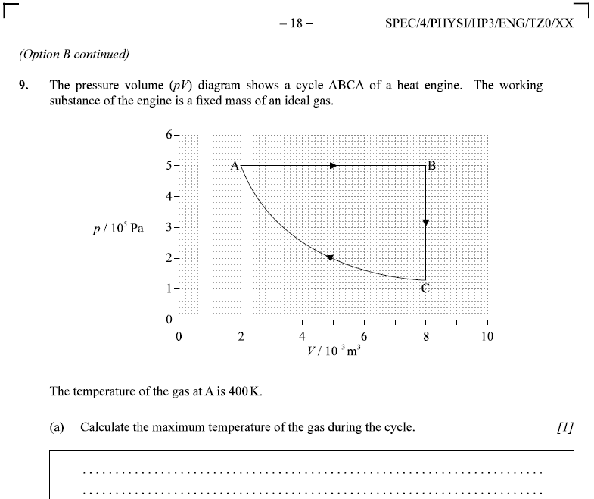

Slide 27
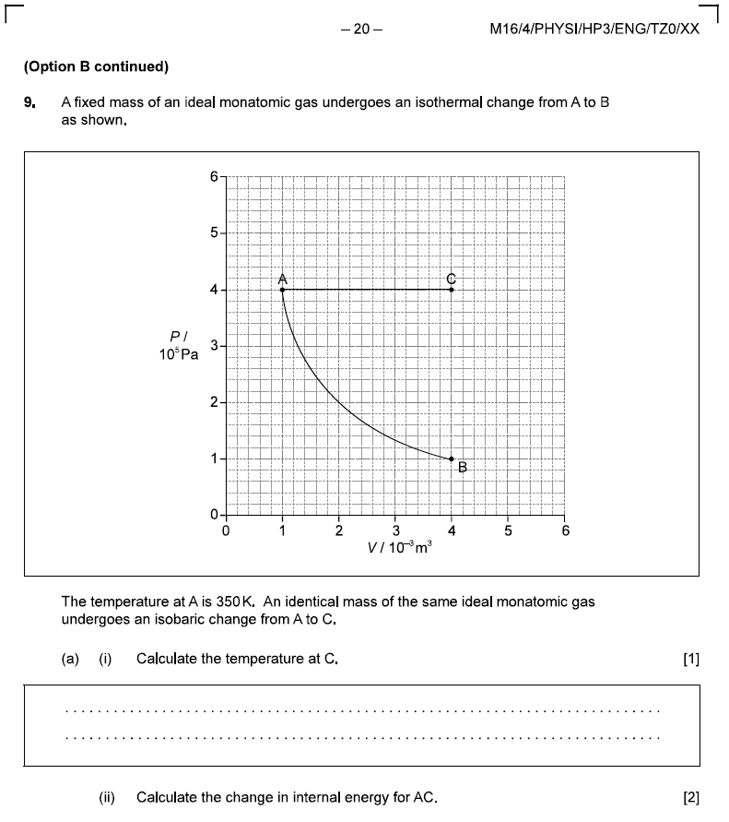

Slide 28
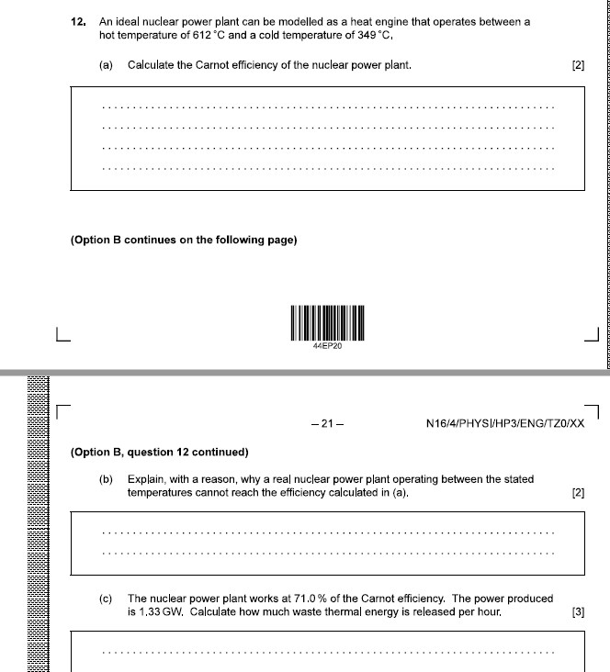

Slide 29
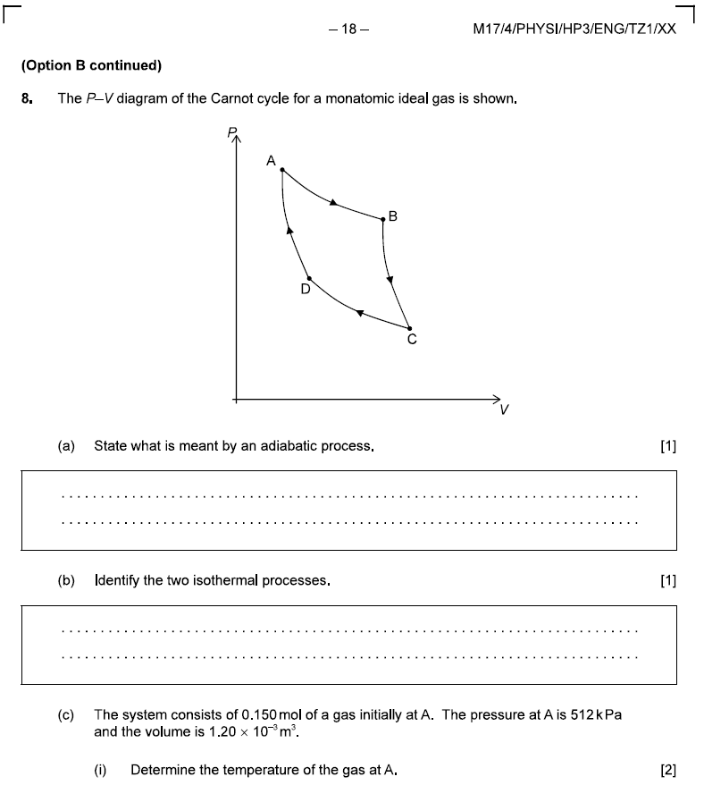

Slide 30
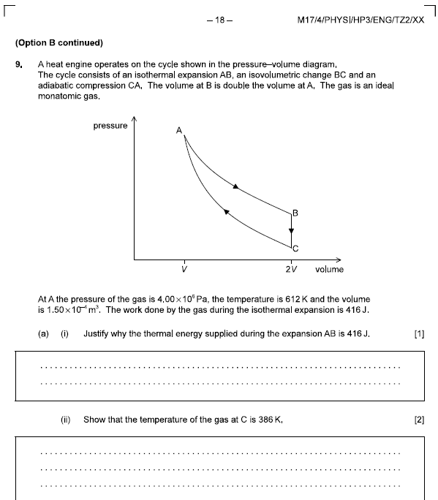

Slide 31
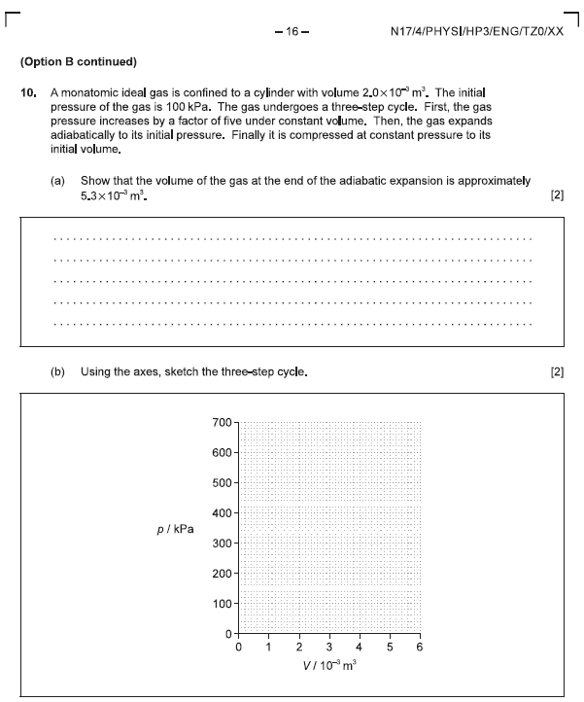

Slide 32
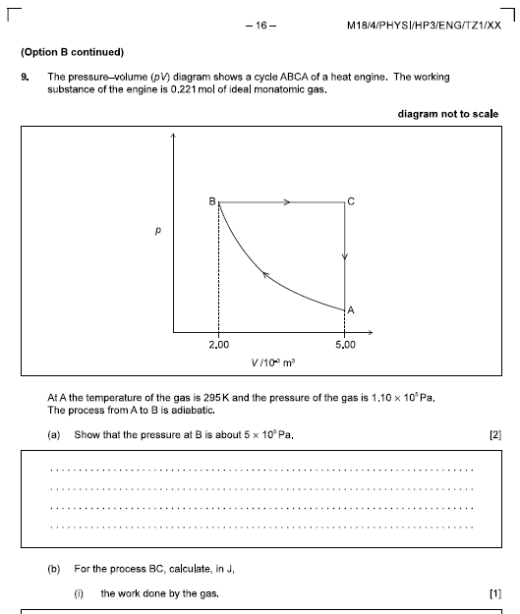

Slide 33
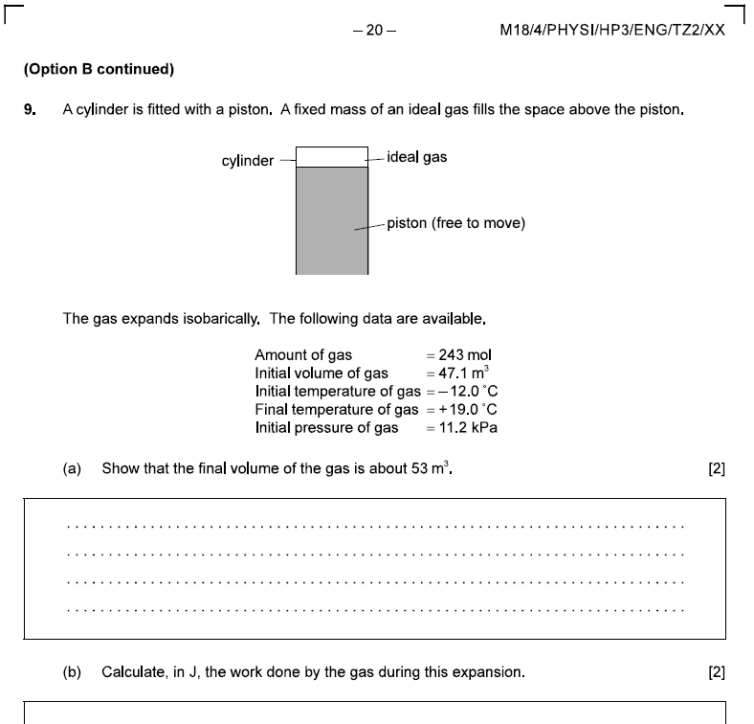

Slide 34
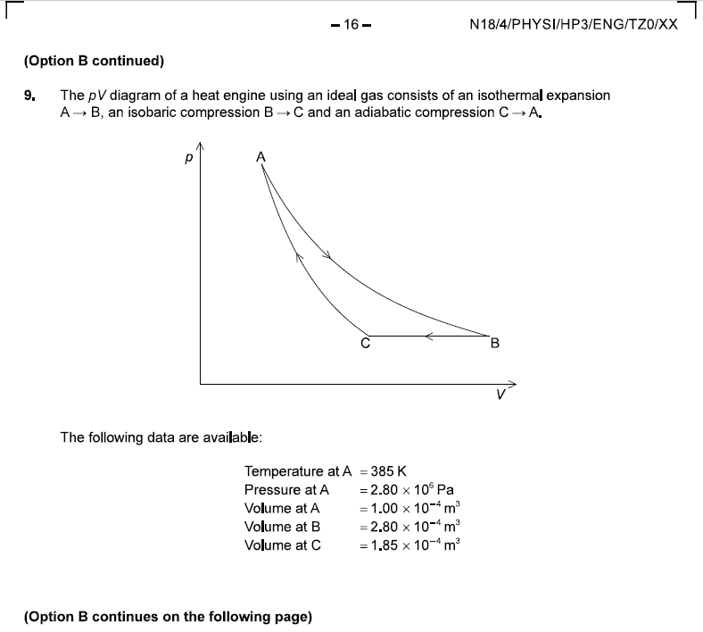

Slide 35
Fluids

Slide 36
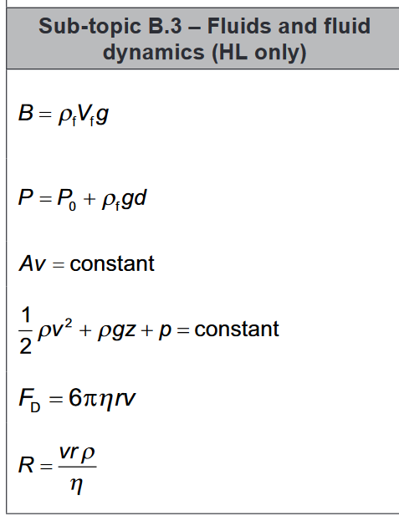

Slide 37
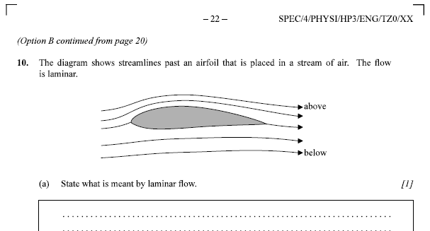
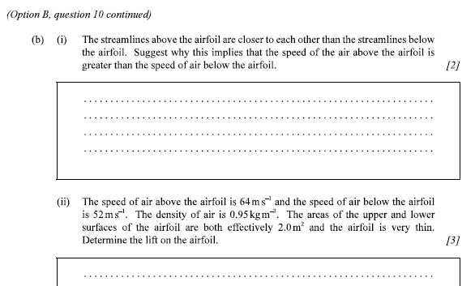

Slide 38
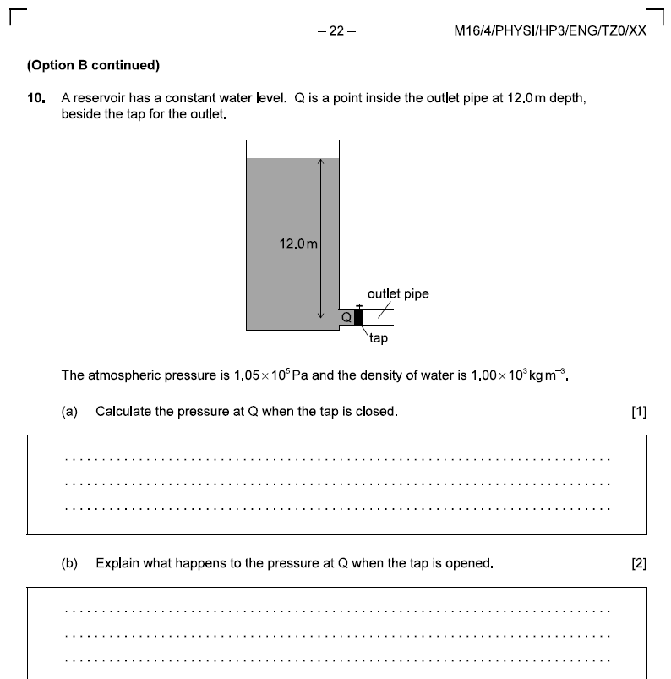

Slide 39
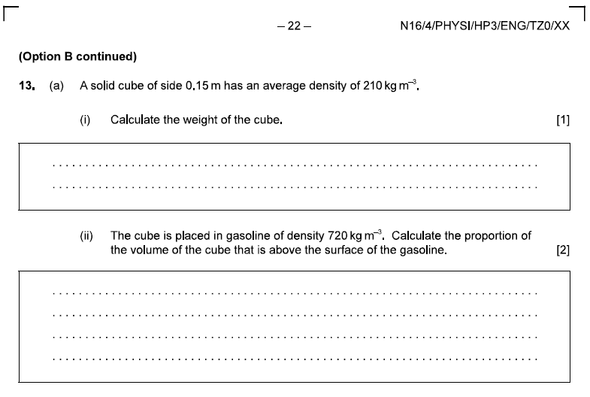

Slide 40
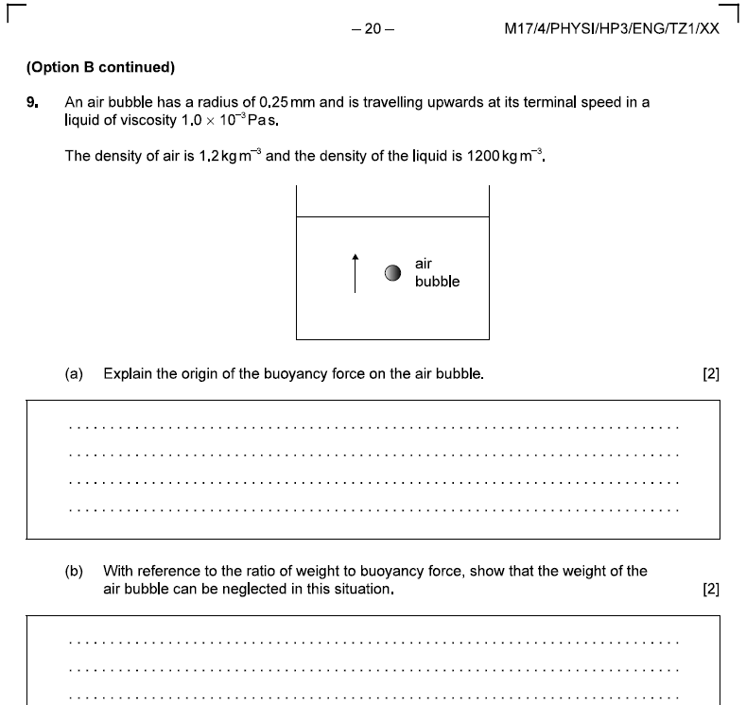

Slide 41
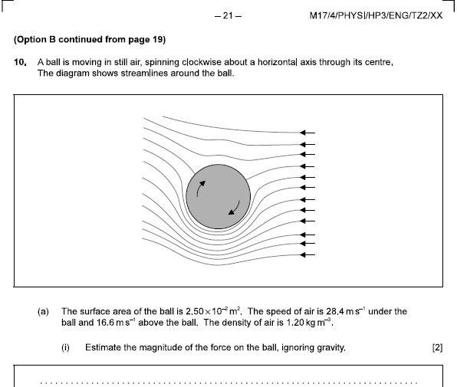

Slide 42
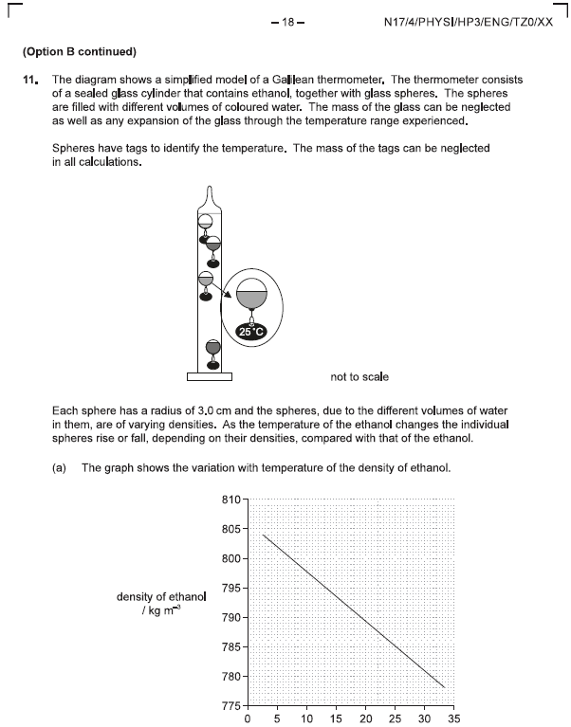

Slide 43
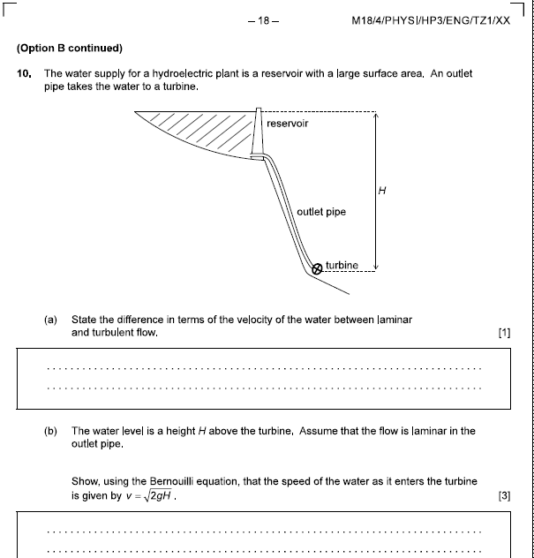

Slide 44
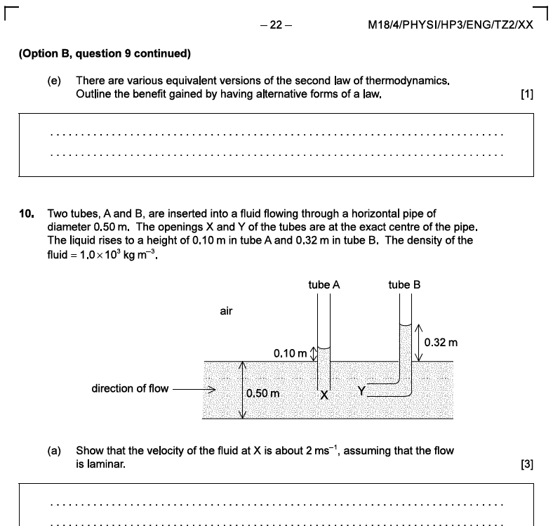

Slide 45
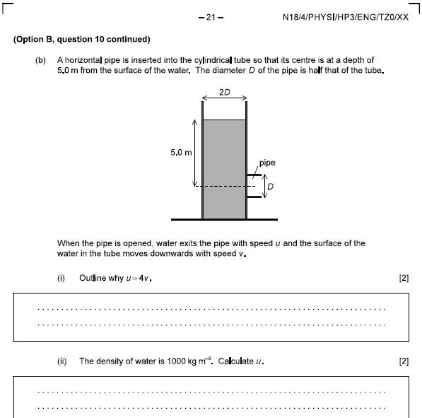

Slide 46
Resonant Systems

Slide 47
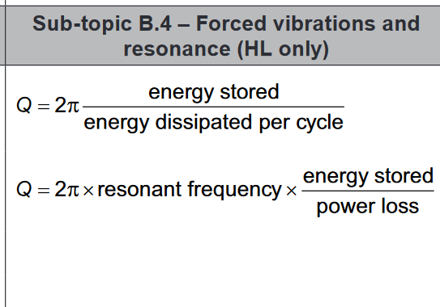

Slide 48
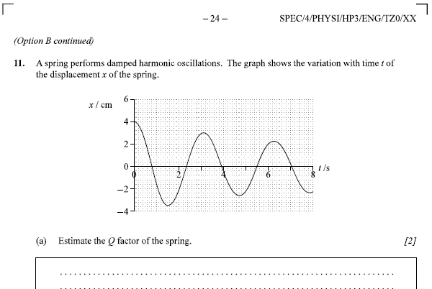

Slide 49
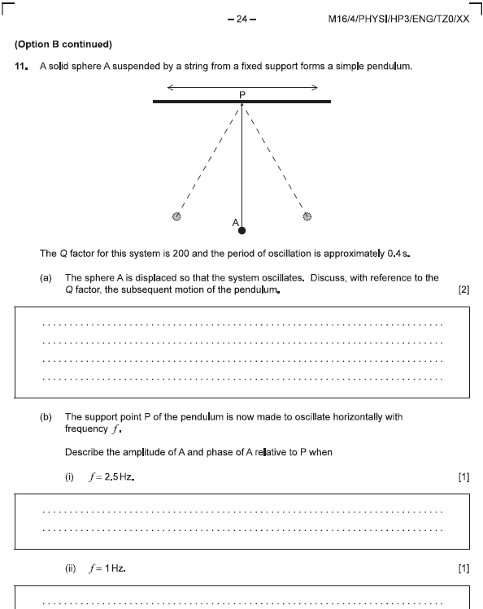

Slide 50
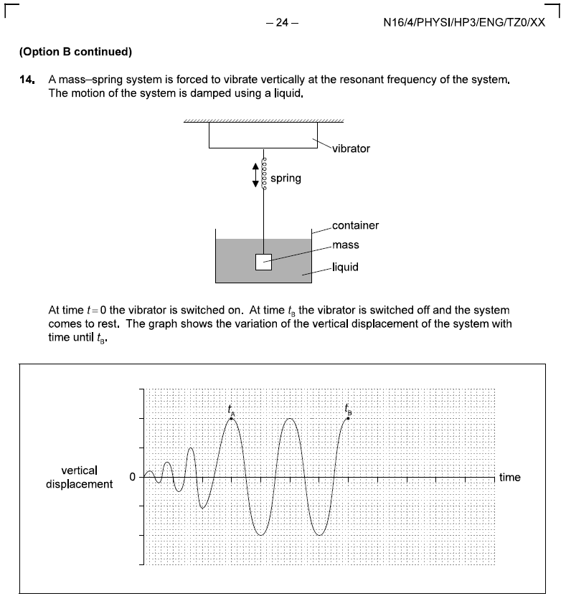

Slide 51
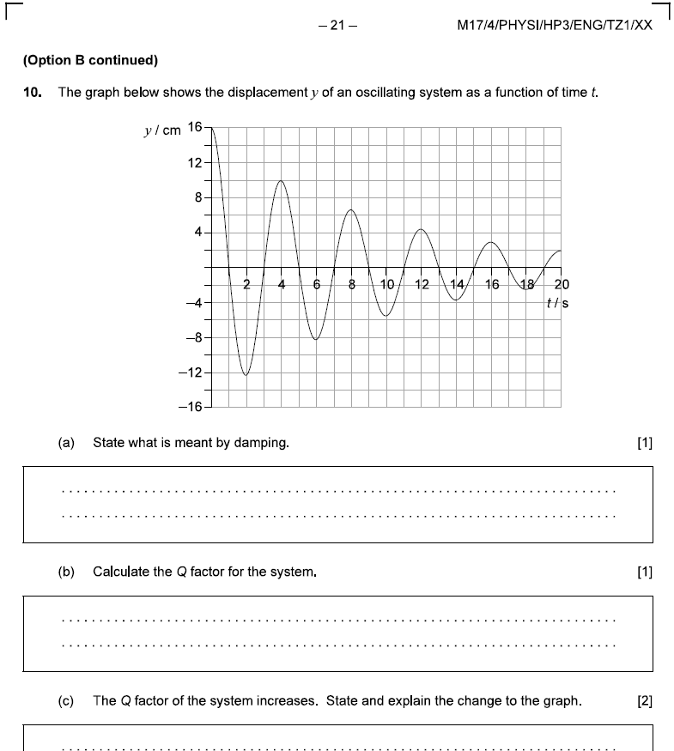

Slide 52
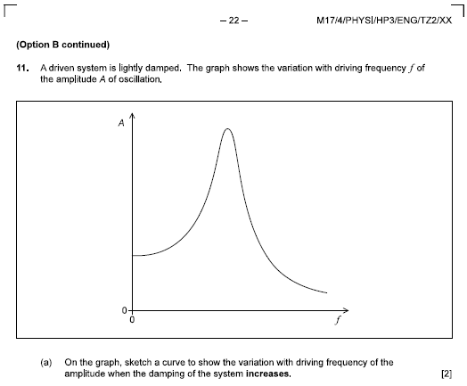
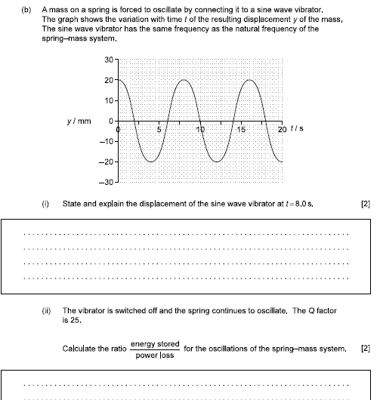

Slide 53
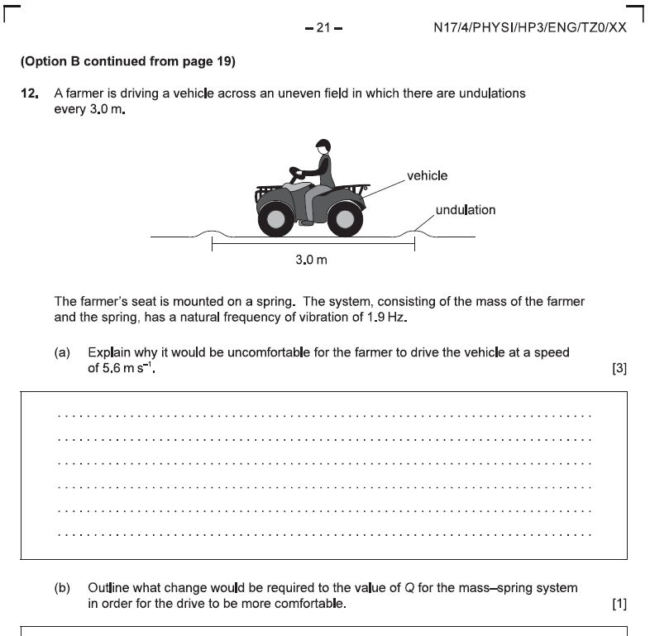

Slide 54
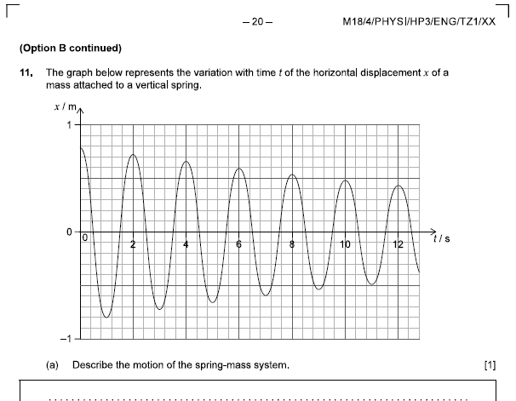

Slide 55
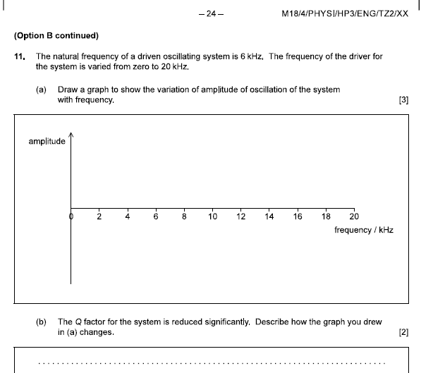

Slide 56
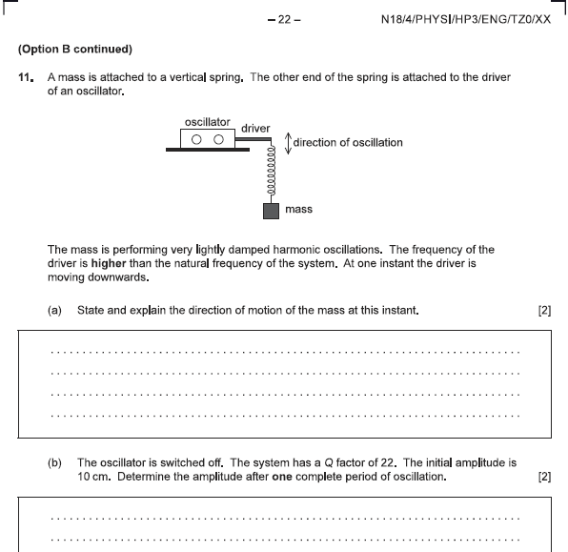

Slide 57
Driven oscillators
f = f for resonance
Phase angle
Q = big small damping
Q

Slide 58
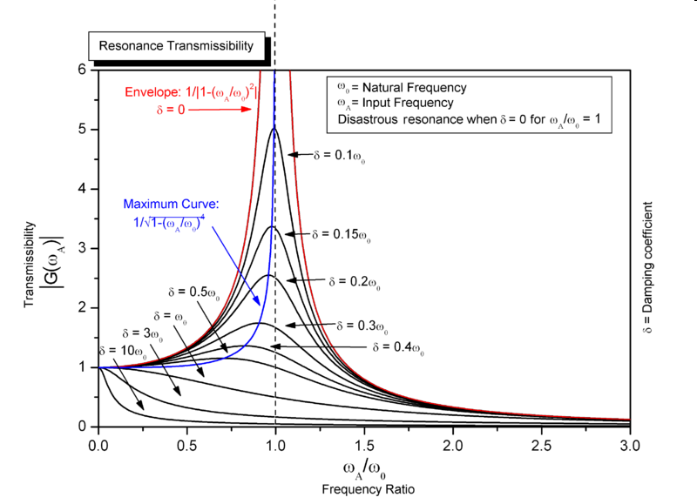

Slide 59
Resonance – Concept 0
x = x_{o}sin(ωt)
ω_{o} =
When ω = ω_{o}, = resonance
Damping:
Lower peak
Smaller ω_{o} (Peak shifts left)
Show
Large mass/Small mass on spring (large mass oscillates slower)
Drive spring with different frequencies

Slide 60
Resonance – Concept 1 - Damping
Force proportional to velocity
Input energy vs dissipated energy
From 0 – 40 s
From 40 – 100 seconds

Slide 61
Force proportional to velocity
Why this shape: X = X_{o}e^{-kt}Cos(ωt)

Slide 62
Resonance – Concept 2 – Q Factor
Q = 10
Q = 5
(Quality Factor)
Arbitrary engineering number
Roughly how many cycles it will go before it stops

Slide 63
Calculations:

Slide 64
Resonance – Concept 3 – Phase
1 (Driver = 0º )
2 (Driver = 90º )
3 (Driver = 180º )
4 (Driver = 270º )
Fast SHO: In Phase Slow SHO: 180º out of phase
Resonant SHO: 90º behind driver (Maximizes coupling)

