Slide 1
Resonance –
Contents:
Concept of resonance
Damped Motion
Q Factor
Phase

Slide 2
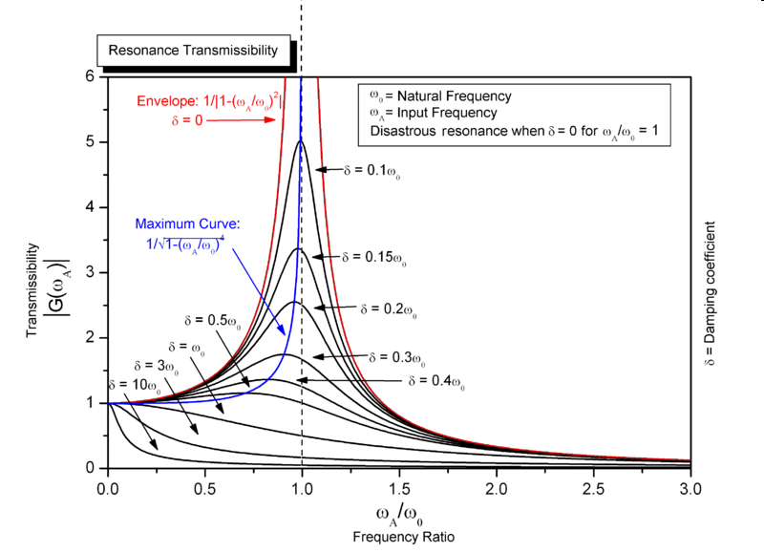
Concept 0

Slide 3
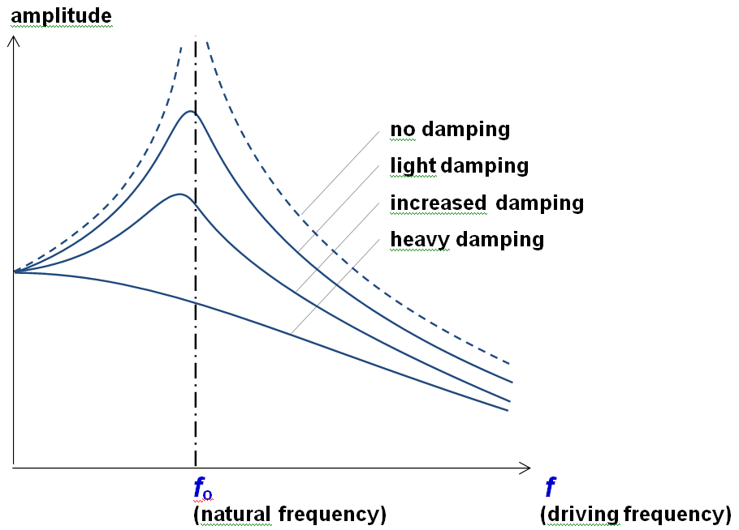
Resonance – Concept 1
x = x_{o}sin(ωt)
ω_{o} =
When ω = ω_{o}, = resonance
Damping:
(More damping = lower Q)
Lower peak (shifts down)
Smaller ω_{o} (Peak shifts left)
Show
Large mass/Small mass on spring (large mass oscillates slower)
Drive spring with different frequencies

Slide 4
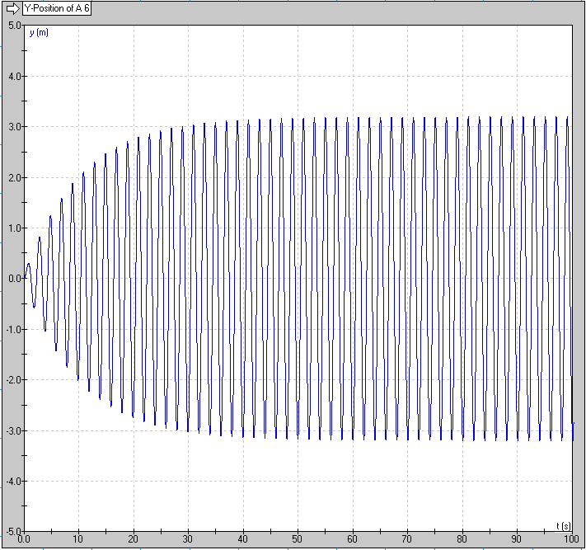
Resonance – Concept 2 - Damping
Force proportional to velocity
Input energy vs dissipated energy
From 0 – 40 s
From 40 – 100 seconds

Slide 5
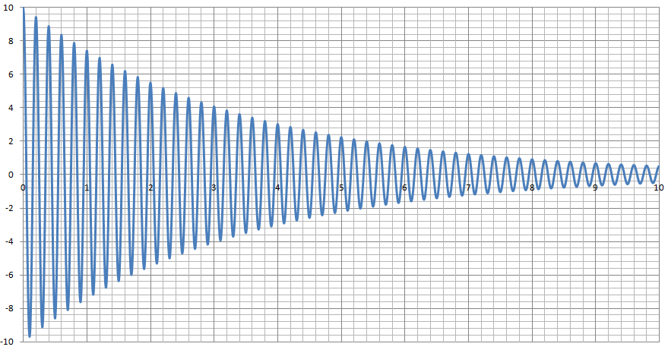
Force proportional to velocity
Why this shape: X = X_{o}e^{-kt}Cos(ωt)

Slide 6
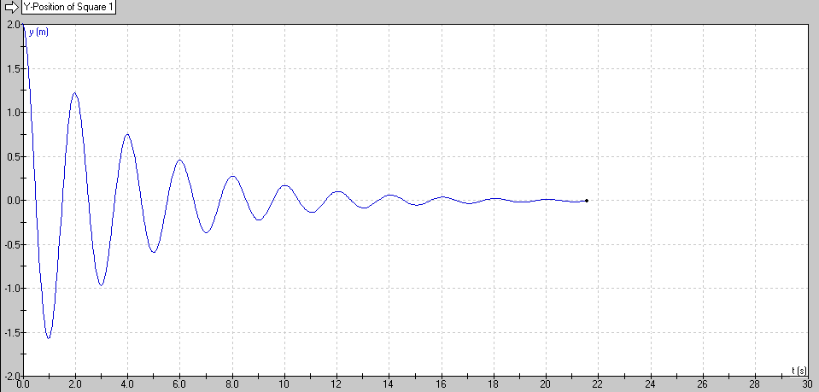
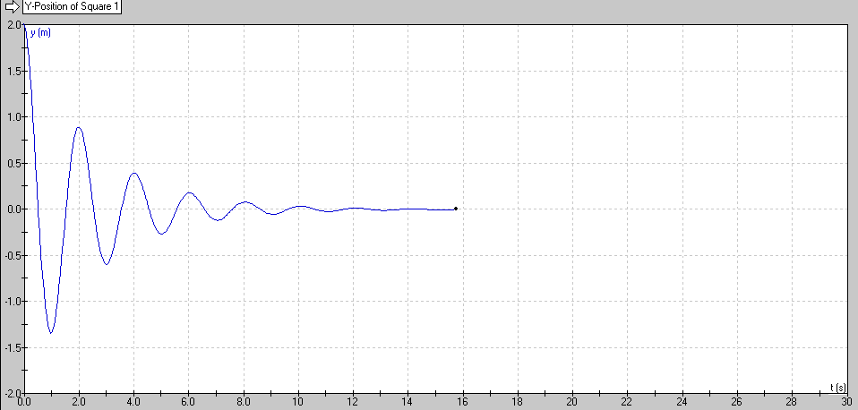
Resonance – Concept 3 – Q Factor
Q = 10
Q = 5
(Quality Factor)
Arbitrary engineering number
Roughly how many cycles it will go before it stops

Slide 7
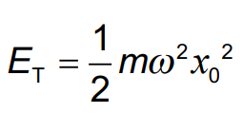
Calculations:

Slide 8
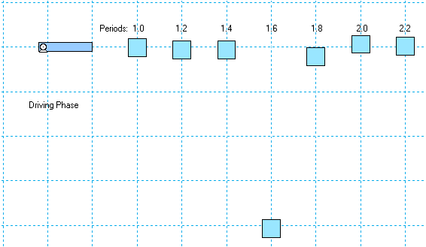
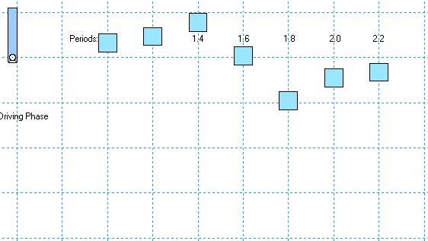
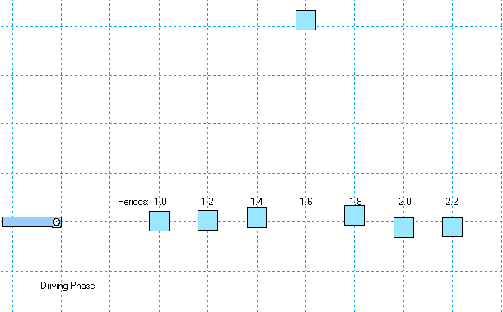
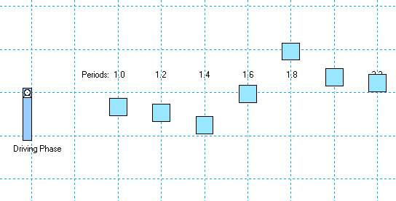
Resonance – Concept 4 – Phase
1 (Driver = 0º )
2 (Driver = 90º )
3 (Driver = 180º )
4 (Driver = 270º )
Fast SHO: In Phase Slow SHO: 180º out of phase
Resonant SHO: 90º behind driver (Maximizes coupling)

Slide 9
