Slide 1
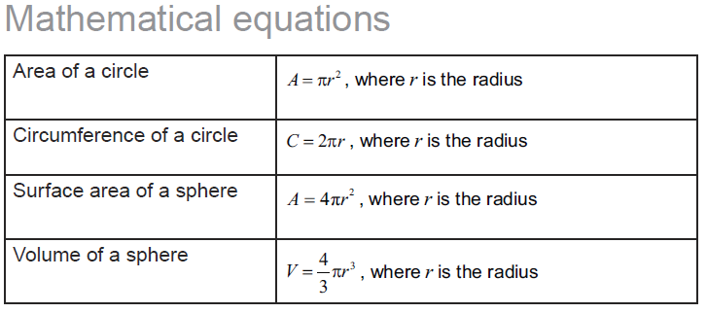
M1-4

Slide 4
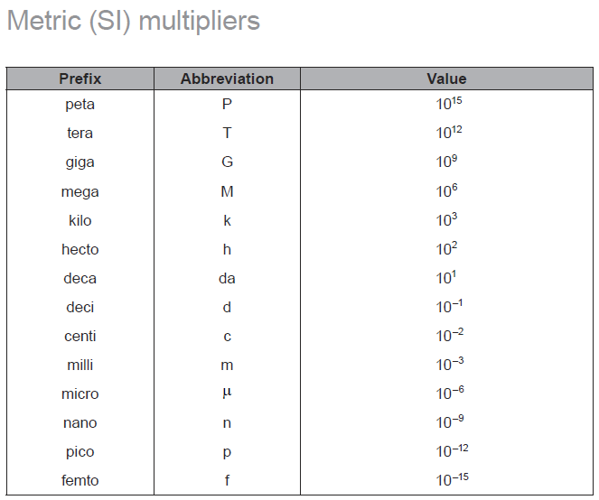

Slide 5
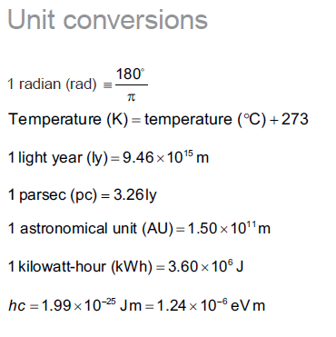

Slide 6
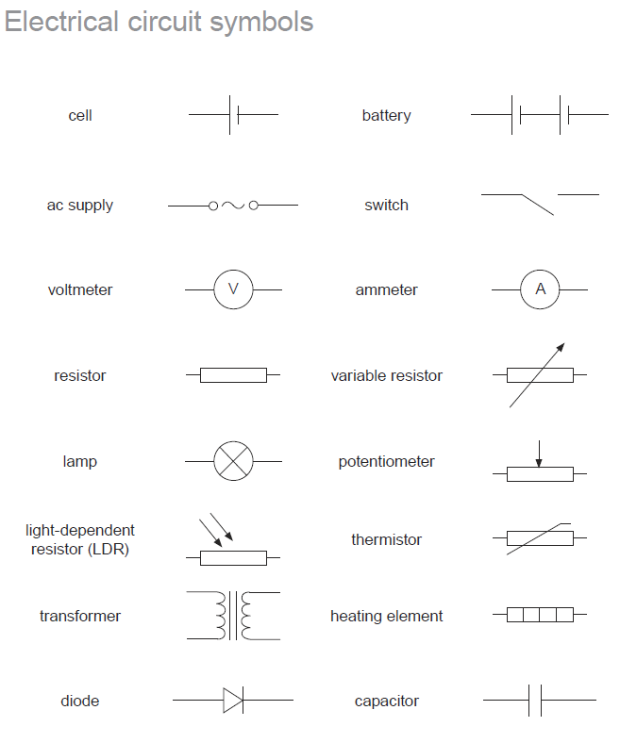

Slide 7
1
2
3

Slide 9
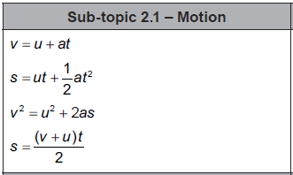

Slide 10
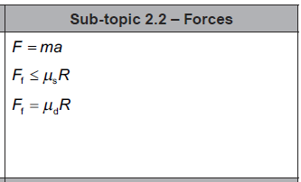

Slide 11
A projectile is projected horizontally from a cliff that is 42.0 m tall. It lands 68.2 m from the base of the cliff. What was its speed of impact? (Remember – speed is the magnitude of the vector)
36.976 m/s

Slide 12
1. There is a coefficient of kinetic friction of 0.140 between a 5.20 kg box and the level floor.
e. The box slides from rest to the right reaching a velocity of 14.5 m/s in a distance of 16.8 m.
What is the acceleration of the box?
What outside force was acting?
6.257 m/s/s,39.7 N Right

Slide 13
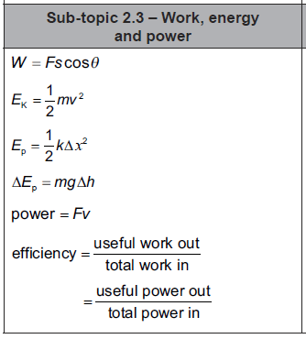

Slide 14
A 657 kg Rollercoaster car at rest on top of a 4.63 m tall hill is sped up by a force of 7480 N for a distance of 4.50 m. What is the height of the car when it is going 7.42 m/s (Neglect friction)
7.05 m

Slide 15
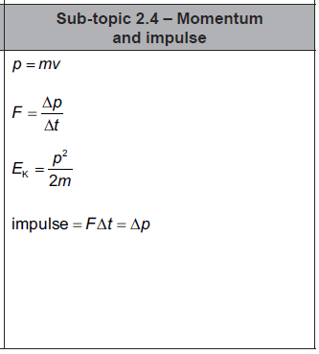

Slide 16
Bumper car A (326 Kg) with velocity 3.7 m/s East collides with the rear of car B (536 Kg) which has a velocity of 2.4 m/s East. After the collision, car A has a velocity of 1.2 m/s to the West. What is the velocity of car B after the collision?
5.38 m/s East

Slide 17
A 0.142 Kg baseball going 37.0 m/s, strikes a bat, and heads straight back to the outfield at 59.0 m/s. If the collision lasted for 0.0135 seconds, what force did the bat exert on the baseball?
1010 N

Slide 18
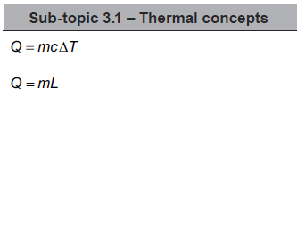

Slide 19
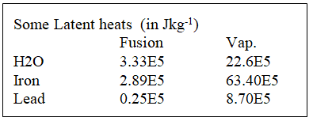
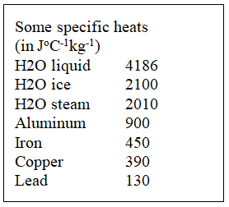
How much energy does it take to heat 2.30 kg of ice from -20.0 ºC to liquid water at 78.0 ºC?
1.61E6J

Slide 20
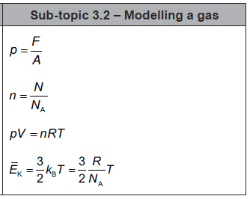

Slide 21
question
answer

Slide 22
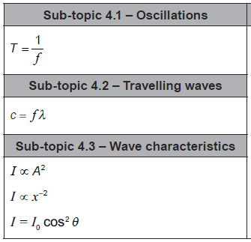

Slide 23
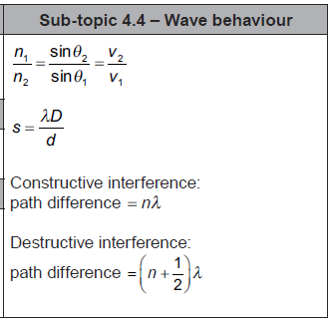

Slide 24
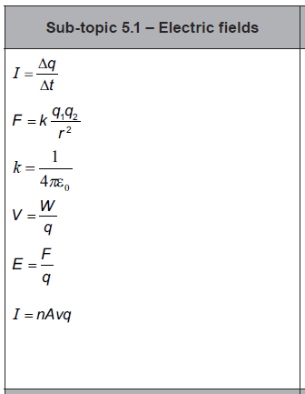

Slide 25
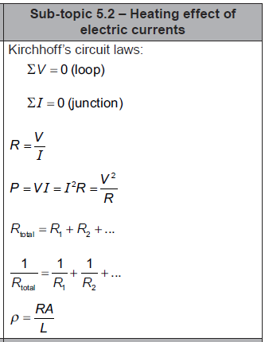

Slide 26
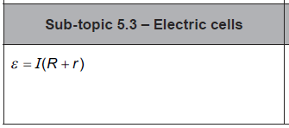

Slide 27
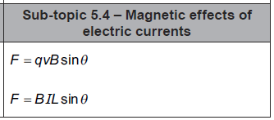

Slide 28
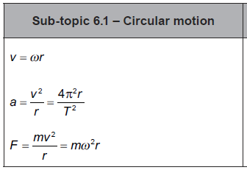

Slide 29
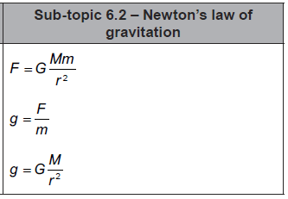

Slide 30
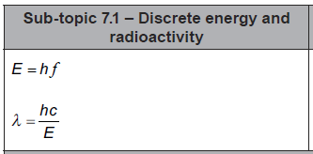

Slide 31
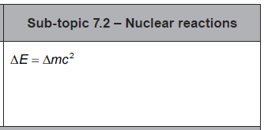

Slide 33
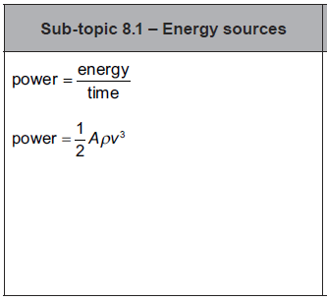

Slide 34
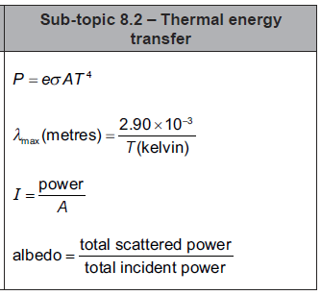

Slide 35
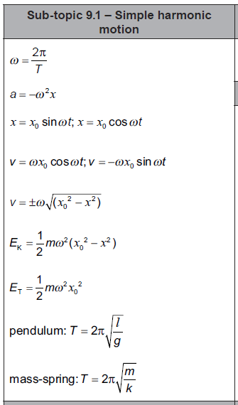

Slide 36
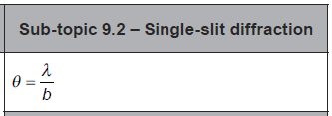

Slide 37
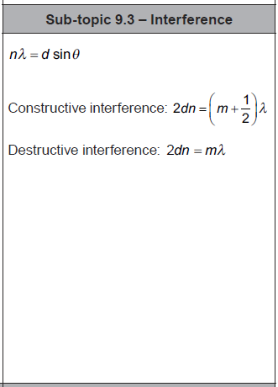

Slide 38
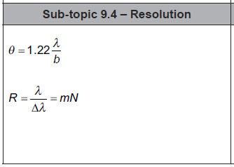

Slide 39
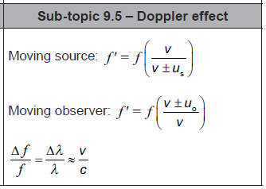

Slide 40
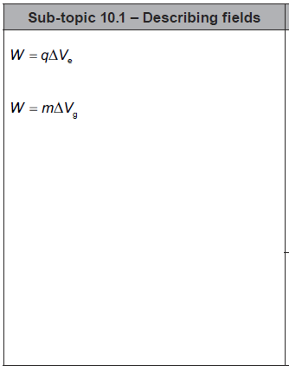

Slide 41
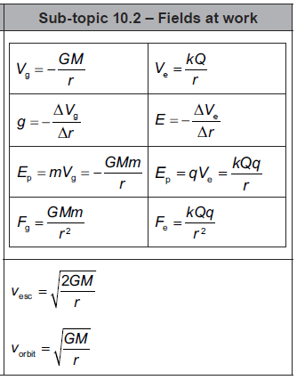
1
2
3
4
5
6
7
8
9
10

Slide 42
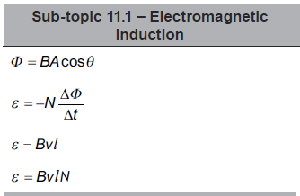

Slide 43
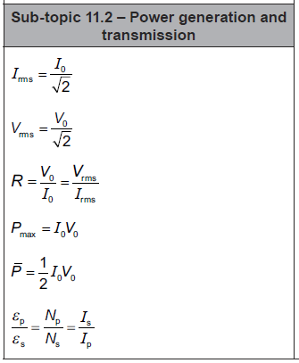

Slide 44
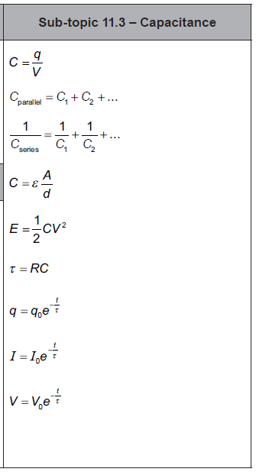

Slide 45
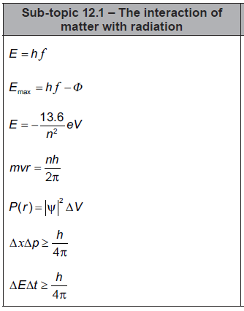

Slide 46
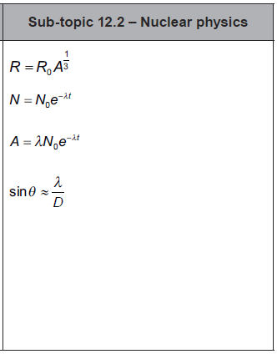

Slide 47
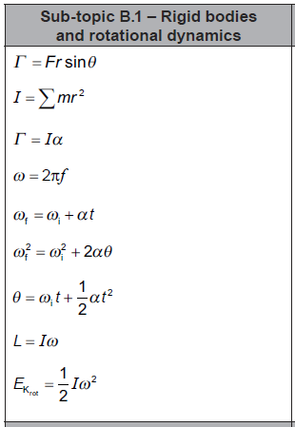

Slide 48
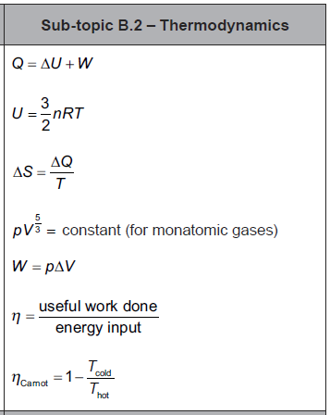

Slide 49
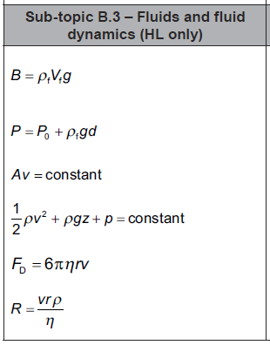

Slide 50
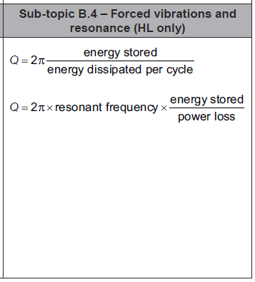

Slide 52
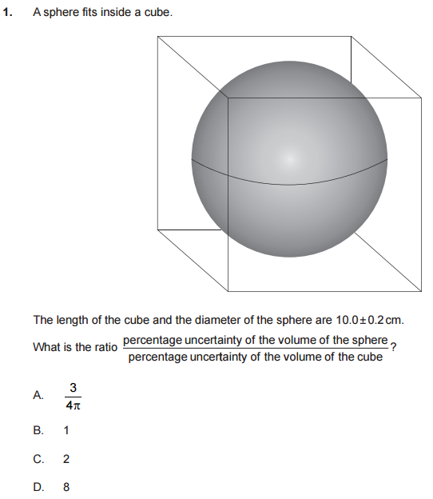
2016HL

Slide 53
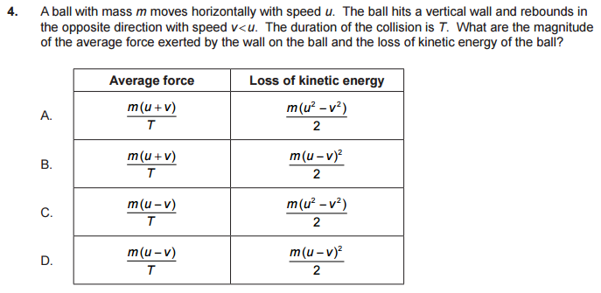
2016HL

Slide 54
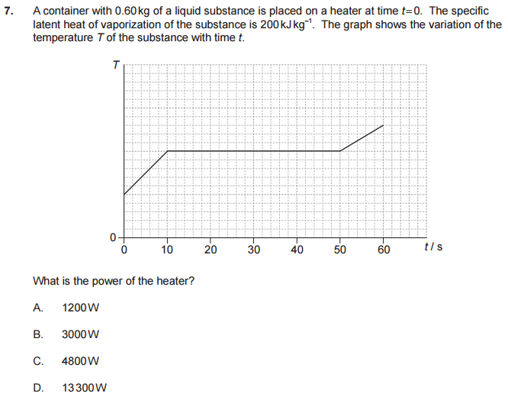
2016HL

Slide 55
2016HL

Slide 56
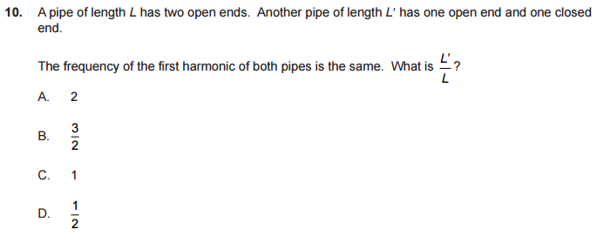
2016HL

Slide 57
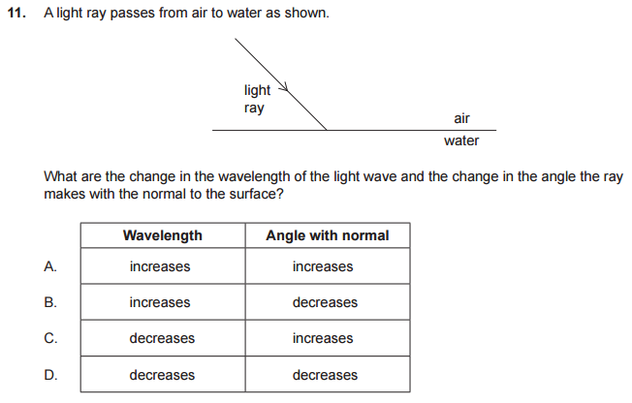
2016HL

Slide 58
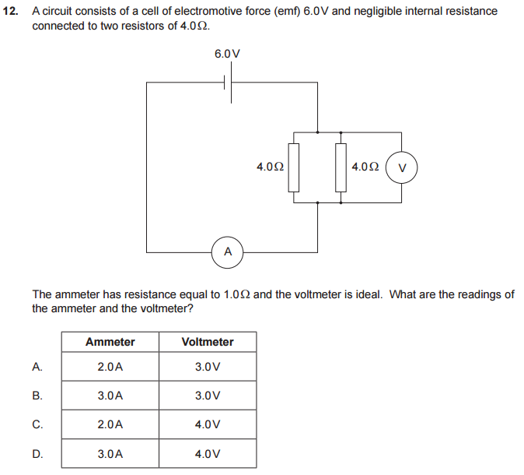
2016HL

Slide 59
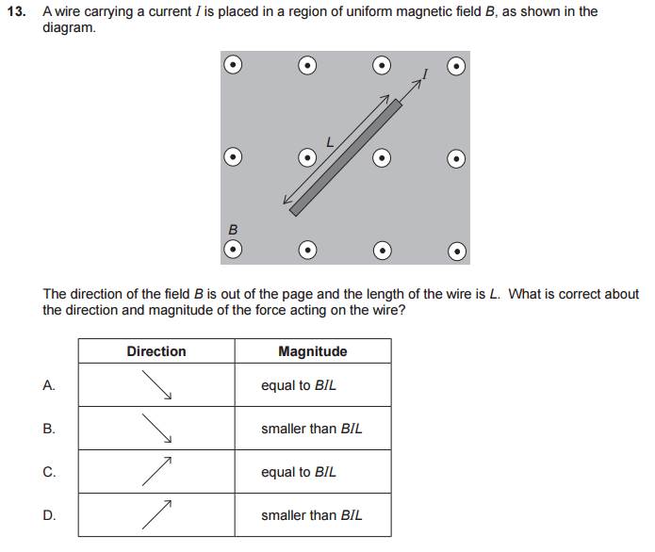
2016HL

Slide 60
2016HL

Slide 61
2016HL

Slide 62
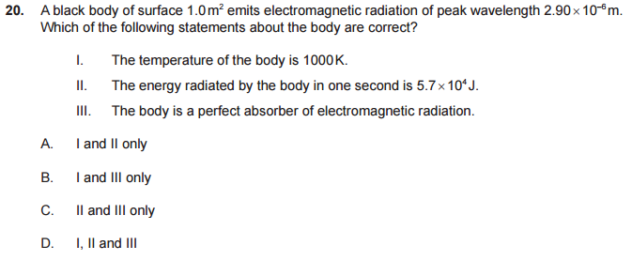
2016HL

Slide 63
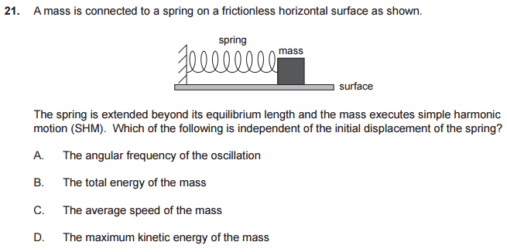
2016HL

Slide 64
2016HL

Slide 65
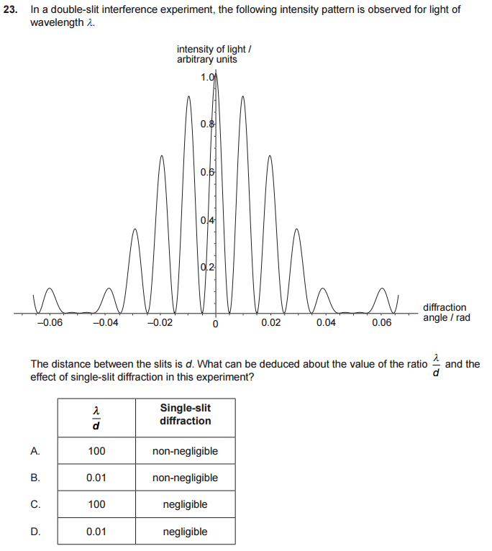
2016HL

Slide 66
2016HL

Slide 67
2016HL

Slide 68
2016HL

Slide 69
2016HL

Slide 70
2016HL

Slide 71
2016HL

Slide 72
2016HL

Slide 73
2016HL

Slide 74
2016HL

Slide 75
2016HL

Slide 76
2016 HL P2

Slide 77
2016 HL P2

Slide 78
2016 HL P2

Slide 79
2016 HL P2

Slide 80
2016 HL P2

Slide 81
2016 HL P2

Slide 82
2016 HL P2

Slide 83
2016 HL P2

Slide 84
2016 HL P2

Slide 85
2016 HL P2

Slide 86
2016 HL P2

Slide 87
2016 HL P2

Slide 88
2016 HL P2

Slide 89
2016 HL P2

Slide 90
2016 HL P2

Slide 91
2016 HL P2

Slide 92
2016 HL P2

Slide 93
2016 HL P2

Slide 94
2016 HL P2

Slide 95
2016 HL P2

Slide 96
2016 HL P2

Slide 97
2016 HL P2

Slide 98
2016 HL P3

Slide 99
2016 HL P3

Slide 100
2016 HL P3

Slide 101
2016 HL P3

Slide 102
2016 HL P3

Slide 103
2016 HL P3

Slide 104
2016 HL P3

Slide 105
2016 HL P3

Slide 106
2016 HL P3

Slide 107
2016 HL P3

