Slide 1
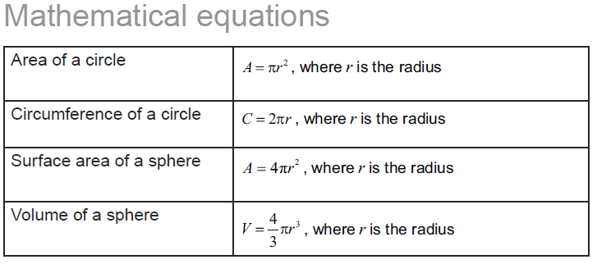
M1-4

Slide 4
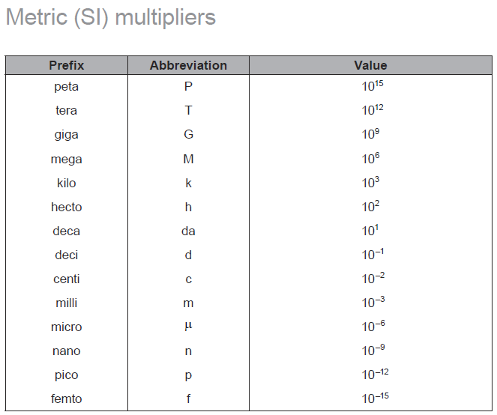

Slide 5
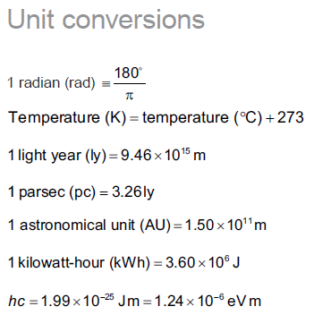

Slide 6
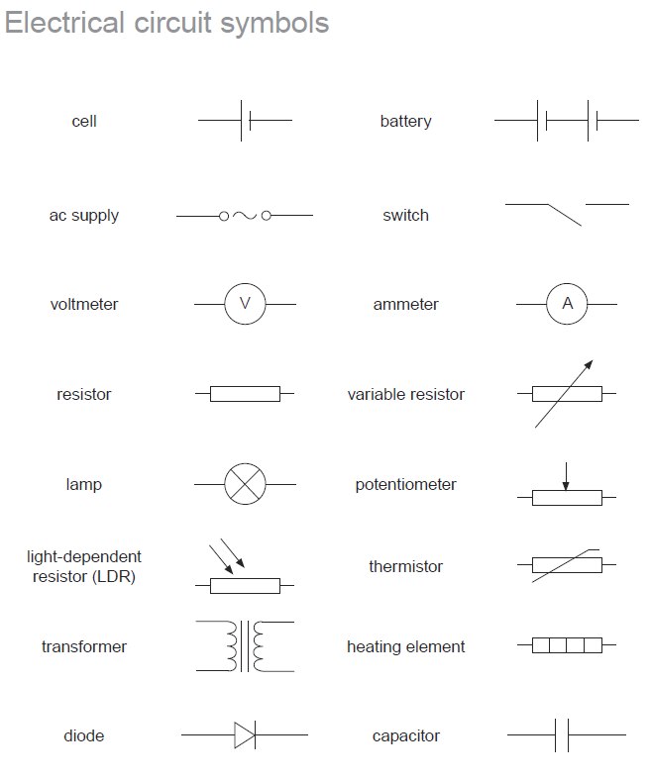

Slide 7
1
2
3

Slide 9
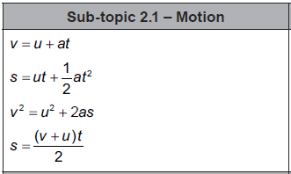

Slide 10
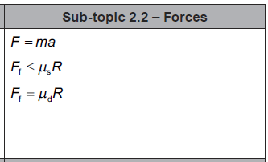

Slide 11
A projectile is projected horizontally from a cliff that is 42.0 m tall. It lands 68.2 m from the base of the cliff. What was its speed of impact? (Remember – speed is the magnitude of the vector)
36.976 m/s

Slide 12
1. There is a coefficient of kinetic friction of 0.140 between a 5.20 kg box and the level floor.
e. The box slides from rest to the right reaching a velocity of 14.5 m/s in a distance of 16.8 m.
What is the acceleration of the box?
What outside force was acting?
6.257 m/s/s,39.7 N Right

Slide 13
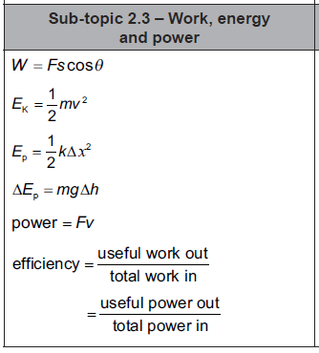

Slide 14
A 657 kg Rollercoaster car at rest on top of a 4.63 m tall hill is sped up by a force of 7480 N for a distance of 4.50 m. What is the height of the car when it is going 7.42 m/s (Neglect friction)
7.05 m

Slide 15
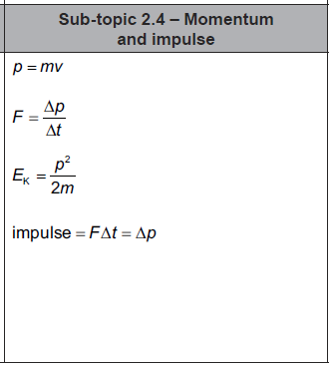

Slide 16
Bumper car A (326 Kg) with velocity 3.7 m/s East collides with the rear of car B (536 Kg) which has a velocity of 2.4 m/s East. After the collision, car A has a velocity of 1.2 m/s to the West. What is the velocity of car B after the collision?
5.38 m/s East

Slide 17
A 0.142 Kg baseball going 37.0 m/s, strikes a bat, and heads straight back to the outfield at 59.0 m/s. If the collision lasted for 0.0135 seconds, what force did the bat exert on the baseball?
1010 N

Slide 18
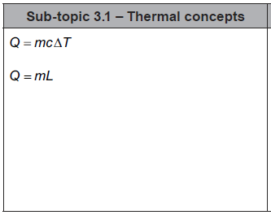

Slide 19
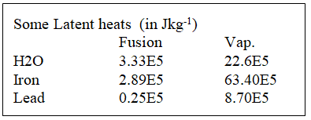
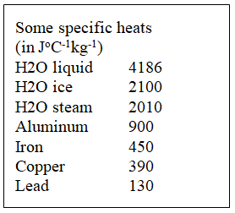
How much energy does it take to heat 2.30 kg of ice from -20.0 ºC to liquid water at 78.0 ºC?
1.61E6J

Slide 20
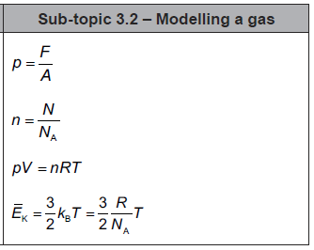

Slide 21
question
answer

Slide 22
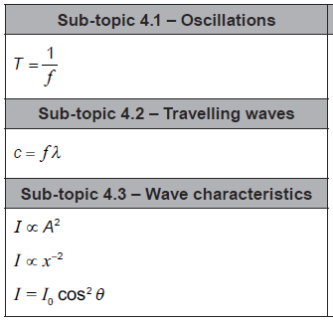

Slide 23
question
answer

Slide 24
question
answer

Slide 25
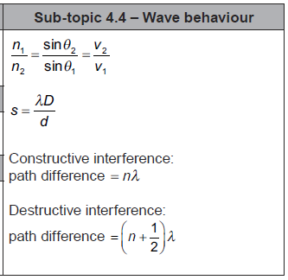

Slide 26
question
answer

Slide 27
question
answer

Slide 28
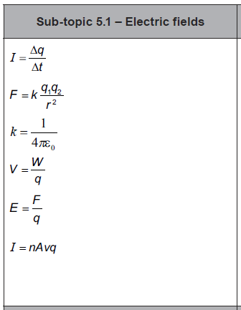

Slide 29
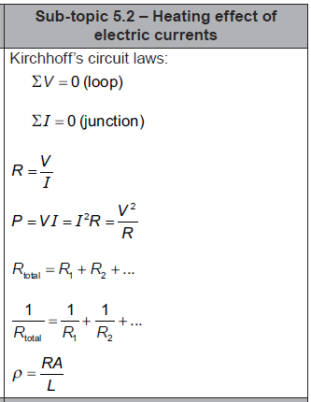

Slide 30
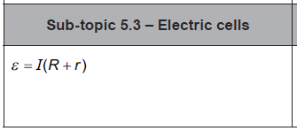

Slide 31
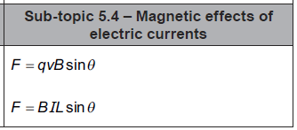

Slide 32
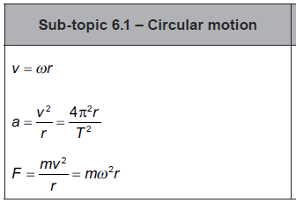

Slide 33
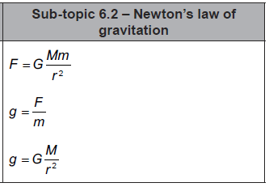

Slide 34
question
answer

Slide 35
question
answer

Slide 36
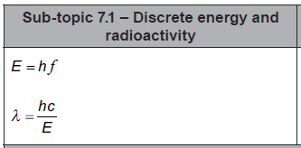

Slide 37
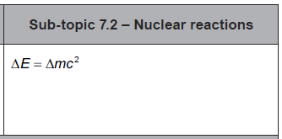

Slide 39
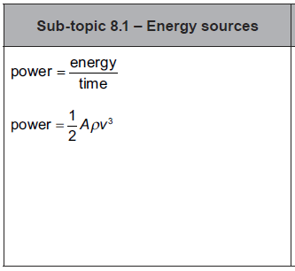

Slide 40
question
answer

Slide 41
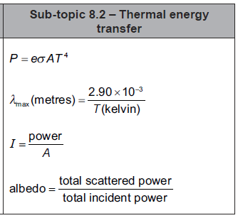

Slide 42
question
answer

Slide 43
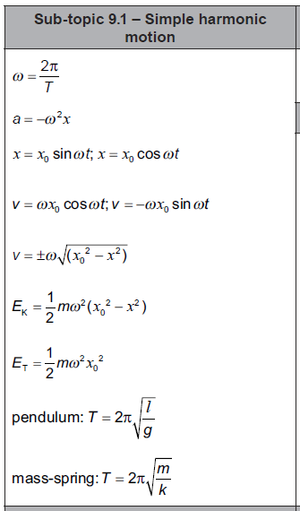

Slide 44
question
answer

Slide 45
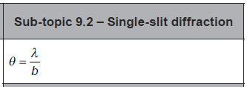

Slide 46
question
answer

Slide 47
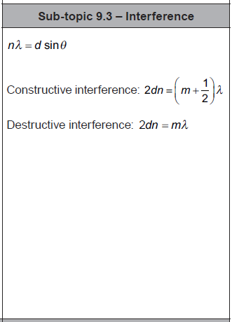

Slide 48
question
answer

Slide 49
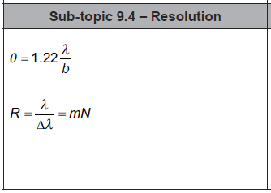

Slide 50
question
answer

Slide 51
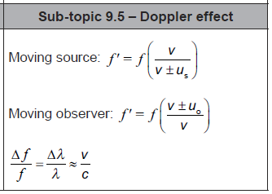

Slide 52
question
answer

Slide 53
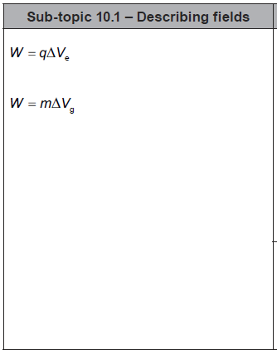

Slide 54
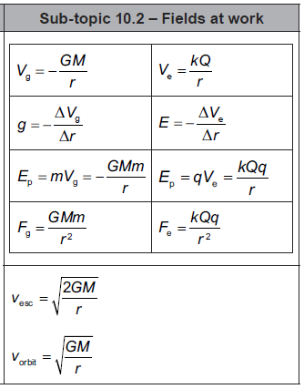
1
2
3
4
5
6
7
8
9
10

Slide 55
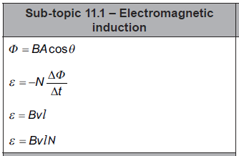

Slide 56
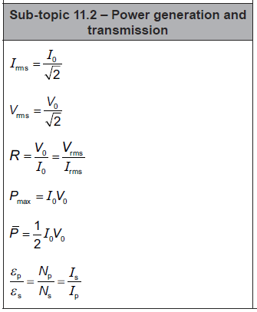

Slide 57
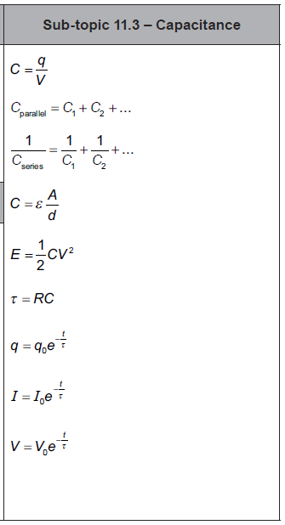

Slide 58
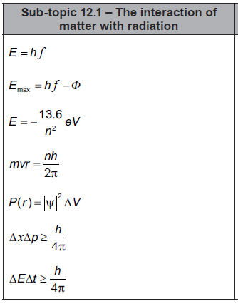

Slide 59
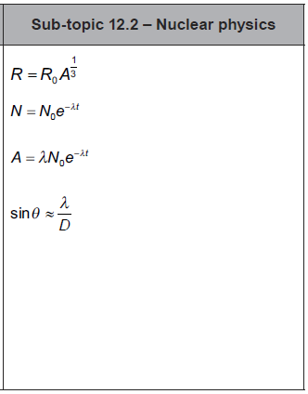

Slide 60
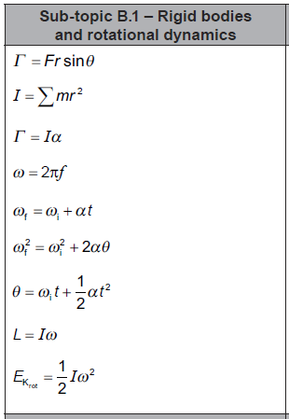

Slide 61
question
answer

Slide 62
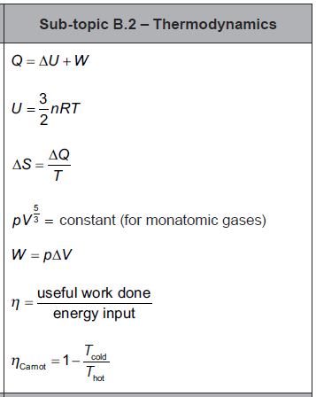

Slide 63
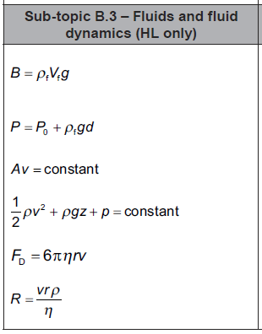

Slide 64
question
answer

Slide 65
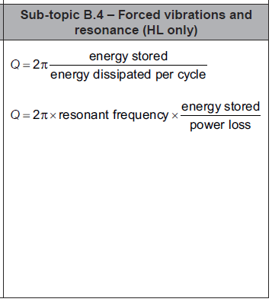

Slide 66
question
answer

