Slide 1
Feynman Diagrams for IB

Slide 2
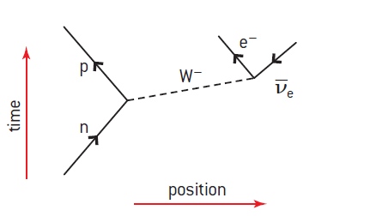
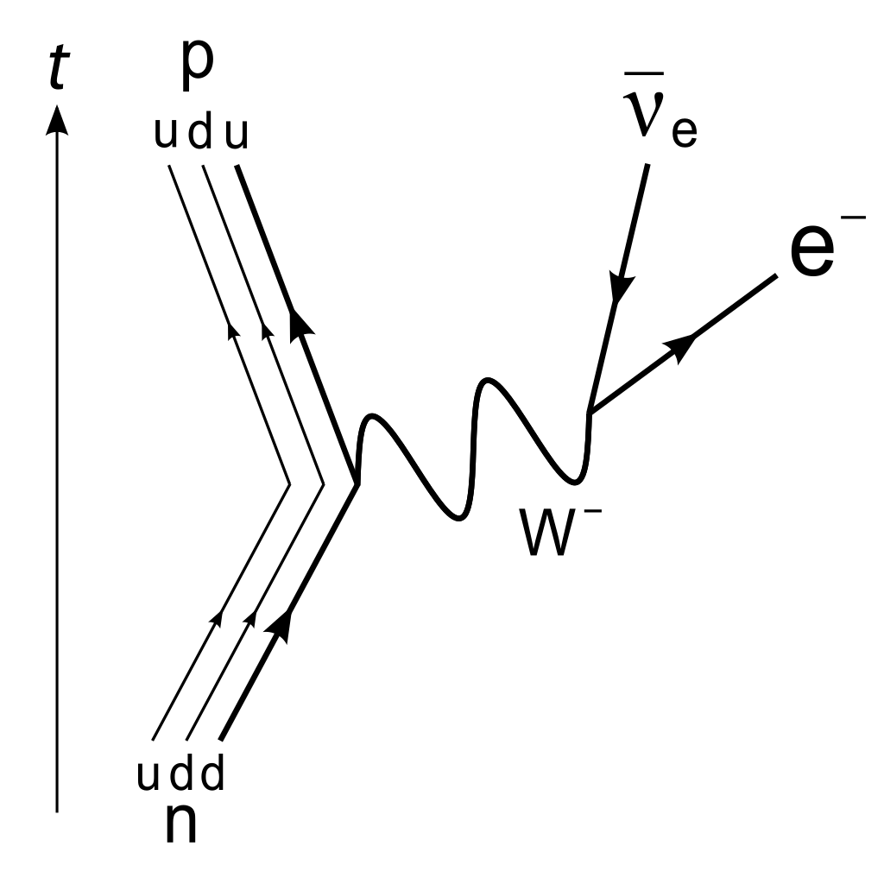
Rules
Time is up, position is to the right. (Sometimes reversed btw)
Exchange particles (Zº, W⁺, W⁻, γ, πº, π⁺, π⁻) are a dotted line, or wavy line.
Matter particles are shown with an arrow forward in time, anti matter, backward.
Vertices obey conservation laws.

Slide 3
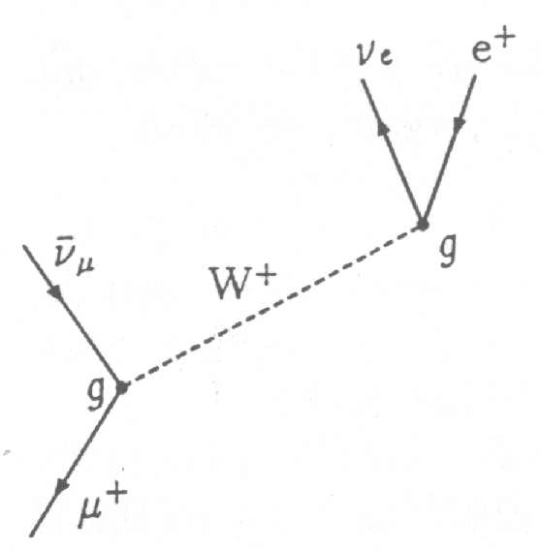
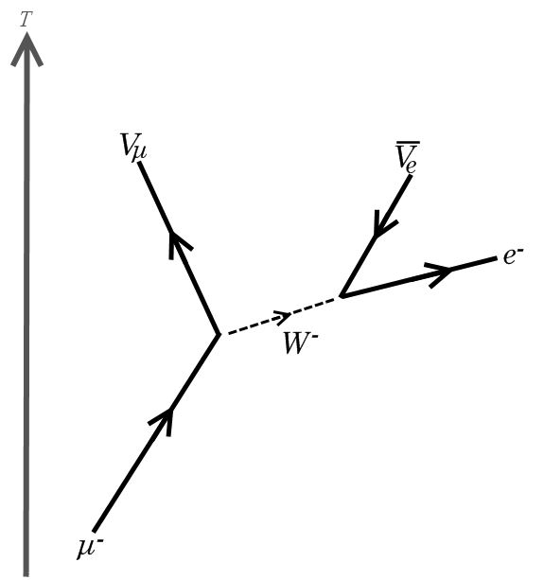
Rules
Time is up, position is to the right. (Sometimes reversed btw)
Exchange particles (Zº, W⁺, W⁻, γ) are a dotted line, or wavy line.
Matter particles are shown with an arrow forward in time, anti matter, backward.
Vertices obey conservation laws.

Slide 12
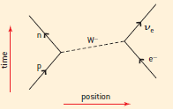

Slide 13
