Slide 1
This reaction occurs with high probability:
π⁻ + p → K_{L}º + Λº
This reaction is never observed:
π⁻ + p → K_{L}º + n
Look at the strangeness…
Produced at a high rate (Via the strong force)
(mesons)

Slide 2
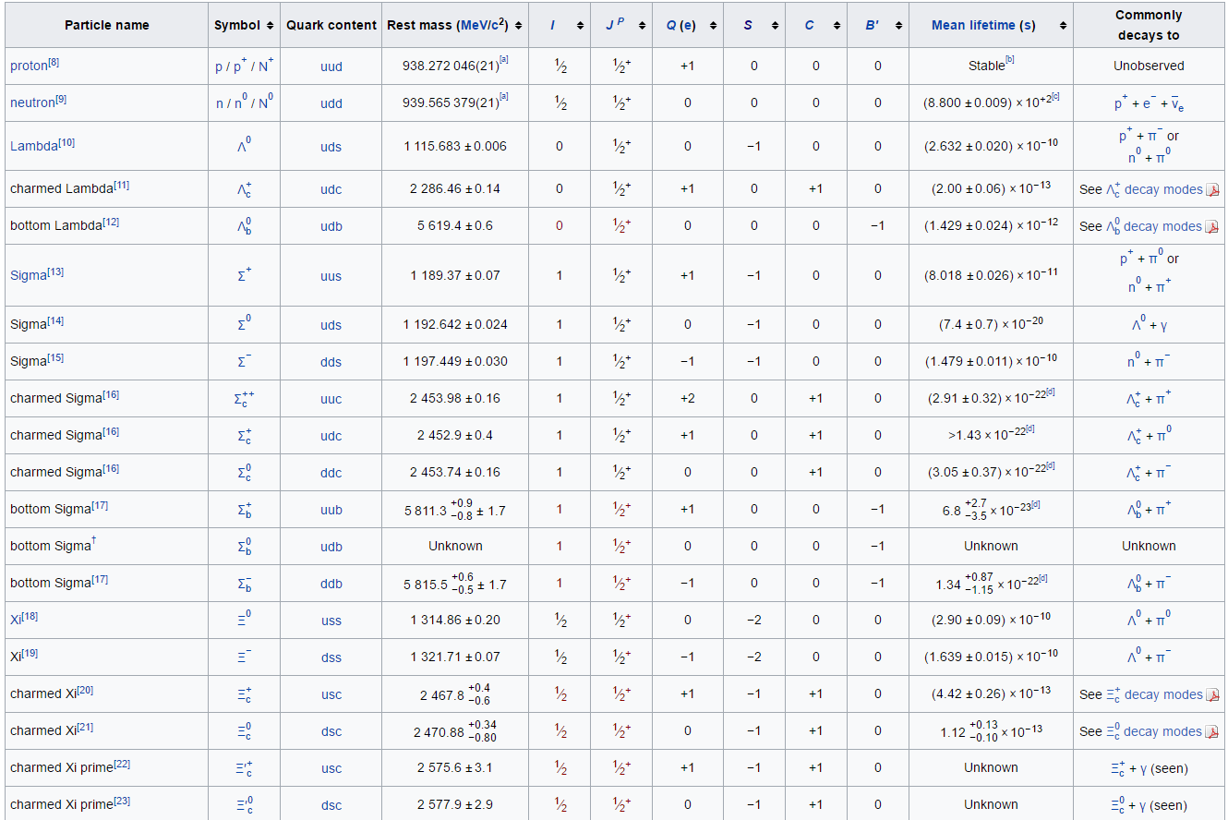
Strange particles have “long” lives/ Strangeness is NOT conserved in decays

Slide 3
Does this reaction conserve strangeness? (we already showed that is conserves B)
p + p ---> Ω⁻ + Ξ⁺ + K_{s}º
yes

Slide 4
Decays of Strange particles do not conserve Strangeness:
Λº → p + π⁻ Λº → n + πº

