Slide 1
Formative Assessment

Slide 2
1. How fast must an alpha particle (m = 6.64x10⁻²⁷ kg) go to get within 5.0x10⁻¹⁵ m of an Iron nucleus (Z = 26) (2.69x10⁷ m/s)

Slide 3
2. What is the wavelength of the photon associated with an electron transition from n = 2 to n = 7 in a hydrogen atom? Is the photon being absorbed, or emitted? (397 nm, absorbed)

Slide 4
3. What is the radius of U-235? (7.41x10⁻¹⁵ m)

Slide 5
If the uncertainty of an electron's position is 1.20x10⁻¹⁰ m, what is the minimum uncertainty (the total range) of its velocity? (4.82x10⁵ m/s)

Slide 6
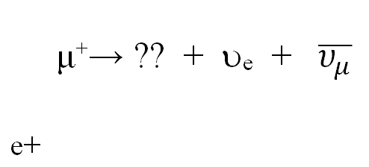
4. Fill in the table below the decay and the reaction. For the decays, find the missing particle. For the reactions, indicate if it is possible, or indicate every law it violates:

Slide 7
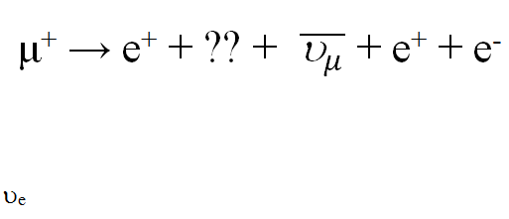
4. Fill in the table below the decay and the reaction. For the decays, find the missing particle. For the reactions, indicate if it is possible, or indicate every law it violates:

Slide 8
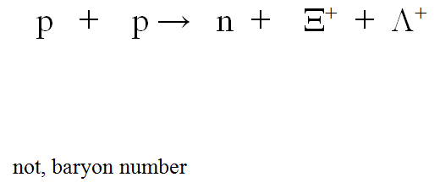
4. Fill in the table below the decay and the reaction. For the decays, find the missing particle. For the reactions, indicate if it is possible, or indicate every law it violates:

Slide 9
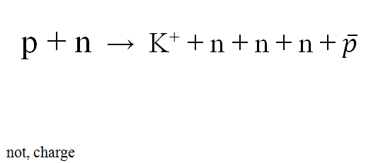
4. Fill in the table below the decay and the reaction. For the decays, find the missing particle. For the reactions, indicate if it is possible, or indicate every law it violates:

Slide 10
5. Write the quark combinations that make up a proton and a neutron: p = n =
Identify the following quark combinations as either a meson, or a baryon. Determine the baryon number, strangeness, and the charge of each:

Slide 11
5. Identify the following quark combinations as either a meson, or a baryon. Determine the baryon number, strangeness, and the charge of each:

Slide 12
question

