Slide 1
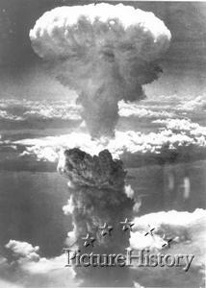
Nuclear Reactions
Contents:
Nuclear reactions
Whiteboard
Hahn and Strassmann and nuclear fission
Einstein’s Letter to Roosevelt
The Manhattan Project
Hiroshima and Nagasaki
Fusion reactions
Nuclear Power

Slide 2
Nuclear reactions
⁴₂He + ¹⁴₇N ---> ¹⁷₈O + ¹₁H
Charge and nucleon number are conserved
Can be written as follows:
¹⁴₇N(α, p)¹⁷₈O
Initial Nucleus(bombarding particle,emitted particle)Final Nucleus
α = ⁴₂He, p = ¹₁H, d(deuterium) = ²₁H, t(tritium) = ³₁H,
¹₀n = neutron, ⁰₀ γ = gamma
Left side mass vs right side mass
Exoergic - releases energy (+Q)
Endoergic - requires energy (-Q)
Particle accelerators provide energy for endoergic

Slide 3
Nuclear reactions - example
What’s the initial nucleus?
??? + n ---> p + ¹⁴₆C
???(n, p)¹⁴₆C
??XX + ¹₀n ---> ¹₁p + ¹⁴₆C
¹⁴₇N

Slide 4
Whiteboards:
Nuclear Reactions
1 | 2 | 3 | 4

Slide 5
¹³⁷₅₆Ba(n, γ)??? (hint)
⁰₀ γ
¹³⁷₅₆Ba + ¹₀n ---> ⁰₀ γ + ??XX
¹³⁸₅₆Ba
¹³⁸₅₆Ba

Slide 6
¹³⁷₅₆Ba(n, ?)¹³⁷₅₅Cs
¹³⁷₅₆Ba + ¹₀n ---> ?? XX + ¹³⁷₅₅Cs
¹₁p
p

Slide 7
²₁H(d, ?)⁴₂He (1 hint)
²₁d
²₁H + ²₁H ---> ?? XX + ⁴₂He
⁰₀γ
γ

Slide 8
¹⁹⁷₇₉Au(α, d)??? (2 hints)
⁴₂α
²₁ d
¹⁹⁷₇₉Au + ⁴₂α ---> ²₁ d + ??XX
¹⁹⁹₈₀Hg
¹⁹⁹₈₀Hg

Slide 9
⁹₄Be(?, t)⁸₄Be (1 hint)
³₁ t
⁹₄Be + ??XX ---> ³₁ t + ⁸₄Be
²₁d
²₁d

Slide 10
Is this reaction exoergic or endoergic? What energy does it give off? (Known as the Q value) (+Q = Exo, -Q = Endo)
¹⁹⁷₇₉Au(α, d) ¹⁹⁹₈₀Hg
¹⁹⁷₇₉Au =196.966543
α = He = 4.002602
total = 200.969145
¹⁹⁹₈₀Hg =198.968253
d = ²H = 2.014102
total = 200.982355
It gains 0.01321 u of mass, so it requires (0.01321)(931.5) = 12.31 MeV of energy
This is endoergic
Q = -12.30 MeV

Slide 11
Try this reaction - is it endo or exo, and how much?
⁴⁰₁₉K(p, n) ⁴⁰₂₀Ca
⁴⁰₁₉K = 39.964000
p = H = 1.007825
⁴⁰₂₀Ca = 39.962591
n = 1.008665
It loses 0.00057 u of mass, so it gives off (0.00057)(931.5) = .53 MeV of energy
This is exoergic
Q = +0.53 MeV

Slide 12
Hahn and Strassmann’s discovery
Fermi discovers that neutrons are the way to go, and discovers many nuclear reactions
In 1938, Otto Hahn and Fritz Strassmann discover that Uranium will split in half:
n + ²³⁵₉₂U ---> ¹⁴¹₅₆Ba + ⁹²₃₆Kr + ( )n (typical)
The reaction releases 200 MeV
The neutrons released could trigger further fission

Slide 13
Let’s find the Q-Value:
n + ²³⁵₉₂U ---> ¹⁴¹₅₆Ba + ⁹²₃₆Kr + ( )n
How many neutrons does it release?
What is the Q-Value? (+173.3 MeV)
What is the energy density in J/kg if this is the only reaction that occurs? (7.112x10¹³ J/kg 7.112x107 MJ/kg)
n = ¹₀n = 1.008665 u
U-235 = 235.043923 u
Ba-141 = 140.914406 u
Kr-92 = 91.926153 u

Slide 14
Hahn and Strassmann’s discovery
Fermi discovers that neutrons are the way to go, and discovers many nuclear reactions
In 1938, Otto Hahn and Fritz Strassmann discover that Uranium will split in half:
n + ²³⁵₉₂U ---> ¹⁴¹₅₆Ba + ⁹²₃₆Kr + 3n (typical)
The reaction releases 173.3 MeV
In general on the order of 200 MeV
The neutrons released could trigger further fission

Slide 15
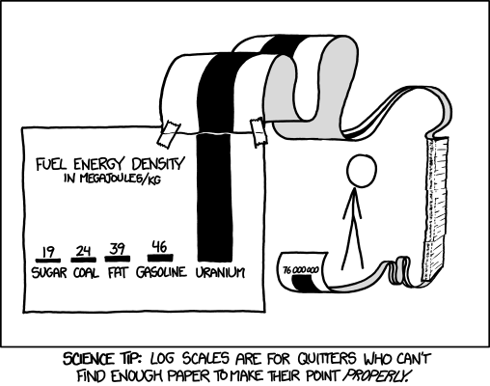

Slide 16
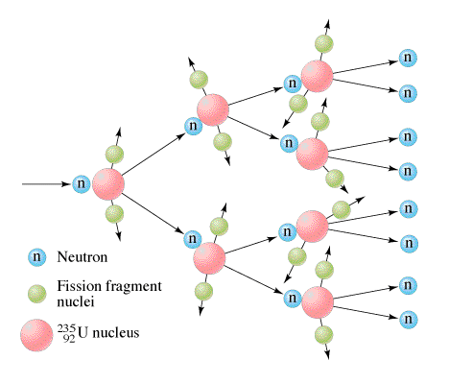
Hahn and Strassmann’s discovery
Scientists begin to realize that a chain reaction could lead to a very powerful explosion
Demo - critical mass…

Slide 17
Einstein’s Letter to Roosevelt
In Summer 1939, US has no atomic energy program
Hitler has halted sales of Czech Uranium
Hitler classifies all nuclear research
Hungarian Physicist Leo Szilard (and many others) worried
Cannot convince Fermi
Turns to Einstein
Einstein returns from vacation, and writes a letter to Roosevelt

Slide 18
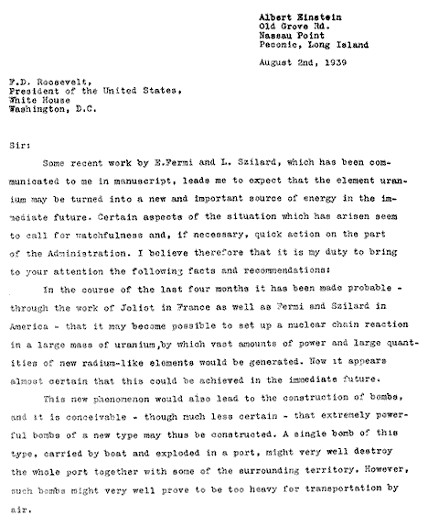
Einstein is a pacifist
Einstein fears Hitler

Slide 19
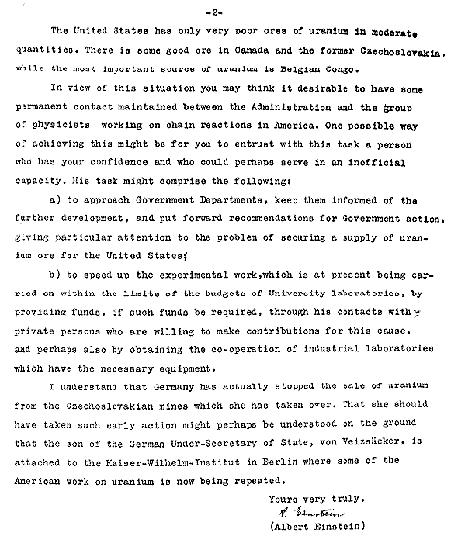
US starts 1 day before Pearl Harbor bombing. (2 ¹/₂ years later)

Slide 20
The Manhattan Project
Started in 1942 in Los Alamos NM
Unprecedented rush to make a bomb
Basic concept - Combining two sub critical masses:
Explosive
Tube
Uranium 235
Separating U 235 from 238 by gaseous diffusion at Oak Ridge
Feynman and the chemical engineer

Slide 21
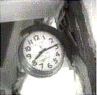
Hiroshima and Nagasaki
Near the end of WWII, the US had been bombing nearly every major city in Japan. For some reason, Hiroshima and Nagasaki had been spared. They had become refugee centers for those displaced by bombing elsewhere.
At 8:15, August 6, 1945 The U.S. detonated a Uranium Fission bomb 1,900 feet above the city of Hiroshima.
TOC

Slide 22
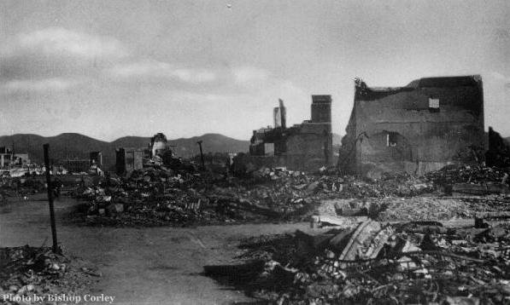
The devastation was nearly complete

Slide 23
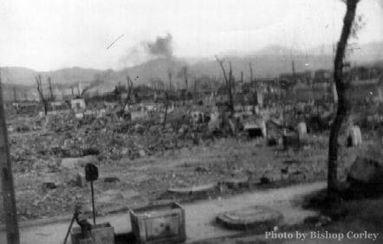
About 100,000 people died immediately..

Slide 24
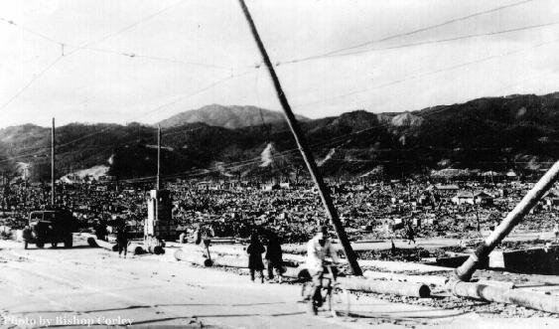
45,000 more died later from the radiation

Slide 25
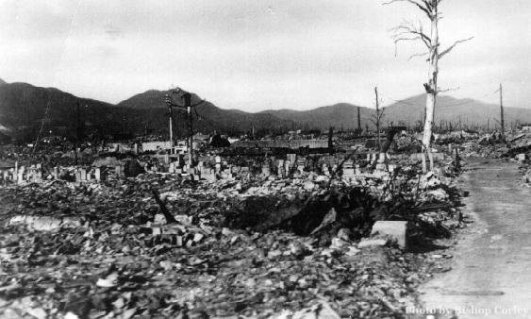
People were killed, and all the people who knew them as well

Slide 26
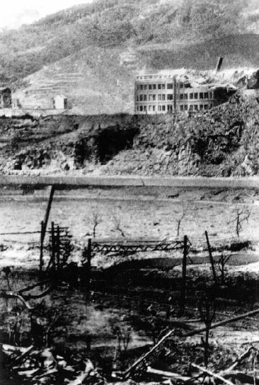
3 days later, we dropped another bomb on the city of Nagasaki, killing 74,000 people,

Slide 27
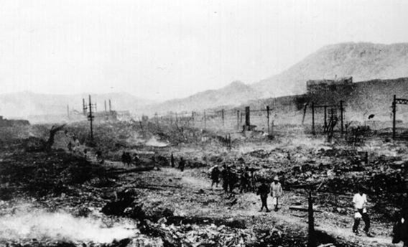
This bomb was a plutonium bomb

Slide 28
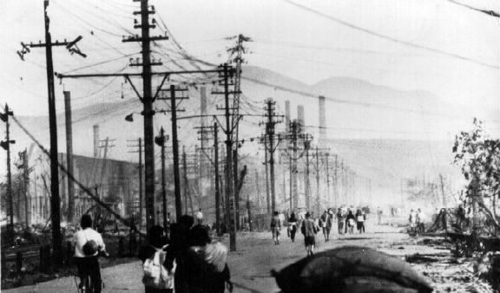
Nagasaki’s rugged topography protected larger parts of the city from the direct blast.

Slide 29
In total, the nuclear bombs the US dropped on Japan killed more than 350,000 people, the vast majority of them non-combatants
Emperor Hirohito surrendered on September 2
Hindsight vs. foresight…

Slide 30
Nuclear Fusion - joining of Nuclei
Fusion powers the sun:
Energy comes primarily from the Proton-Proton cycle:
¹H + ¹H = ²H + e⁺ + ν
¹H + ²H = ³He + γ
³He + ³He = ⁴He + ¹H + ¹H
(requires heat and pressure)

Slide 31
Nuclear Fusion - joining of Nuclei
Helium can also fuse:
⁴He + ⁴He = ⁸Be + γ
⁴He + ⁸Be = ¹²C + γ
Carbon can fuse as well:
¹²C + ¹²C = ²⁴Mg + γ
¹⁶O + ¹⁶O = ²⁸Si + ⁴He
Fusion can keep happening until you reach the mass of Iron or Nickel (In super giant stars)

Slide 32
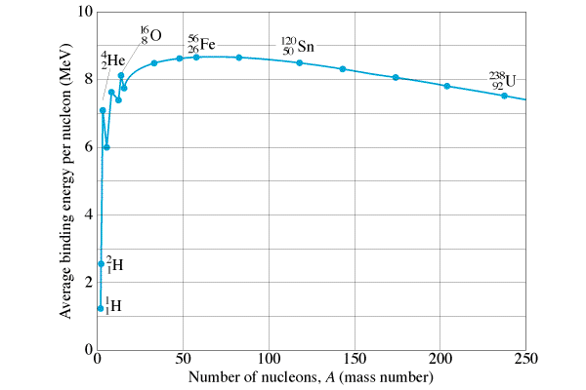
The curve of binding energy
Binding energy per nucleon
Going to more tightly bound releases energy
A U235 bomb is technically difficult
A Pu bomb is easy - not efficient?
Most tightly bound
Fission releases energy
Fusion releases energy

Slide 33
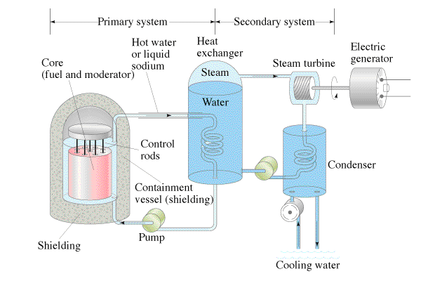
Nuclear power
Closed loop design/moderator
No greenhouse gases emitted/High Energy density
What do you do with the waste?

Slide 34
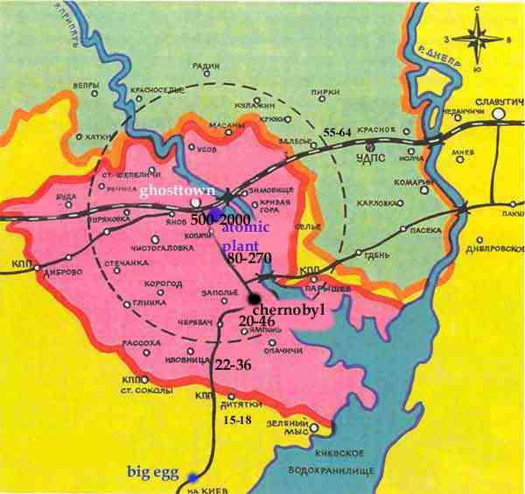
Cherynobl
Kid of Speed
http://www.kiddofspeed.com/

