Slide 1
α
Alpha Decay
Contents:
What it is
Energy of radiation from mass defect
Whiteboard
Why and how
Tunneling

Slide 2
Alpha Decay - Energy of alpha particle
1 u = 931.5 MeV
He (neutral atom) = 4.002602 u
Calculating mass defect of alpha decay 92-U-232 --> 90-Th-228 + Alpha
232.037131 --> 228.028716 + 4.002602
(Appendix F, for Alpha = He 4)
(#electrons?)
232.037131 --> 232.031318 (products have less mass)
Mass defect = parent - products = 232.037131 - 232.031318
= 0.005813 u
E_{k} = (0.005813 u)(931.5 MeV/u) = 5.415 MeV
(Less - daughter E_{k})

Slide 3
Whiteboards:
Alpha Energy
1 | 2

Slide 4
²⁴⁷₉₇Bk --> ²⁴³₉₅Am + α
247.07030 --> 243.061373 + 4.002602
What is energy of alpha? (in MeV and J)
Parent mass = 247.07030 u
Product mass = 243.061373 u + 4.002602 u = 247.063975 u
Mass defect = parent - products = 0.006325 u
Energy of radiation = (.006325 u)(931.5 MeV/u) = 5.892 MeV
= (5.892 x10⁶ eV)(1.602 x 10⁻¹⁹ J/eV) = 9.439 x 10⁻¹³ J
5.892 MeV, 9.439 x 10⁻¹³ J

Slide 5
²⁴³₉₅Am --> ²³⁹₉₃Np + α
243.061373 -->239.052932 + 4.002602
(It’s a decay series!!!)
What is energy of alpha? (in MeV and J)
What is the velocity of the alpha? (Assume? that the alpha gets all the kinetic energy)
m_{α} = 6.64x10⁻²⁷ kg
Parent mass = 243.061373 u
Product mass = 239.052932 u + 4.002602 u = 243.055534 u
Mass defect = parent - products = 0.005839 u
Energy of radiation = (0.005839 u)(931.5 MeV/u) = 5.439 MeV
= (5.439 x10⁶ eV)(1.602 x 10⁻¹⁹ J/eV) = 8.713 x 10⁻¹³ J
E_{k} = ¹/₂mv², m = 6.64 x 10⁻²⁷ kg, E_{k} = 8.713 x 10⁻¹³ J
v = 1.62 x 10⁷ m/s
5.439 MeV, 8.713 x 10⁻¹³ J, 1.62 x 10⁷ m/s

Slide 6
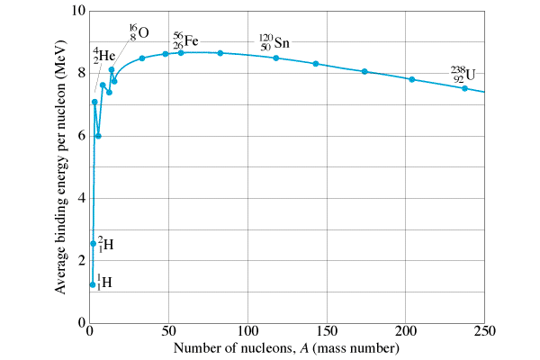
Why Alpha Decay
Only possible if mass products < parent
Tendency to reduce potential energy
Larger nuclei – reduces mass
He nucleus is rather tightly bound
He Nucleus

Slide 7
Tunneling - Energy is not conserved!
E_{k} of alpha - observed
Shape of curve
Capture of Alpha:
Repulsion - Coulombic
Attraction - Strong Nuc.
E_{k(Alpha)} < E_{k(Capture)}
Alpha shouldn’t escape (energy)
ΔEΔt > ^{h}/_{2π}
Violates COE (briefly)
“Tunneling”
Pure quantum randomness

