Slide 1
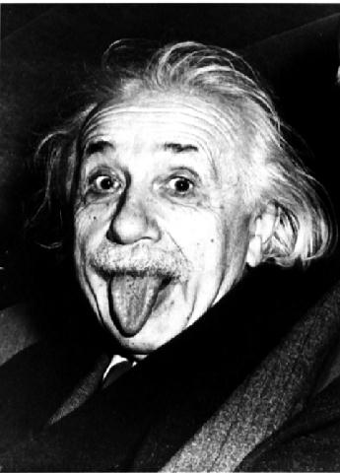
Simultaneity
Contents:
Boxcar example
Car and tunnel

Slide 2
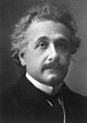
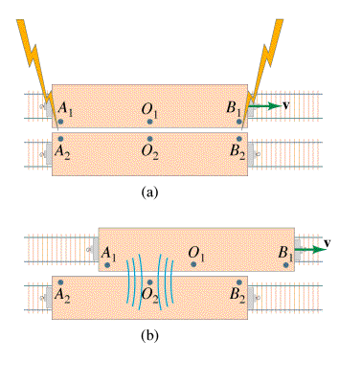
Simultaneity
We can measure speed of light, and time of arrival
Observer 2 sees pulses at same time
Observer 1 sees the light from B first, then A
Simultaneity is relative…

Slide 3
tunnel
v
The car at rest is 14 feet long, but it is moving fast enough so that it fits exactly inside the 10. foot long tunnel.
a) What it its speed.
b) What does the driver see? What do we see?
(simultaneity)

Slide 4
tunnel
v
we see:
(size of car, size of tunnel, simultaneity, tyres)

Slide 5
tunnel
v
driver sees:
(how long is the car, how long is the tunnel, simultaneity, tyres)

