Slide 1
Expanding Space

Slide 2
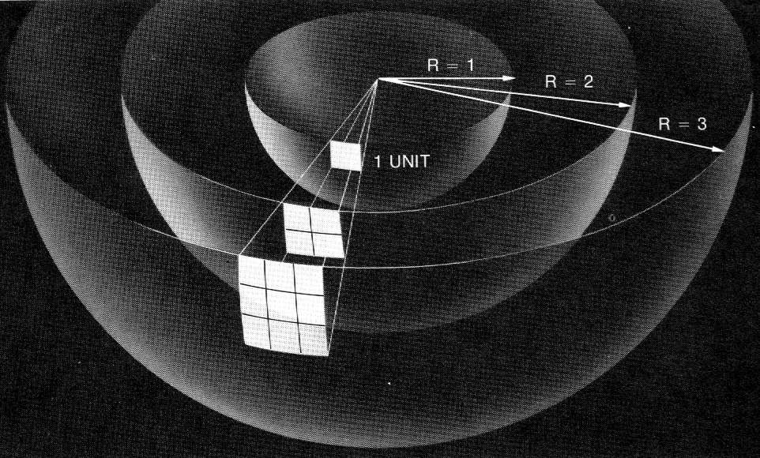
Olber’s Paradox:
In an infinite Newtonian Universe…
Size
Age
Successive shells of stars –
# of stars increases R²
Intensity decreases 1/R²
Shells are same brightness
Adding all shells to infinity sky is infinitely bright
It would be pretty hot too…

Slide 3
Setting the stage:
General relativity predicts that the Universe must be either expanding or contracting.
Einstein thinks it should be static.
Introduces the cosmological constant to keep it static.
Friedmann determines that it still must be dynamic.
Einstein realizes that he is right, and calls the cosmological constant “The greatest mistake of my life”

Slide 4
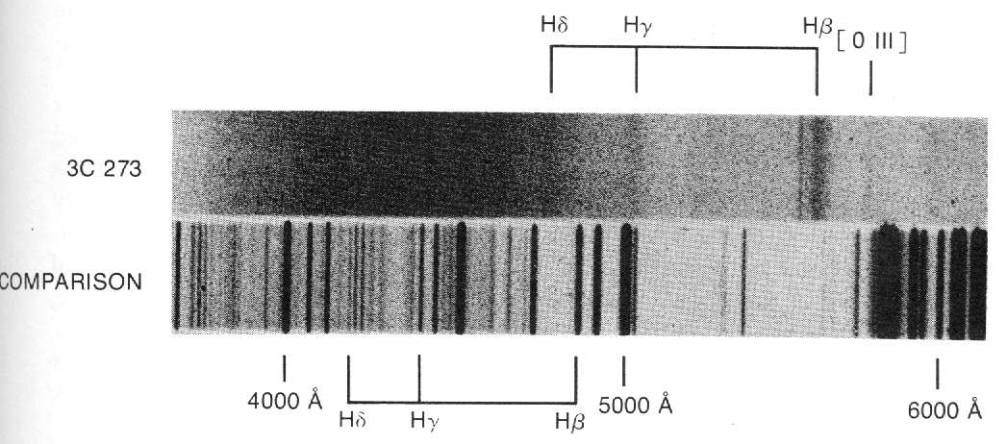
Meanwhile:
Vesto Slipher at the Lowell Observatory in Flagstaff Arizona measures the red shift of spiral “Nebulae”
The redshift is the Doppler effect
36 of 40 spiral nebulae are red shifted

Slide 5
Redshift:
If v << c:
Δλ ≈ v
λ c
Δλ - Change in wavelength
λ - original wavelength
v - recession velocity
c - speed of light

Slide 6
Put this in your notes: What is the change in wavelength of the 656 nm line of a galaxy receding at 20,000 km/s? What is the new wavelength?
20000E3/3E8*656 = 43.7333 nm
656 + 43.7333 = 699.733 nm
44 nm, 700 nm
Notes:
20000E3/3E8*656 = 43.7333 nm
656 + 43.7333 = 699.733

Slide 7
What is the recession rate of a galaxy whose 656 nm line comes in at 691 nm?
(691-656)/656*3E5 = 16,000 km/s
16,000 km/s
Notes:
(691-656)/656*3E5 = 16,000 km/s

Slide 8
Meanwhile:
Edwin Hubble uses the 100 inch telescope on Mt Wilson to look at “spiral nebulae”.
He can pick out individual stars
He finds Cepheids (i.e. the galaxies are made of stars!!! – Lowell “There are no Cepheid there”)
He calculates the distance to and recession velocity of many galaxies.
There is a relationship:

Slide 9
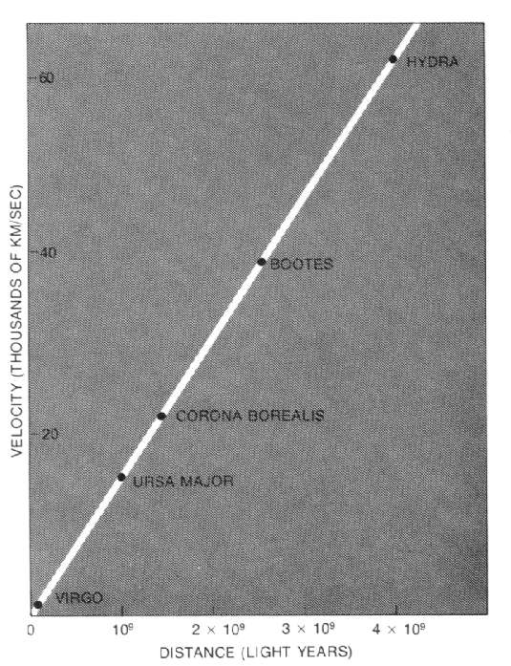
Hubble’s Law:
v = Hd
v = recession velocity in km/s
d = distance in Mpc
H = 71 ^{km/s}/_{Mpc} (± 2.5)
Mpc = Mega parsecs
The greater the distance, the greater the recession velocity.
Notes:
Hubble's law is the name for the astronomical observation in physical cosmology first made by American astronomer Edwin Hubble, that: (1) all objects observed in deep space (interstellar space) are found to have a doppler shift observable relative velocity to Earth, and to each other; and (2) that this doppler-shift measured velocity, of various galaxies receding from the Earth is proportional to their distance from the Earth and all other interstellar bodies. In effect, the space-time volume of the observable universe is expanding (from a smaller past to a larger future); and Hubble's law is the direct physical observation of this process, as it unfolds.[1] The law was first derived from the General Relativity equations byGeorges Lemaître in 1927.[2] Edwin Hubble derived it empirically in 1929[3] after nearly a decade of observations. The recession velocity of the objects was inferred from their redshifts, many measured earlier by Vesto Slipher (1917) and related to velocity by him.[4] It is considered the first observational basis for the expanding space paradigm and today serves as one of the pieces of evidence most often cited in support of theBig Bang model.
The law is often expressed by the equation v = H0D, with H0 the constant of proportionality (the Hubble constant) between the "proper distance" D to a galaxy (which can change over time, unlike the comoving distance) and its velocity v (i.e. the derivative of proper distance with respect to cosmological time coordinate; see Comoving distance#Uses of the proper distance for some discussion of the subtleties of this definition of 'velocity'). The SI unit of H0 is s−1 but it is most frequently quoted in (km/s)/Mpc, thus giving the speed in km/s of a galaxy one megaparsec away. The reciprocal of H0 is the Hubble time.
A recent 2011 estimate of the Hubble constant, which used a new infrared camera on the Hubble Space Telescope (HST) to measure the distance and redshift for a collection of astronomical objects, gives a value of H0 = 73.8 ± 2.4 (km/s)/Mpc.[5][6] An observational determination of the Hubble constant obtained in 2010[7] based upon measurements of gravitational lensing by using the HST yielded a value ofH0 = 72.6 ± 3.1 (km/s)/Mpc. WMAP seven-year results, also from 2010, gave an estimate of H0 = 71.0 ± 2.5 (km/s)/Mpc based on WMAP data alone, and an estimate of H0 = 70.4 +1.3 −1.4 (km/s)/Mpc based on WMAP data with Gaussian priors based on earlier estimates from other studies.[8] In 2009 also using the Hubble Space Telescope the measure was 74.2 ± 3.6 (km/s)/Mpc.[9] The results agree closely with an earlier measurement, based on observations by the HST of Cepheid variable stars, of H0 = 72 ± 8 km/s/Mpc obtained in 2001.[10] In August 2006, a less-precise figure was obtained independently using data from NASA's Chandra X-ray Observatory: H0 = 77 (km/s)/Mpc or about 2.5×10−18 s−1with an uncertainty of ± 15%.[11] NASA's WMAP site summarizes existing data to indicate a constant of 70.8 ± 1.6 (km/s)/Mpc if space is assumed to be flat, or 70.8 ± 4.0 (km/s)/Mpc otherwise,[12] although these estimates have been on the site since January 2007[13] and may not

Slide 10
Put this in your notes: What is the distance to a galaxy that has a 480 nm line that comes in at 497 nm?
(Use H = 71 ^{km/s}/_{Mpc} )
(497-480)/480*3E5 = 10625 km/s
10625 km/s /(71 ^{km/s}/_{Mpc}) = 149.6 Mpc
150 Mpc
Notes:
(497-480)/480*3E5/71 = 149.6 Mpc

Slide 11
What is the recession rate of a galaxy that is 26 Mpc away?
(Use H = 71 ^{km/s}/_{Mpc} )
26 Mpc*(71 ^{km/s}/_{Mpc}) = 1846 km/s
1800 km/s
Notes:
1300 km/s

Slide 12
What is the distance to a point where the recession velocity is half the speed of light? (c = 3E5 km/s)
(Use H = 71 ^{km/s}/_{Mpc} )
1.5E5km/s/(71 ^{km/s}/_{Mpc}) = 2112 Mpc
2100 Mpc
Notes:
3E5/50 = 6000 Mpc

Slide 13
So what does it mean that every galaxy is moving away from us?
The universe is expanding
(demo - rubber band)
Is our position in the universe unique?
Notes:
(497-480)/480*3E5/50 = 212.5 Mpc

Slide 14
Put this in your notes: Estimate the age of the universe from the a Hubble constant of 71 km/s/MPc
(1 ly = 9.46x10¹² km, 1 parsec = 3.26 ly)
T ≈ 1/H
13.8 GY

Slide 15
An expanding universe:
Before
After

Slide 16
An expanding universe:

Slide 17
An expanding universe:

Slide 18
An expanding universe:

Slide 19
An expanding universe:

