Slide 1
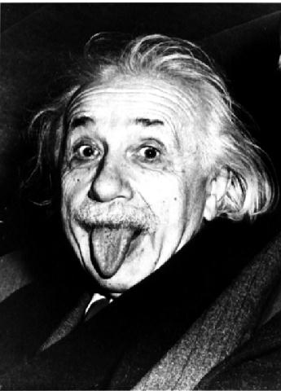
Relative velocity
Contents:
Relative velocity equation

Slide 2
Relative velocity
Contents:
Relative velocity equation

Slide 3
Relative velocity
Contents:
Relative velocity equation

Slide 4
Relative velocity
Contents:
Relative velocity equation

Slide 5
Relative velocity
Contents:
Relative velocity equation

Slide 6
Relative velocity
Contents:
Relative velocity equation

Slide 7
Relative velocity
Contents:
Relative velocity equation

Slide 8
Relative velocity
Contents:
Relative velocity equation

Slide 9
Relative velocity
Contents:
Relative velocity equation

Slide 10
Relative velocity
Contents:
Relative velocity equation

Slide 11
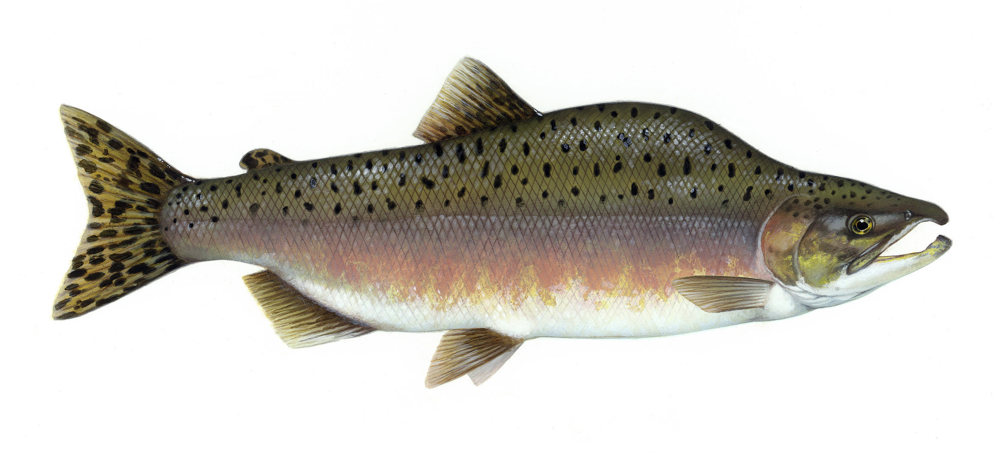
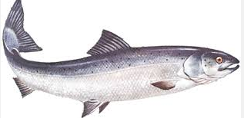
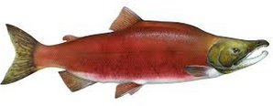
Relative velocity
Contents:
Relative velocity equation

Slide 12
v = 60 mph
us (We see u_{x})
u’_{x} = 30 mph
Example – Tom is on a flatbed car going 60 mph to the east. He throws a javelin at 30 mph forward (relative to him, in the direction he is going) How fast is the javelin going with respect to us? (This is a Galilean transform)

Slide 13
Relative Velocity
30 mph
u’_{x} = ?
75 mph
Example – Mary is on a flatbed car going 30 mph toward us, and when she throws a baseball at us, we measure it going 75 mph With what speed did Mary throw it in her frame of reference?
TOC

Slide 14
0.85 c
us
0.56 c
Example – Tom is on a flatbed car going 0.85 c to the east. He throws a javelin at 0.56 c forward (relative to him, in the direction he is going) How fast is the javelin going with respect to us? (why Galilean doesn’t work, lay out what is what)
in general – when you want to subtract velocities, use the left, add, right

Slide 15
Use the addition formula
This is about 0.96 c

Slide 16
Relative Velocity
.67c
u’_{x} = ?
.82c
Example – Mary is on a flatbed car going 0.67c toward us, and when she throws a baseball at us, we measure it going 0.82c. With what speed did Mary throw it in her frame of reference?
TOC

Slide 17
Use the subtraction formula
This is about 0.33 c

Slide 18
Whiteboards:
Relative Velocity
1 | 2 | 3 | 4
TOC

Slide 19
Rob the hamster rides to the right on a cart going 0.36 c. He throws a baseball at 0.68 c relative to him in the direction he is going. How fast is the baseball going in the earth frame?
Use addition:
ux = (0.36 + 0.68 c)/(1+(0.36 c)(0.68 c)/c²) = 0.8355 c
W
0.84 c

Slide 20
Rob rides to the right on a cart going 0.36 c. He throws a baseball in the direction he is already going. We observe the baseball going 0.98 c relative to the earth frame. How fast did Rob throw the ball in his frame?
Use addition:
.92 c = (0.36 + v )/(1+(0.36 c)(v)/c²) = 0.8355 c
v = 0.957972806 ≈ 0.96 c
W
0.96 c

Slide 21
Rob rides to the right on a cart going 0.36 c. He throws a baseball at 0.68 c relative to him opposite the direction he is going. How fast is the baseball going in the earth frame?
Use subtraction:
ux = (0.36 - 0.68 c)/(1-(0.36 c)(0.68 c)/c²) = -0.4237 c
W
-0.42 c

Slide 22
Rob rides to the right on a cart going 0.36 c. He shines a torch in the direction he is going. How fast do we see the photons from the torch moving in the earth frame. (See what the formula says)
What if he shines if backwards?
Use addition:
ux = (0.36 + 1 c)/(1+(0.36 c)(1 c)/c²) = 1 c
subtraction also yields this result:
ux = (0.36 1 1 c)/(1-(0.36 c)(1 c)/c²) = -1 c
W
Your Father

