Slide 1
Basics of Magnetism
North pole, South pole, and magnetic field
Magnets and domains
How magnets pick things up
Wires with current
Whiteboard – direction of B field around wire
Loops
Whiteboard – direction of North pole

Slide 2
Demo -
Magnet in dish on overhead
Definition of N and S poles
Compass on overhead
Finding polarity of a magnet
Shocking revelation
THE EARTH’S NORTH POLE IS A MAGNETIC SOUTH POLE!

Slide 3
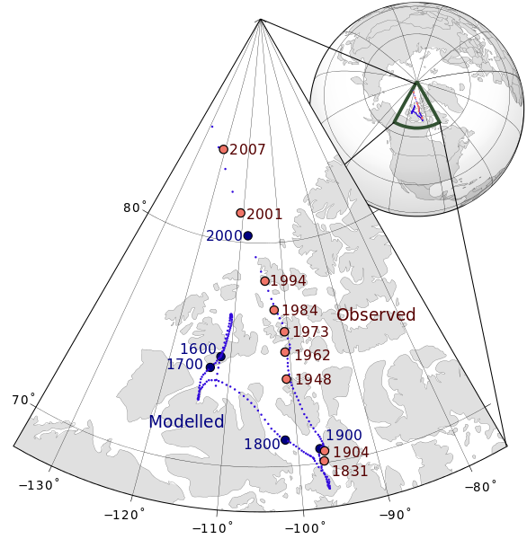
Notes:
Magnetic north pole positions of the Earth. Poles shown are dip poles, defined as positions where the direction of the magnetic field is vertical. Red circles mark magnetic north pole positions as determined by direct observation, blue circles mark positions that have been modelled mathematically.

Slide 4
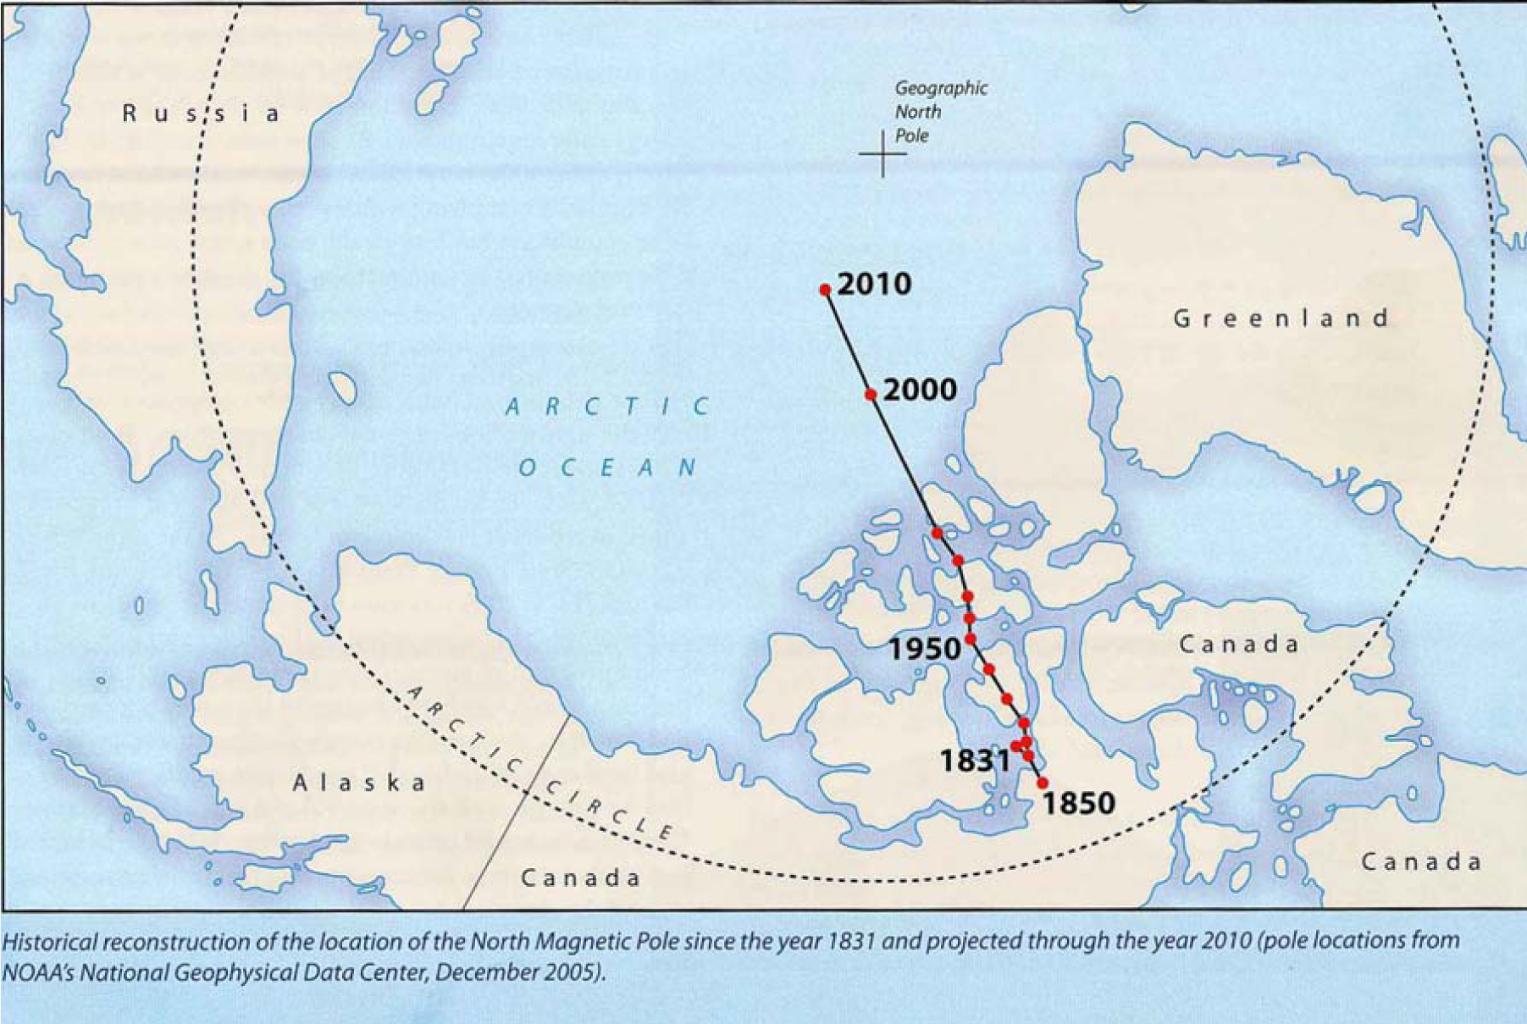
Notes:
http://otbpmaps.com/magnetic-declination/

Slide 5
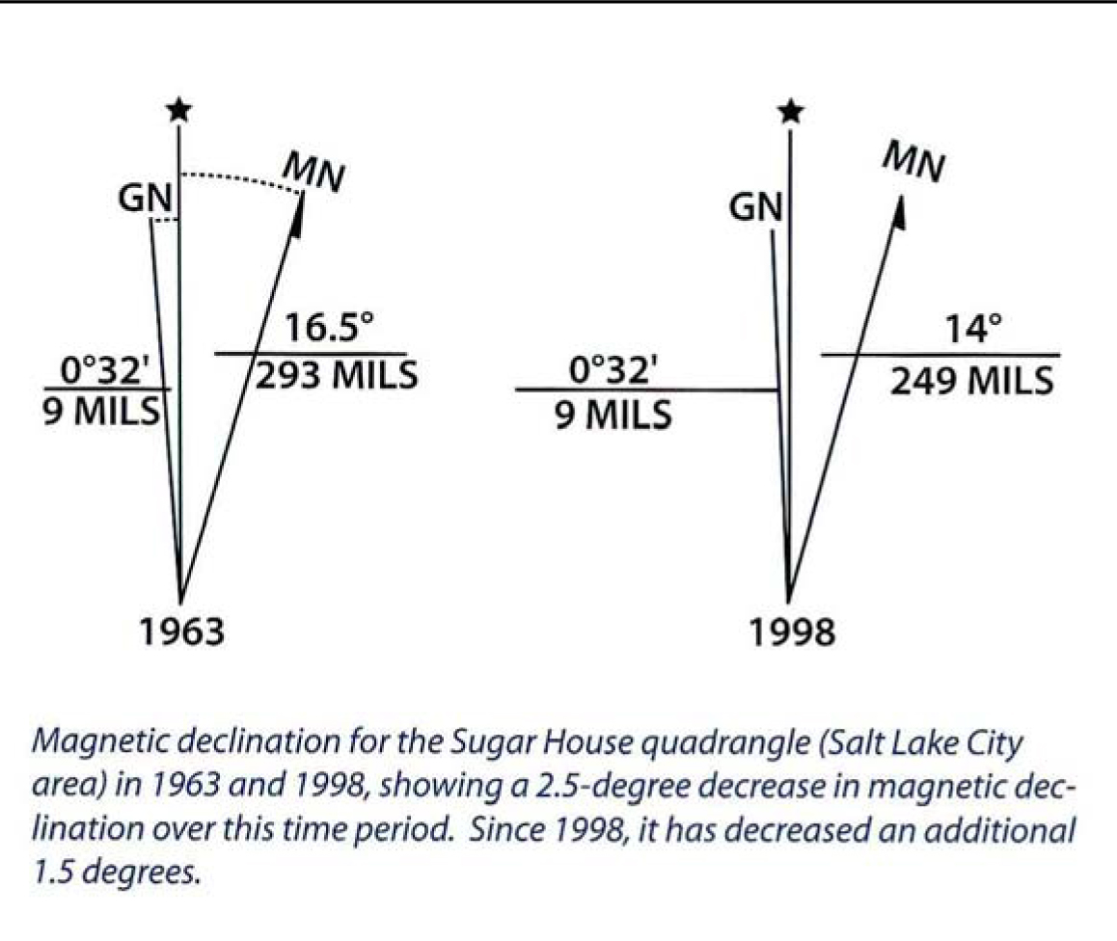
For Salt Lake City, declination is currently decreasing at a rate of about 7 minutes of a degree per year.
At the bottom of most USGS topographic quadrangle maps is a diagram that shows three north arrows -- true north, grid north, and magnetic north -- and the angles between them.
True north (The star symbol in the diagram indicates true north).
Magnetic north (MN) shows the direction a magnetic compass would point at the time the map was published.
Grid north (GN) The difference between true north and grid north is an inherent effect of transforming the earth's spherical surface to a plane surface.
Notes:
http://otbpmaps.com/magnetic-declination/
http://www.usgs.gov/faq/categories/10482/3019

Slide 6
There is no magnetic monopole
Demo
Magnet on pivot
Demo - iron filings
B field is N to S

Slide 7
N
How do magnets pick things up?
Induced magnetism
Distance/Force
Demo with compass
Magnet
S
N
Magnet
S
Ferrous material
(No induced)
N
S
Induced

Slide 8
Remember electric field
+
+
+
+
+
-
-
-
-
-
Direction of B is from N to S
Demo:
Magnaprobe and fixed magnet
Remember – B Field Lines:
Leave the N pole
Enter the S pole
+ to -

