Slide 1
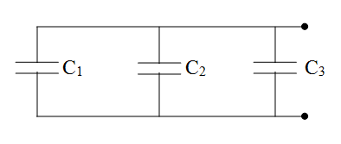
Capacitors in Parallel:

Slide 2
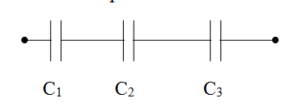
Capacitors in Series:

Slide 3
